Slide 1

Mount Saint Mary’s University “Ecclesia” Program Presents:
Living Word: Scriptures of the 2021 Liturgical Year
Lectionary Readings for the Weekdays of Advent
Fr. Felix Just, S.J., Ph.D.
Living Word Catholic Biblical Ministries
http://catholic-resources.org

Slide 2
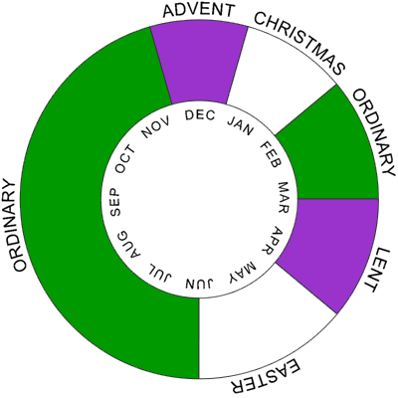
Liturgical Year: Overview

Slide 3

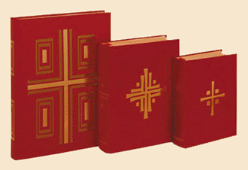
Lectionary Structure: Sundays
Three-Year Cycle:
  Matthew (2020)
  Mark (2021)
  Luke (2022)
Three Main Readings:
  OT Reading
  + Responsorial Psalm
  NT Epistles
  + Gospel Acclamation
  NT Gospel

Slide 4

Lectionary Structure: Weekdays
Two Main Readings:
  First Reading (OT/NT)
  + Responsorial Psalm
  Gospel
Two-Year Cycle:
  Odd Years (vol. 2)
  Even Years (vol. 3)
  Only applies to Ordinary Time
  Same readings each year for Advent, Xmas, Lent, Easter

Slide 5
How the Readings Were Chosen
Weekdays of Advent:
"There are two series of readings: one to be used from the beginning of Advent until 16 December; the other from 17 to 24 December.
In the first part of Advent there are readings from the Book of Isaiah, distributed in accord with the sequence of the book itself and including the more important texts that are also read on the Sundays. For the choice of the weekday Gospel the first reading has been taken into consideration.
On Thursday of the second week the readings from the Gospel concerning John the Baptist begin. The first reading is either a continuation of Isaiah or a text chosen in view of the Gospel.
In the last week before Christmas the events that immediately prepared for the Lord's birth are presented from the Gospel of Matthew (chapter 1) and Luke (chapter 1). The texts in the first reading, chosen in view of the Gospel reading, are from different Old Testament books and include important Messianic prophecies." (Lectionary for Mass, "Introduction," chap. 5, par. 94.)

Slide 6
Advent 2020 Overview: Three Parts
1a) Early Advent: OT Prophecies, esp. from Isaiah
Nine Weekdays (Mon-Wed): Nov. 30 – Dec. 9, 2020
1b) Middle Advent: John (Baptist) the Precursor
Thurs, Dec. 10, to Wed, Dec. 16, 2020
2) Late Advent: Events just before Jesus’ Birth
Thurs-Thurs, Dec. 17 – 24, 2020 (except Sun, Dec. 20)
Note: This division applies both to the Sunday readings and to the Weekday readings.

Slide 7
Early Advent: First Nine Days
Until Wednesday of the 2nd Week of Advent
First Reading: Key Prophecies from Isaiah
  Responsorial Psalm: thematically related
Gospels: How Jesus Fulfills Those Prophecies
  Alleluia Verse: related

Slide 8
Middle Advent: Up to Dec. 16
Weekdays starting 2nd Week Thursday
First Reading: more texts from Isaiah
  Responsorial: still thematically related
Gospel: John the Baptist
  All the Gospel texts about J.B. after Jesus’ baptism,
  except for the death/beheading of J.B.

Slide 9
Late Advent: Dec. 17-24
Final “Octave” before Christmas
  Eight days: always begin Dec. 17, no matter what weekday it is.
  Thus, some weekdays of 3rd Week of Advent may be dropped.
Gospel: Events just before the Lord’s birth
  Matt 1:1-25 – divided into two parts, for Dec. 17 & 18
    Roman Ordo prescribes vv.1-24; but USA Lectionary also includes v.25.
  Luke 1:1-79 – divided into six parts, for Dec. 19-24
    Luke intertwines the stories of the births of John the Baptist and of Jesus
Alleluia Verse: “O Antiphons”
  Slightly different order than “O Come, O Come, Emmanuel” hymn

Slide 10
“Common” Texts for Advent
Lectionary Note (at #173):
“The psalm as a rule is drawn from the Lectionary because the individual psalm texts are directly connected with the individual readings: the choice of psalm depends therefore on the readings. Nevertheless, in order that the people may be able to join in the responsorial psalm more readily, some texts of responses and psalms have been chosen, according to the different seasons of the years and classes of saints, for optional use, whenever the psalm is sung, in place of the text corresponding to the reading (cf. General Instruction of the Roman Missal, n. 36).”
Common Refrain for Advent:
  “Come, O Lord, and set us free.”
Common Psalms for Advent:
  Ps 25:4-5ab, 8-9, 10+14 – “To you, O Lord, I lift my soul.” (v. 1)
  Ps 85:9ab+10, 11-12, 13-14 – “Lord, show us your mercy and love.” (v. 8a)

Slide 11
Common Alleluia Verses, up to Dec. 16 (#192)
“Come and save us, LORD our God; let your face shine upon us that we may be saved.”
(See Ps 80:4)
“Show us, LORD, your love, and grant us your salvation.” (Ps 85:8)
“The LORD is our Judge, our Lawgiver, our King; he it is who will save us.” (Isa 33:22)
“Raise your voice and tell the good news: Behold, the Lord GOD comes with power.”
(See Isa 40:9cb+10a)
“Let the clouds rain down the Just One, and the earth bring forth a Savior.” (See Isa 45:8)
“Seek the LORD while he may be found; call him while he is near.” (Isa 55:6)
“Prepare the way of the Lord, make straight his paths: All flesh shall see the salvation of God.” (Luke 3:4cd+6)
“The Lord will come; go out to meet him! He is the prince of peace.”
“Behold, our Lord shall come with power; he will enlighten the eyes of his servants.”
“Behold, the Lord comes to save his people; blessed are those prepared to meet him.”
“Behold, the King will come, the Lord of earth: and he will take away the yoke of our captivity.”
“The day of the Lord is near: Behold, he comes to save us.”
“Come, O Lord, do not delay: forgive the sins of your people.”
“Come, Lord, bring us your peace; that we may rejoice before you with a perfect heart.”

Slide 12
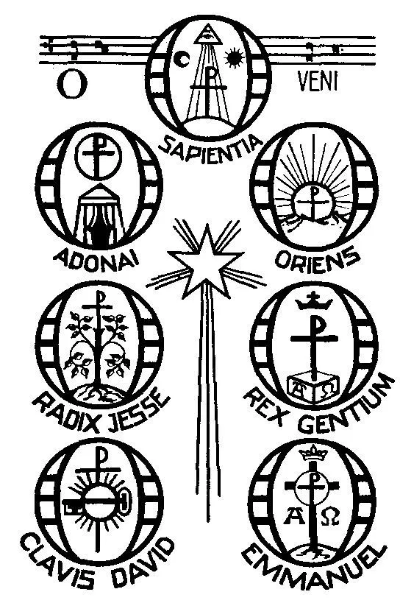
Common Alleluia Verses, Dec. 17-24 (#201)
“O Wisdom of our God Most High, guiding creation with power and love:
come to teach us the path of knowledge!”
“O Leader of the House of Israel, giver of the Law to Moses on Sinai:
come to rescue us with your mighty power!”
“O Root of Jesse’s stem, sign of God's love for all his people:
come to save us without delay!”
“O Key of David, opening the gates of God's eternal Kingdom:
come and free the prisoners of darkness!”
“O Radiant Dawn, splendor of eternal light, sun of justice:
come and shine on those who dwell in darkness
and in the shadow of death!”
“O King of all nations and keystone of the Church:
come and save man, whom you formed from the dust!”
“O Emmanuel, our King, and Giver of Law:
come to save us, Lord our God!”
See https://catholic-resources.org/Lectionary/Advent-O-Antiphons.htm

Slide 13

1st Week of Advent – Monday
1st Reading: Isa 2:1-5 (Years B & C)
  "The Lord will gather all nations into the eternal peace of the Kingdom of God."
1st Reading: Isa 4:2-6 (Year A, when Isa 2:1-5 is used on Sunday)
  "There will be splendor for the survivors."
Responsorial: Ps 122:1-2, 3-4b, 4cd-5, 6-7, 8-9
  “Let us go rejoicing to the house of the Lord.”
Gospel: Matt 8:5-11
  "Many will come from the east and the west into the Kingdom of heaven."
  (Jesus heals a centurion’s servant, and marvels at his faith.)

Slide 14
1st Week of Advent – Tuesday
1st Reading: Isa 11:1-10
  "The Spirit of the Lord God shall rest upon him."
  Also read on 2nd Sunday, Year A
Responsorial: Ps 72:1-2, 7-8, 12-13, 17
  “Justice shall flourish in his time, and fullness of peace forever.”
Gospel: Luke 10:21-24
  "Jesus rejoices in the Holy Spirit."
  (A short prayer of Jesus to the Father, and a Blessing for his disciples.)

Slide 15
1st Week of Advent – Wednesday
1st Reading: Isa 25:6-10a
  "The Lord invites us to his feast and will wipe away the tears from all faces."
Responsorial: Ps 23:1-3a, 3b-4, 5, 6
  “I shall live in the house of the Lord all the days of my life.”
Gospel: Matt 15:29-37
  "Jesus heals many and multiplies the bread."
  (An Evangelist’s summary, and the Feeding of the 4000.)

Slide 16
1st Week of Advent – Thursday
1st Reading: Isa 26:1-6
  "Let in a nation that is just, one that keeps faith."
Responsorial: Ps 118:1+8-9, 19-21, 25-27a
  “Blessed is he who comes in the name of the Lord.”
Gospel: Matt 7:21, 24-27
  "Whoever does the will of my Father
  will enter the Kingdom of heaven."
  (Conclusion of Sermon on Mount: Parable of building on rock or sand.)

Slide 17
1st Week of Advent – Friday
1st Reading: Isa 29:17-24
  "On that day, the eyes of the blind shall see."
Responsorial: Ps 27:1, 4, 13-14
  “The Lord is my light and my salvation.”
Gospel: Matt 9:27-31
  "Believing in Jesus, two who were blind are cured."
  (First of two stories in Matthew of Jesus giving sight to two blind men.)

Slide 18
1st Week of Advent – Saturday
1st Reading: Isa 30:19-21, 23-26
  "The Merciful One will show you mercy when you cry out."
Responsorial: Ps 147:1-2, 3-4, 5-6
  “Blessed are all who wait for the Lord.”
Gospel: Matt 9:35—10:1, 5a, 6-8
  "At the sight of the crowds,
  Jesus' heart was moved with pity for them."
  (Jesus heals many; harvest/laborers saying; then commissions his disciples.)

Slide 19

2nd Week of Advent – Monday
1st Reading: Isa 35:1-10
  "God himself will come and save you."
  Also read on 3rd Sunday, Year A
Responsorial: Ps 85:9ab+10, 11-12, 13-14
  “Our God will come to save us!”
Gospel: Luke 5:17-26
  "We have seen incredible things today."
  (Healing of a paralytic & discussion of forgiving sins.)

Slide 20
2nd Week of Advent – Tuesday
1st Reading: Isa 40:1-11
  "God consoles his people."
  Also read on 2nd Sunday, Year B
Responsorial: Ps 96:1-2, 3+10ac, 11-12, 13
  “The Lord our God comes with power.”
Gospel: Matt 18:12-14
  "God does not will that the little ones be lost."
  (Parable of Good Shepherd, with 99+1 sheep)

Slide 21
2nd Week of Advent – Wednesday
1st Reading: Isa 40:25-31
  "The Lord God is almighty and gives strength to the fainting."
Responsorial: Ps 103:1-2, 3-4, 8+10
  “O bless the Lord, my soul!”
Gospel: Matt 11:28-30
  "Come to me, all you who labor."
  (Brief & familiar saying of Jesus.)

Slide 22
2nd Week of Advent – Thursday
1st Reading: Isa 41:13-20
  “I am your redeemer, the Holy One of Israel.”
Responsorial: Ps 145:1+9, 10-11, 12-13ab
  “The Lord is gracious and merciful; slow to anger, and of great kindness.”
Gospel: Matt 11:11-15
  "None greater than John the Baptist has been born."

Slide 23
2nd Week of Advent – Friday
1st Reading: Isa 48:17-19
  “If only you would hearken to my commandments.”
Responsorial: Ps 1:1-2, 3, 4+6
  “Those who follow you, Lord, will have the light of life.”
Gospel: Matt 11:16-19
  "They listened neither to John nor to the Son of Man."

Slide 24
2nd Week of Advent – Saturday
1st Reading: Sir 48:1-4, 9-11
  “Elijah was enveloped in a whirlwind.”
Responsorial: Ps 80:2ac+3b, 15-16, 18-19
  “Lord, make us turn to you; let us see your face and we shall be saved.”
Gospel: Matt 17:9a, 10-13
  "Elijah has already come, and they did not recognize him."

Slide 25

3rd Week of Advent – Monday
Lectionary Note for each weekday this 3rd week:
"If today is December 17 or 18, omit these readings and use those given for the weekdays of Advent, nos. 193 or 194."
1st Reading: Num 24:2-7, 15-17a
  “A star shall advance from Jacob.”
Responsorial: Ps 25:4-5ab, 6+7bc, 8-9
  “Teach me your ways, O Lord.”
Gospel: Matt 21:23-27
  "John's baptism: where did it come from?"

Slide 26
3rd Week of Advent – Tuesday
1st Reading: Zeph 3:1-2, 9-13
  “Messianic salvation is promised to all of the poor.”
Responsorial: Ps 34:2-3, 6-7, 17-18, 19+23
  “The Lord hears the cry of the poor.”
Gospel: Matt 21:28-32
  "John came and sinners believed in him."

Slide 27
3rd Week of Advent – Wednesday
1st Reading: Isa 45:6c-8, 18, 21c-25
  “Let the clouds rain down.”
Responsorial: Ps 85:9ab+10, 11-12, 13-14
  “Let the clouds rain down the Just One, and the earth bring forth a Savior.”
Gospel: Luke 7:18b-23
  "Go back and tell John what you have seen and heard."

Slide 28
3rd Week of Advent – Thursday
1st Reading: Isa 54:1-10
  “Like a forsaken wife, the Lord has called you back.”
Responsorial: Ps 30:2+4, 5-6, 11-12a+13b
  “I will praise you, Lord, for you have rescued me.”
Gospel: Luke 7:24-30
  "John is the messenger who prepares the way of the Lord."

Slide 29
3rd Week of Advent – Friday
1st Reading: Isa 56:1-3a, 6-8
  “My house shall be called a house of prayer for all peoples.”
Responsorial: Ps 67:2-3, 5, 7-8
  “O God, let all the nations praise you!”
Gospel: John 5:33-36
  "John was a burning and shining lamp."

Slide 30
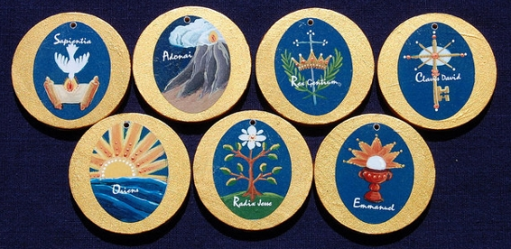
Weekdays of Advent: Dec. 17-24
Lectionary Note at the beginning of this section:
  “The following readings are used from December 17 to 24.
  If a Sunday occurs during this time, the weekday readings for that day are omitted, but they may be anticipated or used later on another day during the week, especially to avoid duplicating the Sunday readings.”
  For exact dates: https://catholic-resources.org/Lectionary/Overview-Advent.htm
Alleluia Verses: Use the “O Antiphons”
  See https://catholic-resources.org/Lectionary/Advent-O-Antiphons.htm

Slide 31
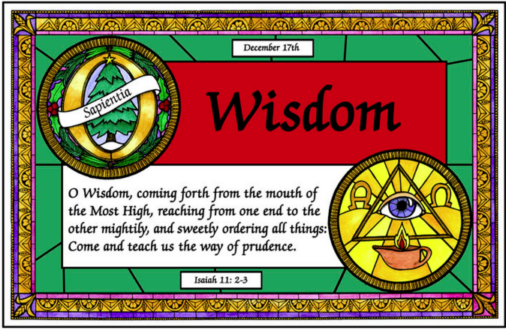
Dec. 17
1st Reading: Gen 49:2, 8-10
  “The scepter shall not depart from Judah.”
Responsorial: Ps 72:1-2, 3-4ab, 7-8, 17
  “Justice shall flourish in his time, and fullness of peace for ever.”
Alleluia:
  “O Wisdom of our God Most High,
  guiding creation with power and love:
  come to teach us the path of knowledge!”
Gospel: Matt 1:1-17
  “The genealogy of Jesus Christ, the Son of David.”

Slide 32
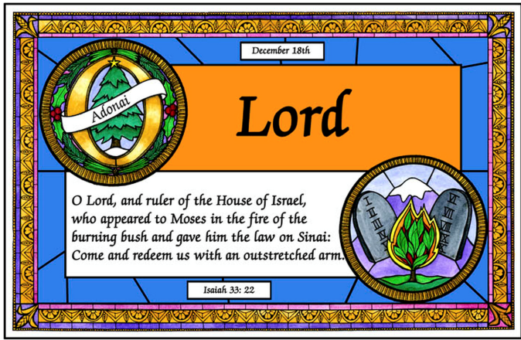
Dec. 18
1st Reading: Jer 23:5-8
  “I will raise up a righteous shoot to David.”
Responsorial: Ps 72:1-2, 12-13, 18-19
  “Justice shall flourish in his time, and fullness of peace for ever.”
Alleluia:
  “O Leader of the House of Israel,
  giver of the Law to Moses on Sinai:
  come to rescue us with your mighty power!”
Gospel: Matt 1:18-25
  “Jesus was born of Mary, the betrothed of Joseph, a son of David.” (Joseph’s dreams about the conception of Jesus.)

Slide 33
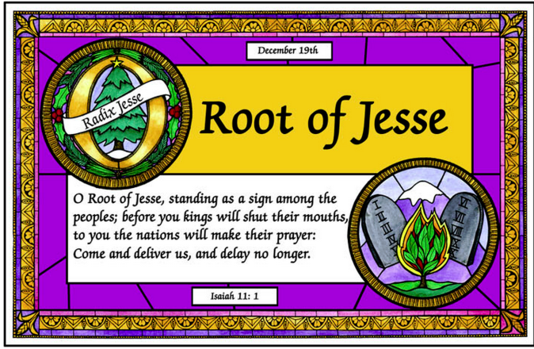
Dec. 19
1st Reading: Judg 13:2-7, 24-25a
  “The birth of Samson is announced by an angel.”
Responsorial: Ps 71:3-4a, 5-6ab, 16-17
  “My mouth shall be filled with your praise, and I will sing your glory!”
Alleluia:
  “O Root of Jesse’s stem,
  sign of God's love for all his people:
  come to save us without delay!
Gospel: Luke 1:5-25
  “The birth of John the Baptist is announced by Gabriel.”
  (Angel Gabriel appears to Zechariah in the Jerusalem Temple.)

Slide 34
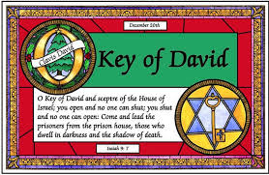
Dec. 20
1st Reading: Isa 7:10-14
  “Behold, the virgin shall be with child.”
  Also read on 4th Sunday, Year A
Responsorial: Ps 24:1-2, 3-4ab, 5-6
  “Let the Lord enter; he is the king of glory.”
Alleluia:
  “O Key of David, opening the gates of God's eternal Kingdom:
  come and free the prisoners of darkness!”
Gospel: Luke 1:26-38
  “You will conceive in your womb and bear a son.”
  (Annunciation: the angel Gabriel visits Mary)

Slide 35
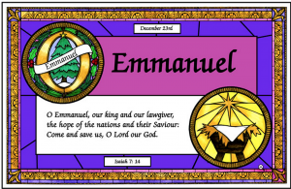
Dec. 21
1st Reading: Cant 2:8-14
  “Hark! my lover comes, springing across the mountains.”
  Or Zeph 3:14-18a - “The King of Israel, the Lord, is in your midst.”
Responsorial: Ps 33:2-3, 11-12, 20-21
  “Exult, you just, in the Lord! Sing to him a new song.”
Alleluia:
  “O Emmanuel, our King and Giver of Law:
  come to save us, Lord our God!”
Gospel: Luke 1:39-45
  “And how does this happen to me, that the mother of my Lord should come to me?” (Visitation: Mary visits Elizabeth, who calls Mary blessed)

Slide 36
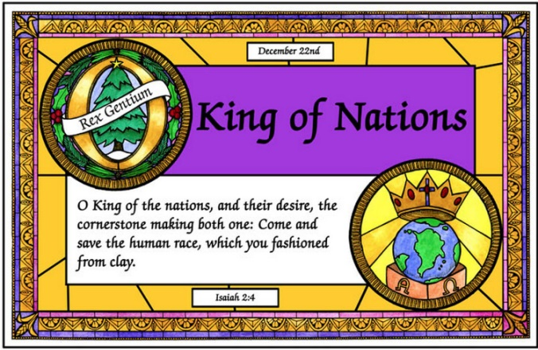
Dec. 22
1st Reading: 1 Sam 1:24-28
  “Hannah gives thanks for the birth of Samuel.”
Responsorial: 1 Sam 2:1, 4-5, 6-7, 8abcd
  “My heart exults in the Lord, my Savior.”
Alleluia:
  “O King of all nations and keystone of the Church:
  come and save man, whom you formed from the dust!”
Gospel: Luke 1:46-56
  “The Mighty One has done great things for me.”
  (Magnificat: Mary's song of praise to God)

Slide 37
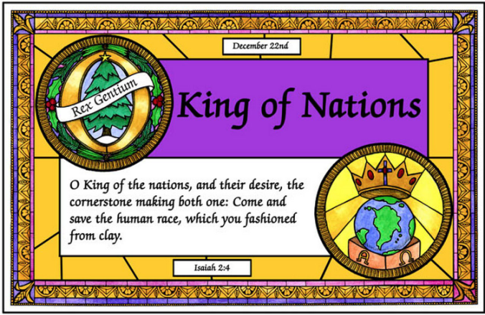
Dec. 23
1st Reading: Mal 3:1-4, 23-24
  “I will send you Elijah, the prophet,
  before the day of the Lord comes.”
Responsorial: Ps 25:4-5ab, 8-9, 10+14
  “Lift up your heads and see; your redemption is near at hand.”
Alleluia:
  “O King of all nations and keystone of the Church:
  come and save man, whom you formed from the dust!”
Gospel: Luke 1:57-66
  “The birth of John the Baptist.”
  (also his circumcision and naming)

Slide 38
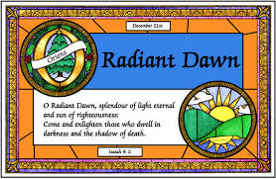
Dec. 24 (morning Mass)
1st Reading: 2 Sam 7:1-5, 8b-12, 14a, 16
  “The Kingdom of David shall endure forever in the sight of the Lord.”
  Also read on 4th Sunday, Year B
Responsorial: Ps 89:2-3, 4-5, 27+29
  “For ever I will sing the goodness of the Lord.”
Alleluia:
  “O Radiant Dawn, splendor of eternal light, sun of justice:
  come and shine on those who dwell in darkness and in the shadow of death!”
Gospel: Luke 1:67-79
  “The daybreak from on high has visited us.”
  (Benedictus: Zechariah's hymn blessing God)

Slide 39
Possible Interruptions
Nov. 30 – St. Andrew, Apostle
Dec. 8 – Immaculate Conception
Dec. 12 – Our Lady of Guadalupe
Notes:
  If these feasts fall on a weekday, then their “Proper” readings are used instead of the readings for the Advent weekday.
  If Nov. 30 or Dec. 12 fall on a Sunday, they are omitted that year.
  If Dec. 8 is a Sunday, then Immaculate Conception is Mon, Dec. 9.
  For “Memorials” or “Optional Memorials” of other saints, the special prayers for those Masses can be used, but the Advent readings should still be used.

Slide 40
Nov. 30 – St. Andrew, Apostle
Lectionary # 684 – Feast with Proper Readings
First Reading: Rom 10:9-18
  “Thus faith comes from what is heard,
  and what is heard come through the word of Christ.”
Responsorial: Ps 19:8, 9, 10, 11
  “The judgments of the Lord are true, and all of them are just.”
Alleluia Verse: Matt 4:19
  “Come after me, says the Lord, and I will make you fishers of men.”
Gospel: Matt 4:18-22
  “Immediately they left their nets and followed him.”

Slide 41
Dec. 8 – Immaculate Conception
Lectionary # 689 - Solemnity with Proper Readings
First Reading: Gen 3:9-15, 20
  “I will put enmity between your offspring and hers.”
Responsorial: Ps 98:1, 2-3ab, 3cd-4
  “Sing to the Lord a new song, for he has done marvelous deeds.”
Second Reading: Eph 1:3-6, 11-12
  “He chose us in Christ before the foundation of the world.”
Alleluia Verse: cf. Luke 1:28
  “Hail, Mary, full of grace, the Lord is with you; blessed are you among women.”
Gospel: Luke 1:26-38
  “Hail, full of grace! The Lord is with you.”

Slide 42
Dec. 12 – Our Lady of Guadalupe
Lectionary # 690A - Feast in USA, with Proper Readings
First Reading: Zech 2:14-17
“Rejoice, O daughter Zion! See, I am coming.”
or Rev 11:19a; 12:1-6a, 10ab
“A great sign appeared in the sky.”
Responsorial: Judith 13:18bcde, 19
  “You are the highest honor of our race.”
Alleluia Verse:
  “Blessed are you, holy Virgin Mary, deserving of all praise;
  from you arose the sun of justice, Christ our God.”
Gospel: Luke 1:26-38
  “Behold, you will conceive in your womb and bear a son.”
or Luke 1:39-47
  “Blessed is she who believed.”

Slide 43
Review: Three Parts of Advent
1a) Early Advent: OT Prophecies, esp. from Isaiah
Nine Weekdays (Mon-Wed): Nov. 30 – Dec. 9, 2020
1b) Middle Advent: John (Baptist) the Precursor
Thurs, Dec. 10– 16, 2020
2) Late Advent: Events just before Jesus’ Birth
Dec. 17 – 24, 2020 (except Sun, Dec. 20)
Note: This division applies both to the Sunday readings and to the Weekday readings.

Slide 44
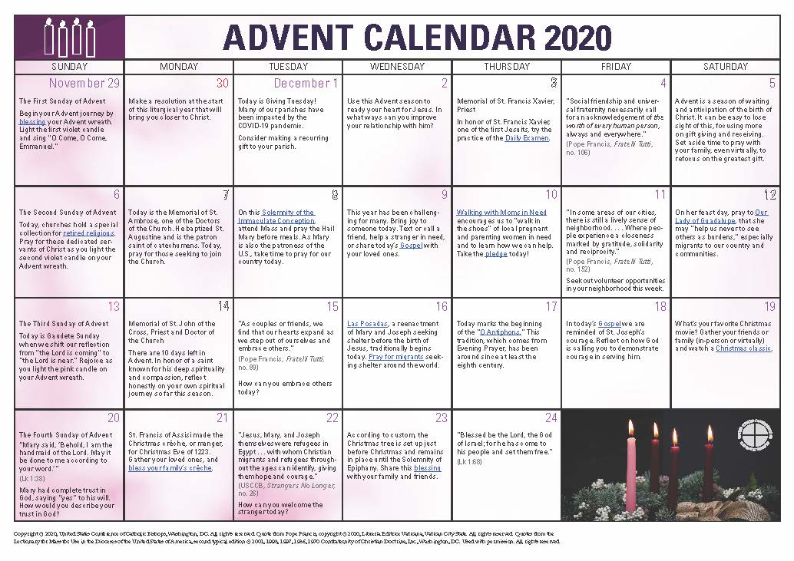
Questions? Observations?
https://www.usccb.org/prayer-and-worship/liturgical-year-and-calendar/advent

Slide 45

Lectionary Readings for Advent
Fr. Felix Just, S.J., Ph.D.
http://catholic-resources.org
THANKS FOR WATCHING !

