Slide 1


Mount Saint Mary’s University “Ecclesia” Program Presents:
Living Word: Scriptures of the 2021 Liturgical Year
Lectionary Readings for the Christmas Season
Fr. Felix Just, S.J., Ph.D.
Living Word Catholic Biblical Ministries
http://catholic-resources.org

Slide 2
Welcome to “Living Word” !
Webinar Series co-sponsored by:
  “Ecclesia” Program of Mount Saint Mary’s University, LA
    Gail Gresser, Director of Campus Ministry
    “Serving those who serve the Church”
  “Living Word Catholic Biblical Ministries,” Los Angeles
    New name for Fr. Felix’s adult faith-formation programs
Welcome to All, especially :
  Prior “Ecclesia” program participants
  Pilgrims from 2011-2019 pilgrimages
  “Catholic Bible Institute of Southern Arizona”
  Several “Catholic Bible Institutes” in California
  Members of EOHSJ, Serra Club, Loyola Institute
  Deacons of the Archdiocese of Los Angeles
  Other NEW folks, here for the first time!

Slide 3
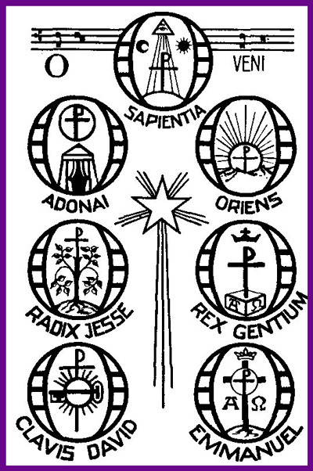
“O” Prayers
O WISDOM, who came forth from the mouth of the Most High,
and who order all things mightily and sweetly.
Come and teach us the way of prudence!
O LORD AND RULER of the House of Israel,
who appeared to Moses in the burning bush
and gave him the law on Sinai:
Come and redeem us with outstretched arms.
O ROOT OF JESSE, before whom kings keep silence
and unto whom the Gentiles shall pray:
Come to deliver us, and tarry not.
O KEY OF DAVID, and Scepter of the House of Israel,
who opens and no one shuts, who shuts and no one opens:
Come and bring forth the captives from prison.
O DAWN OF THE EAST, brightness of light eternal, and Sun of Justice;
Come and enlighten those who sit in darkness and in the shadow of death.
O KING OF THE GENTILES and their desired One,
the Cornerstone that makes all people one:
Come and deliver us, whom you formed out of the dust of the earth.
O EMMANUEL, God with us, Our King and Lawgiver,
the expected of the nations and their Savior:
Come to save us, O Lord our God.

Slide 4
“Living Word” Webinar Series
Zoom Webinars on the Lectionary for Mass
  Saturdays, 9:00 a.m. – 12:30 p.m. (Pacific Time)
  Open to the Public (feel free to invite others)
  FREE (but donations appreciated)
Monthly, from Nov. 2020 to April 2021
  Nov. 21, 2020 – Readings of Advent
  Dec. 19, 2020 – Readings of the Christmas Season
  Jan. 9, 2021 – Gospel of Mark (Liturgical Year B)
  Feb. 13, 2021 – Readings of Lent
  March 27, 2021 – Readings of Holy Week & Triduum
  April 17, 2021 – Readings of the Easter Season

Slide 5

DONATIONS
If you’d like to support MSMU’s Ecclesia program and Living Word Catholic Biblical Ministries, please make a tax-deductible donation, so that we can offer more webinars and other programs to anyone, regardless of their financial circumstances.
  We cannot accept online donations yet, but hope to enable this feature soon.
Please make your check payable to "LMU Jesuit Community."
Then mail your check to:
  Fr. Felix Just, SJ
  LMU Jesuit Community
  PO Box 45041
  Los Angeles, CA 90045

Slide 6
Lectionary Readings
Basic Questions of This Year’s Webinar Series:
WHICH biblical texts are read at Catholic Masses?
  Seasons: Advent; Christmas; Lent; Easter; Ordinary Time
  Sundays/Feasts: 1st Reading, Psalm, 2nd Reading, Alleluia, Gospel
  Weekdays: 1st Reading, Psalm, Alleluia, Gospel
WHY were the assigned readings chosen?
  Brief “Rationale” in Lectionary’s “Introduction” (in printed editions)
    Chap. 2 in 1969 edition; or Chap. 5 in 1981 edition.
    Season by season; first Sundays/Feasts, then Weekdays
For charts, handouts, more info, see my website:
http://catholic-resources.org/Lectionary/
  Also has the full text of the 1981 “Introduction”

Slide 7
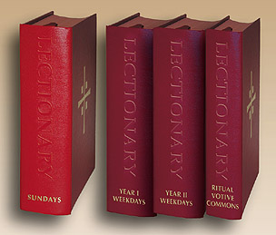
Liturgical Season of CHRISTMAS
Outline of Today’s Webinar:
  Gospel Infancy Narratives: Overview Matt vs. Luke
    + Closer look at readings from Matthew 1-2
  Readings from Luke 1-2 during Christmas Season
    + Readings for other major feasts up to Baptism of the Lord
  Readings from John 1 and 1 John during Christmas
    + Other readings for Christmas Weekdays
  Ten minute breaks after each part
Lectionary for Mass Website:
  http://catholic-resources.org/Lectionary

Slide 8
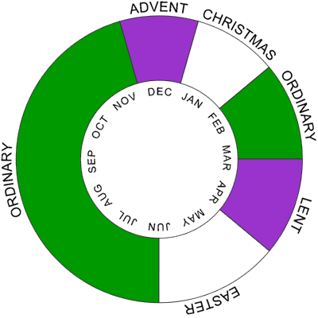
The Liturgical Year

Slide 9
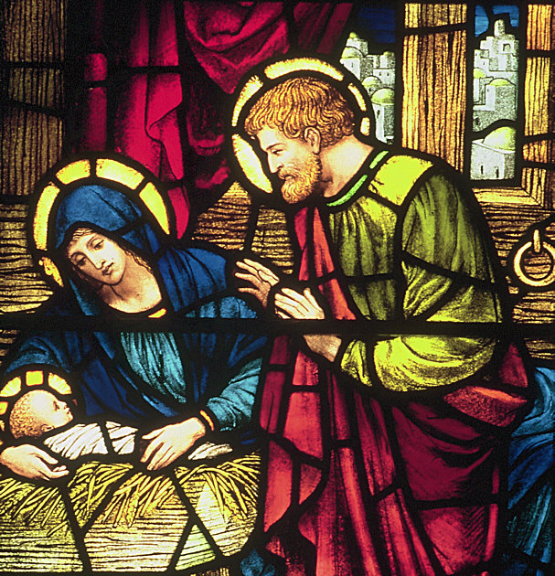
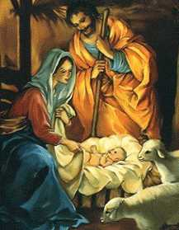
CHRISTMAS:
The Nativity of the Lord

Slide 10
Advent, CHRISTMAS, Epiphany
Advent – Season of preparation & waiting
  begins 4 Sundays before Christmas (rarely 4 full weeks)
CHRISTMAS – Birth/Nativity of Jesus
  Christmas Eve & Day – Dec. 24/25
    Four Masses: Vigil, Midnight, Dawn, Day
  Special Feasts during Christmas Season:
    St. Stephen, St. John Evangelist, Holy Innocents, etc.
  Christmas Octave, Jan. 1: Mary / Naming Jesus / World Peace
Epiphany – Coming of the Magi
  Sunday, Jan. 2 to 8 (traditionally Jan. 6)
Baptism of the Lord – Christmas Season ends

Slide 11
Christmas Season – Lect. Intro
"For the vigil and the three Masses of Christmas both the prophetic readings and the others have been chosen from the Roman tradition.
The Gospel on the Sunday within the Octave of Christmas, Feast of the Holy Family, is about Jesus' childhood and the other readings are about the virtues of family life.
On the Octave Day of Christmas, Solemnity of the Blessed Virgin Mary, the Mother of God, the readings are about the Virgin Mother of God and the giving of the holy Name of Jesus."

Slide 12
Christmas Season – Lect. Intro
"On the second Sunday after Christmas,
the readings are about the mystery of the Incarnation.
[N/A in USA, since Epiphany was moved to Sunday.]
On the Epiphany of the Lord, the Old Testament reading
and the Gospel continue the Roman tradition;
the text for the reading from the Letters of the Apostles
is about the calling of the nations to salvation.
On the Feast of the Baptism of the Lord,
the texts chosen are about this mystery."
(Lectionary for Mass, "Introduction," ch. 5, par. 95)

Slide 13
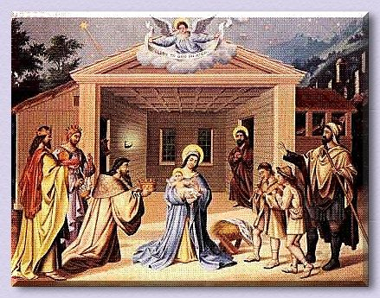
The Infancy Narratives in Matthew & Luke

Slide 14
Lectionary: Last Week of Advent
Matt 1 & Luke 1
Dec. 17 | MATT 1:1-17 | Genealogy of Jesus
Dec. 18 | Matt 1:18-24* | Dreams of Joseph
Dec. 19 | LUKE 1:5-25 | Gabriel & Zechariah
Dec. 20 | Luke 1:26-38 | Annunciation: Gabriel & Mary
Dec. 21 | Luke 1:39-45 | Visitation: Mary & Elizabeth
Dec. 22 | Luke 1:46-56 | Magnificat: Canticle of Mary
Dec. 23 | Luke 1:57-66 | Birth of John (the Baptist)
Dec. 24 | Luke 1:67-79 | Benedictus: Canticle of Zechariah
*Note: The USA Lectionary also prints v. 25, in which Jesus is born and named!

Slide 15
Lectionary: Christmas Readings
Matt 1–2 & Luke 2 & John 1
13-ABC | Christmas: Vigil Mass | Matt 1:1-25 or 1:18-25 | Genealogy & Joseph’s Dreams (already read weekdays Dec. 17 & 18)
20-ABC | The Epiphany of the Lord | Matt 2:1-12 | Visit of the Magi
17-A | Sunday in Octave of Christmas: Holy Family (Year A) | Matt 2:13-15, 19-23 | Flight into Egypt; Return from Egypt
698 | Dec. 28: Holy Innocents | Matt 2:13-18 | Flight into Egypt; Massacre of Innocents
14-ABC | Christmas: Mass at Midnight | Luke 2:1-14 | Jesus’ Birth; Angels & Shepherds
15-ABC | Christmas: Mass at Dawn | Luke 2:15-20 | Shepherds Visit Baby Jesus
18-ABC | Jan. 1: Mary, Mother of God | Luke 2:16-21 | Shepherds Visit Mary & Jesus; Jesus’ Circumcision
17-B 202,203 | Sunday in Octave of Christmas: Holy Family (Year B) | Luke 2:22-40 or 2:22, 39-40 | Presentation in the Temple (also read weekdays Dec. 29 & 30)
17-C | Sunday in Octave of Christmas: Holy Family (Year C) | Luke 2:41-52 | Boy Jesus (age 12) in the Temple
16-ABC 19ABC,204 | Christmas: Mass during the Day (also Dec. 31, and 2nd Sunday after Christmas, if used) | John 1:1-18 or 1:1-5, 9-14 | Prologue to John’s Gospel

Slide 16
Infancy Narratives: Overview
Two Main Accounts Very Different:
  Matt 1—2 (48 verses; 1:1-25; 2:1-23)
  Luke 1—2 (132 verses; 1:1-80; 2:1-52)
  Nothing in Mark or Paul (cf. Gal. 4:4)
  “Incarnation of Word” in John 1:1-18 (esp. vs. 14)
Common Elements in Both Infancy Narratives:
  Main characters: Mary, Joseph, Jesus
  Supporting characters: Angels, Holy Spirit
  Titles attributed to Jesus: Christ, son of David
  Heritage: children of Abraham/Israel, house of David
  Place names: Nazareth in Galilee, Bethlehem in Judea
  Historical period: during the reign of King Herod

Slide 17
Infancy Narrative: Matt vs. Luke
Matthew 1–2 (only 48 verses, including genealogy) | Luke 1–2 (total of 132 verses, plus 16 more in genealogy)
1:1 - Title of the Gospel | 1:1-4 - Literary introduction to the Gospel
1:2-17 - Genealogy of Jesus (Abraham → King David →Exile →Joseph) | (Genealogy is included later, in Luke 3:23-38)
- | 1:5-25 - Angel Gabriel announces John the Baptist’s birth
1:18-24 - Unnamed angel announces Jesus’ birth to Joseph in a dream | 1:26-38 - Angel Gabriel announces Jesus’ birth to Mary while awake
- | 1:39-56 - Mary visits Elizabeth (incl. Mary's “Magnificat”)
- | 1:57-58 - Elizabeth gives birth to her son (John the Baptist)
- | 1:59-80 - John is circumcised & named (incl. Zechariah's “Benedictus”)
- | 2:1-5 - Joseph & Mary journey to Bethlehem for the census
1:25 & 2:1a - Mary’s son is born in Bethlehem of Judea, and he is named Jesus | 2:6-7 - Mary gives birth to her son in Bethlehem of Judea (but the infant is not named until v. 21)
- | 2:8-14 - Angels appear to some shepherds (incl. the angels' "Gloria")
- | 2:15-20 - Shepherds visit Mary & Joseph & the infant lying in a manger
- | 2:21 - The infant is circumcised & named Jesus
- | 2:22-38 - Jesus is presented in the Temple (incl. Simeon's "Nunc Dimittis")
2:1b-12 - Magi from the East come; they first visit Herod, then Jesus | -
2:13-21 - Joseph & Mary flee to Egypt with the child Jesus; the Innocents are murdered; the Holy Family returns to Israel | -
2:22-23 - They journey to Nazareth (for the first time) | 2:39-40 - The family returns to Nazareth
- | 2:41-52 - At age twelve, Jesus & his parents visit the Jerusalem Temple

Slide 18
Infancy Narrative: Matt vs. Luke
Driving Force of Narrative:
  MATT: Hebrew Script. fulfilled (1:22-23; 2:5-6, 15, 17-18, 23)
  LUKE: Holy Spirit at work (1:1, 35, 41, 67; 2:25-27)
Jesus' Heritage:
  MATT: Son of David, son of Abraham (1:1-17);
  legal son of Joseph, but child of the Holy Spirit (1:18-25)
  LUKE: Son of God, son of Mary by the Holy Spirit (1:26-38);
  heir to David's throne, over the house of Judah (1:32-33; 2:4)

Slide 19
Infancy Narrative: Matt vs. Luke
Geography:
  LUKE: Starts in Nazareth; Visit to Bethlehem; Return to Nazareth
    Shepherds visit “Baby” in a “Manger”
  MATT: Starts in Bethlehem; Visit to Egypt; Move to Nazareth
    Magi visit “child” (toddler) in “house”
Chronology:
  LUKE: from 15 months before Jesus’ birth to ~40 days after
    Family returns from Jerusalem to Nazareth after “Presentation”
  MATT: from a few months before Jesus’ birth, to ?? years after
    Live in Bethlehem a year or more(?), until flight to Egypt;
    How long in Egypt before their return?

Slide 20
Infancy Narrative: Matt vs. Luke
Main OT Stories used by Matthew:
  Dreamer Joseph (Genesis 37–41)
  Baby Moses (Exodus 1–2)
Main OT Stories used by Luke:
  Birth of Samson (Judges 13)
  Birth of Samuel (1 Samuel 1–2)

Slide 21
Infancy Narrative: Matt vs. Luke
Characters Emphasized:
  MATT:
  Men: King David, Joseph of Nazareth, Magi from the East, King Herod, chief priests & scribes, Ethnarch Archelaus
  LUKE:
  Women: Virgin Mary of Nazareth, Elizabeth, Anna;
  Poor & Aged: Shepherds, Zechariah, Simeon
Main Themes:
  MATT: obstacles, conflict, fear, murder, politics
  LUKE: glory, praise, joy; poverty, humility, faith

Slide 22
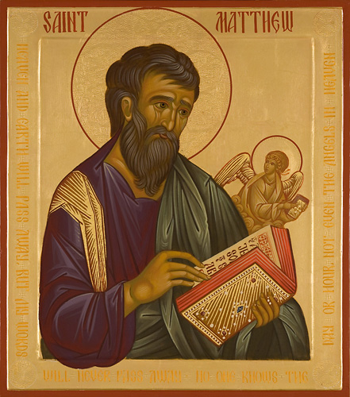
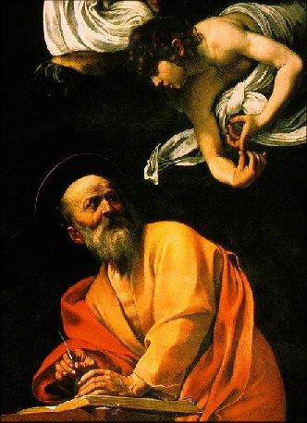
Gospel acc. to Matthew

Slide 23
Content/Outline of Matt 1—2
1:1 – Gospel Title
1:2-17 – Jesus’ Genealogy (Abraham/David/Exile/Messiah)
1:18-24 – Angel tells Joseph of Jesus’ birth in a dream
1:25 & 2:1a – Mary’s son is born in Bethlehem of Judea, and named Jesus
2:1b-12 – Magi from East visit Herod, then Jesus
2:13-21 – Joseph & Mary flee to Egypt with child; Innocents murdered; Holy Family returns to Israel
2:22-23 – They move north to Nazareth
  Matt 1—2 is a “Gospel in Miniature” (Mt’s main themes already here)

Slide 24
Matt 1:1-17 – Genealogy
Dec. 17 & Christmas Vigil Mass
Ancestry: Jesus = “Son of Abraham, Son of David” (1:1)
Four OT Women in Matt’s Genealogy
  Tamar (Matt 1:3; see Gen 38) – incest?
  Rahab (Matt 1:5a; see Josh 2) – prostitute?
  Ruth (Matt 1:5b; see Ruth 2–4) – foreign widow?
  Wife of Uriah (Mt 1:6; cf. 2 Sam 11–12) – Bathsheba; adultery?
Genealogy: 3 Groups of 14 Generations
  Abraham → David → Babylon → Messiah

Slide 25
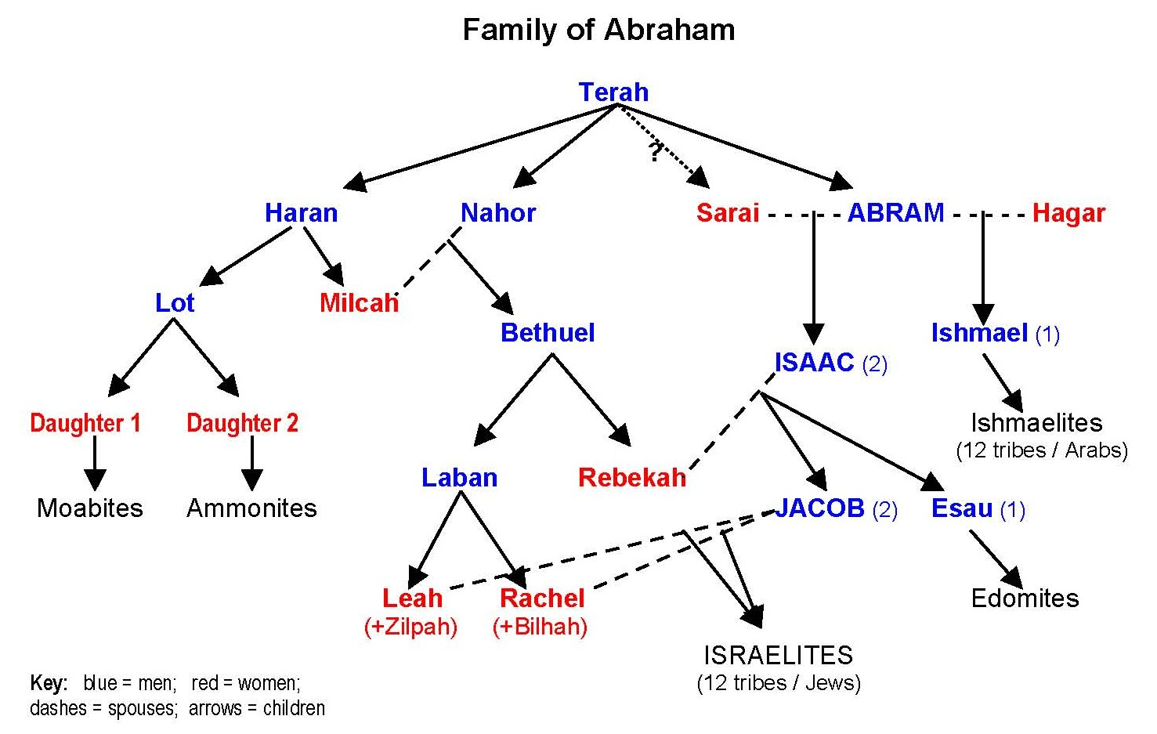
Family of Abraham

Slide 26
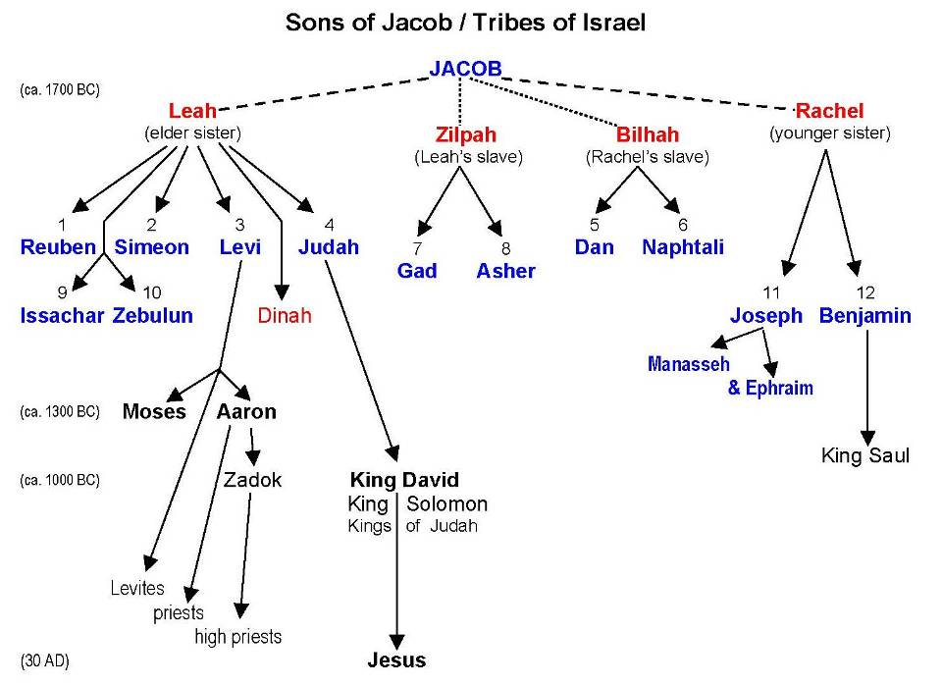
Sons of Jacob

Slide 27
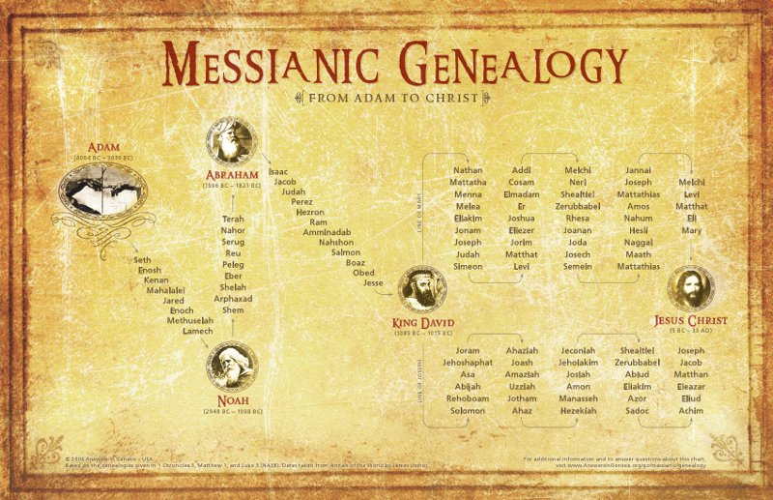
Messianic Genealogy

Slide 28
Matthew’s Portrait of Jesus
Son of Abraham, Son of David
  legitimate “King of the Jews”
  unlike the Herodians (family of King Herod),
  who are not “Davidic” (family of King David)
King of the Jews
  In Mark, used only at Jesus’ trial (Mk 15)
  In Matt (already in 2:2), the Magi ask,
  “Where is the newborn king of the Jews?”
  many more parables involving kings;
  more royal allusions as Jesus enters Jerus.

Slide 29
Matthew’s Portrait of Jesus
Matthew’s Genealogy (1:1-17)
  “The book of the genealogy of Jesus Christ,
  the son of David, the son of Abraham…
  Thus the total number of generations
  from Abraham to David is
  fourteen generations;
  from David to the Babylonian exile,
  fourteen generations;
  from the Babylonian exile to the Messiah,
  fourteen generations.” (1:1, 17)
Why 14? Why recall Babylonian exile?

Slide 30
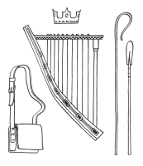
Jesus: King of the Jews?
Hebrew Numerology (“Gematria”)
  Each letter has an associated number;
  most common system (for 22 Hebrew letters):
  Alef = 1; Bet = 2; Gimel = 3;
  Dalet = 4; Hey = 5; Vav = 6; etc.
  Hebrew omits vowels: "David" = D V D
  dalet - vav - dalet = 4 + 6 + 4 = 14 !
Davidic Monarchy: ca. 1000 – 587 BC
  587 BC = Babylonians conquer Jerusalem
  and kill the last Davidic king’s sons!
  After returning from the Babylonian Exile,
  the people hope for restoration of the Davidic Monarchy,
  led by a “Son of David” as “Messiah” (“anointed king”)

Slide 31
Jesus: Beloved Son of God
Voice from heaven at Baptism:
  “This is my beloved Son, with whom I am well pleased” (3:17)
Devil tempts Jesus in the desert:
  “If you are the Son of God…” (4:3, 6)
Voice from heaven at Transfiguration:
  “This is my beloved Son, with whom I am well pleased” (17:5)
People taunt Jesus on the cross:
  “If you are the Son of God…” (27:3, 6)
Strange incidents at Crucifixion:
  Temple veil torn; earthquake; tombs open (27:51-53)

Slide 32
Jesus: Emmanuel & Savior
Emmanuel (“God with Us”; 1:21-23; 28:20)
  Infancy: “She will bear a son, and you are to name him Jesus, for he will save his people from their sins.” / All this took place to fulfill what had been spoken by the Lord through the prophet: / “Look, the virgin shall conceive and bear a son, and they shall name him Emmanuel,” which means, “God is with us”
  (Matt 1:21-23; cf. Isa 7:14).
  Last words of the risen Jesus: “And remember, I am with you always, to the end of the age.” (Matt 28:20; cf. 26:29)

Slide 33
Jesus: Emmanuel & Savior
Savior (see 8:25; 10:22; 14:40; 24:13)
  Name: Jesus = Yeshua = “YHWH saves”
  During storm at sea, Jesus’ disciples cry, “Lord, save us” (Matt 8:25);
  when Peter tries to walk on water, he cries, “Lord, save me” (14:30).
  Related texts:
  “Whoever endures to the end will be saved” (10:22; 24:13; cf. 24:22).
Consider: HOW does God “save” us?

Slide 34
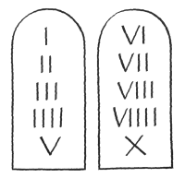
Jesus: Great Teacher
Rabbi/Teacher, with Disciples:
  Explains “Torah” (God’s Instructions/Teachings/Precepts)
Teacher, prophet, law-giver, like Moses:
  Both are saved as babies, while other boys killed
  Both flee to/from Egypt when in danger
  Both go up a mountain to deal with Torah/Law
  Both fast for 40 days and 40 nights
  First 5 books of Hebrew Bible attributed to Moses
  In Matthew, 5 long speeches attributed to Jesus
  Jesus explicitly upholds the teachings/laws of Moses;
  doesn’t abolish them (Matt 5:17-20; 22:35-40; etc.)

Slide 35
For Your Prayer & Reflection:
What does it mean for Jesus to be your “King”?
  In what ways do you want Jesus to “rule” your life?
Which other titles of Jesus found in Matthew mean the most to you personally?
  Son of Abraham
  Son of David
  Emmanuel
  Savior
  Teacher
  Etc.?

Slide 36
Mt 1:18–24/25 — Joseph’s Dream
4th Sun. Advent A & Dec. 18 & Christmas Vigil Mass
Mary, “betrothed” to Joseph (not yet married);
“found with child through the holy Spirit”
Joseph, righteous, decides to “divorce” her quietly
Angel appears to him in a dream: “Do not be afraid…”
  To take Mary as your wife (into your home)
  For the child is conceived through the Holy Spirit
  She will bear a son; You are to name him Jesus (“God saves”)
  All this fulfills what the Lord said thru the prophet (Isaiah 7:14):
  “maiden/virgin with child; will bear son; name him Emmanuel”
Joseph awoke, and did as the angel commanded

Slide 37
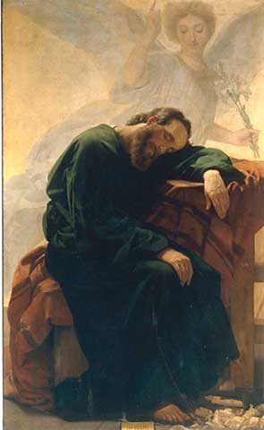
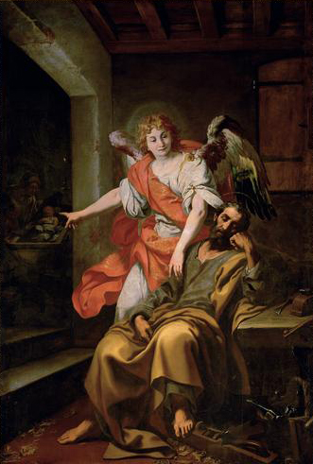

Slide 38
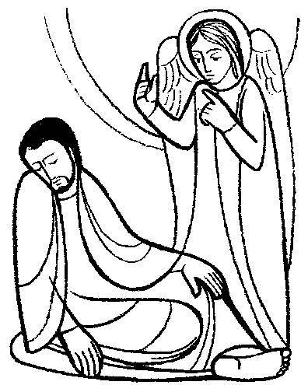
Matthew 1:18-20a
This is how the birth of Jesus Christ came about.
When his mother Mary was betrothed to Joseph,
but before they lived together,
she was found with child through the Holy Spirit.
Joseph her husband,
since he was a righteous man,
yet unwilling to expose her to shame,
decided to divorce her quietly.
Such was his intention when, behold,
the angel of the Lord appeared to him
in a dream and said,

Slide 39
Matthew 1:20b-24 (or also v. 25)
“Joseph, son of David,
do not be afraid to take Mary your wife into your home. (lit. “take Mary as your wife”)
For it is through the Holy Spirit that this child has been conceived in her.
She will bear a son and YOU are to name him JESUS,
because he will SAVE his people from their sins.”
All this took place to fulfill what the Lord had said through the prophet:
Behold, the virgin shall conceive and bear a son,
and they shall name him Emmanuel, which means “God is with us.”
When Joseph awoke, he did as the angel of the Lord
had commanded him, and took his wife into his home.
[25: He had no relations with her until she bore a son,
and he named him Jesus.]
Note: Vs. 25 in Ordo Lectionum Missae for Christmas Vigil,
but not for 4th Sunday of Advent or Dec. 18.
USA Lectionary includes vs. 25 on all these days.

Slide 40
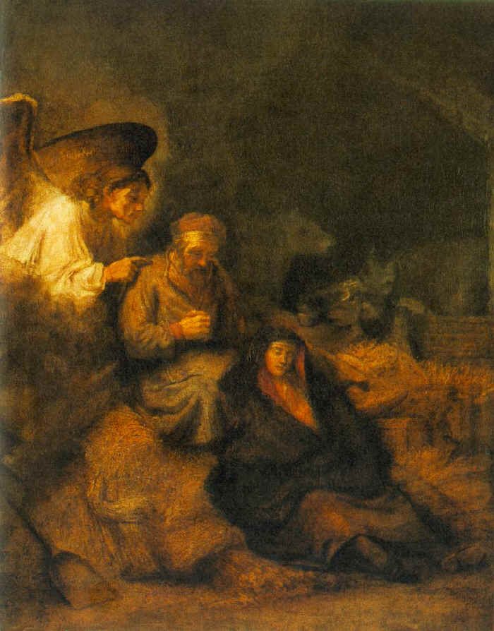
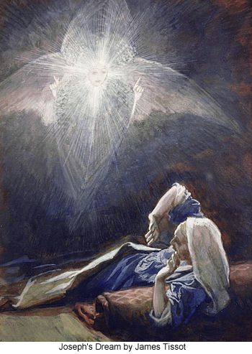
Joseph’s Dreams

Slide 41
Is Joseph the Father of Jesus?
Most Catholics think: NO!
  Emphasis on the Virgin Birth and Perpetual Virginity of Mary
Correct answer is: Both YES and NO!
  NOT biologically, genetically, sexually
  But YES he is, LEGALLY & Socially/Culturally
  Joseph accepts/takes Mary as his (legal) wife.
  Joseph accepts/names Jesus as his (legal) son!
  Mary says to Jesus, “Your father and I…” (Lk 2:48)
  Jesus is “Son of David” only through the line of Joseph!

Slide 42
Real “Fatherhood”
Not primarily biological / sexual
  Many men “father” children w/o accepting responsibility
Rather, it is chosen / adopted
  Men who truly act to protect / raise the “children”
Just as WE are really “children” of God.
  God is not just creator, but “adopts” us as children & heirs – both Jews & Gentiles (Paul emphases to the Romans)!
Cf. “Parable of 2 Sons” (Matt 21:28-32)
  One says yes, but doesn’t; Other says no, but does!

Slide 43
BIRTH of Jesus (Mt 1:25; 2:1a)
Only mentioned briefly, almost in passing:
Matt 1:24-25 – Conclusion of Joseph’s dream:
  “When Joseph awoke, he did as the angel of the Lord had commanded him and took his wife into his home. / He had no relations with her until she bore a son, and he named him Jesus.”
Matt 2:1a – Intro to story of the Magi:
  “When Jesus was born in Bethlehem of Judea, in the days of
  King Herod, behold, magi from the east arrived in Jerusalem,”

Slide 44
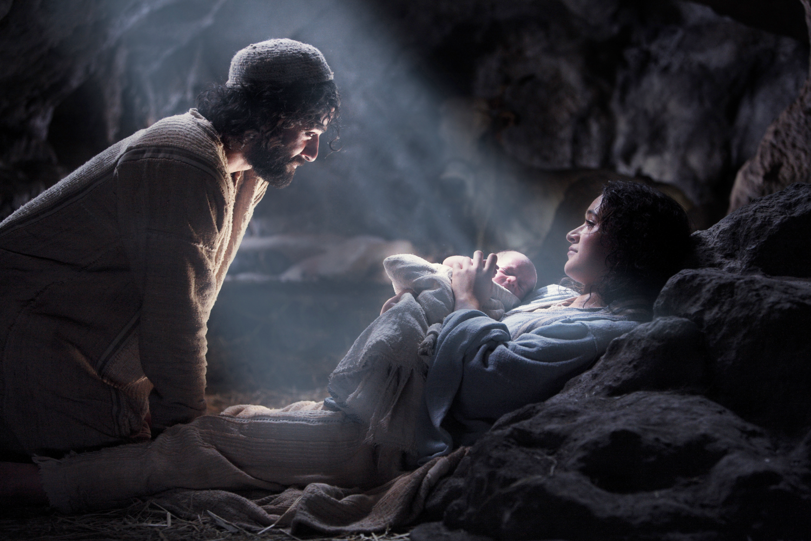

Slide 45
Visit of the Magi (Mt 2:1b-12)
Days of King Herod; Magi from East arrive in Jerusalem
  “Where is the newborn king of the Jews?”
  “We saw his star at it rising and have come to do him homage.”
Herod troubled, assembles chief priests & scribes
  Inquires where the Messiah was to be born:
  “in Bethlehem of Judea” (cf. Micah 5:1; 2Sam 5:2)
  Sends the Magi to Bethlehem; asks them to report back
Magi set out; again follow the star; are overjoyed!
  Enter the house; see the child with his mother Mary
  Worship; offer gifts of gold, frankincense, myrrh

Slide 46
Matt 2:1-12 – Visit of the Magi
Epiphany Sunday ABC
When Jesus was born in Bethlehem of Judea, in the days of King Herod, behold, magi from the east arrived in Jerusalem, ² saying, "Where is the newborn king of the Jews? We saw his star at its rising and have come to do him homage."
³ When King Herod heard this, he was greatly troubled, and all Jerusalem with him. ⁴ Assembling all the chief priests and the scribes of the people, he inquired of them where the Messiah was to be born.
⁵ They said to him, "In Bethlehem of Judea, for thus it has been written through the prophet: ⁶ 'And you, Bethlehem, land of Judah, are by no means least among the rulers of Judah; since from you shall come a ruler, who is to shepherd my people Israel.'"
⁷ Then Herod called the magi secretly and ascertained from them the time of the star's appearance.
⁸ He sent them to Bethlehem and said, "Go and search diligently for the child. When you have found him, bring me word, that I too may go and do him homage."
⁹ After their audience with the king they set out. And behold, the star that they had seen at its rising preceded them, until it came and stopped over the place where the child was.
¹⁰ They were overjoyed at seeing the star, ¹¹ and on entering the house they saw the child with Mary his mother. They prostrated themselves and did him homage. Then they opened their treasures and offered him gifts of gold, frankincense, and myrrh.
¹² And having been warned in a dream not to return to Herod, they departed for their country by another way.

Slide 47
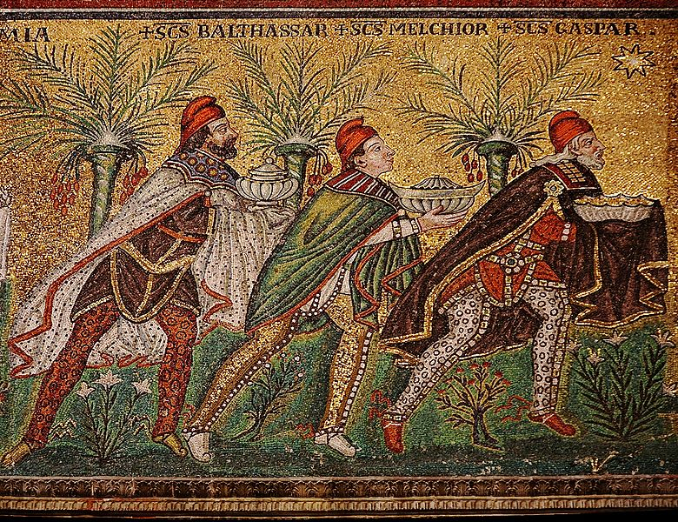

Slide 48
Matt 2:13-21 – Flight to Egypt & Return
Dec. 28 (vv. 13-18); Holy Family, Year A (vv. 13-15, 19-23)
Joseph’s second dream (vv. 13-15):
  Warned to flee to Egypt with Mary and child
Murder of the Innocents (vv. 16-18):
  Cruelty of King Herod
  Why all baby boys less than TWO years old?
Joseph’s third dream (vv. 19-21):
  After Herod’s death, Holy Family returns to Israel
Joseph’s fourth dream (vv. 22-23):
  Warned not to settle in Judea, but go north to Galilee

Slide 49
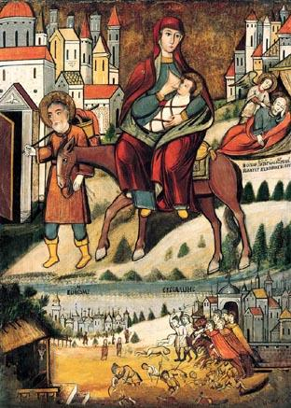
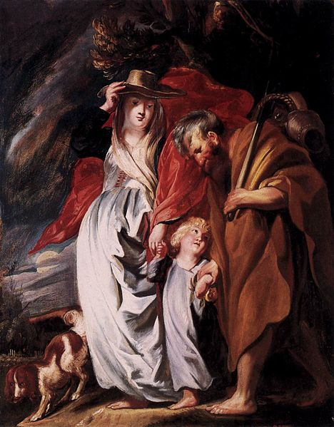

Slide 50
Mt 2:22-23 – Family Moves to Nazareth
Matthew: Journey to Nazareth in Galilee
  Lived in Bethlehem prior to Jesus’ birth, and afterward!
  Jesus is a “toddler” when Magi visit (6-18 months old?)
  After return from Egypt, go north for the first time
  Reason: fear of Herod Archelaus, son of Herod the Great
Contrast Luke:
  Family had previously lived in Nazareth
  Went south only temporarily, due to census
  Returned to Nazareth soon (~40 days) after Jesus’ birth

Slide 51
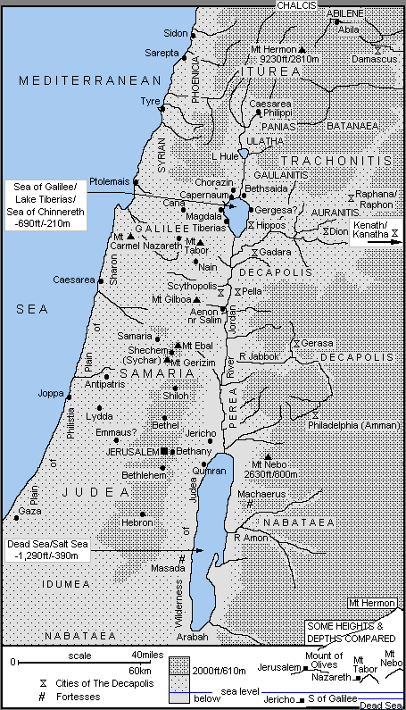
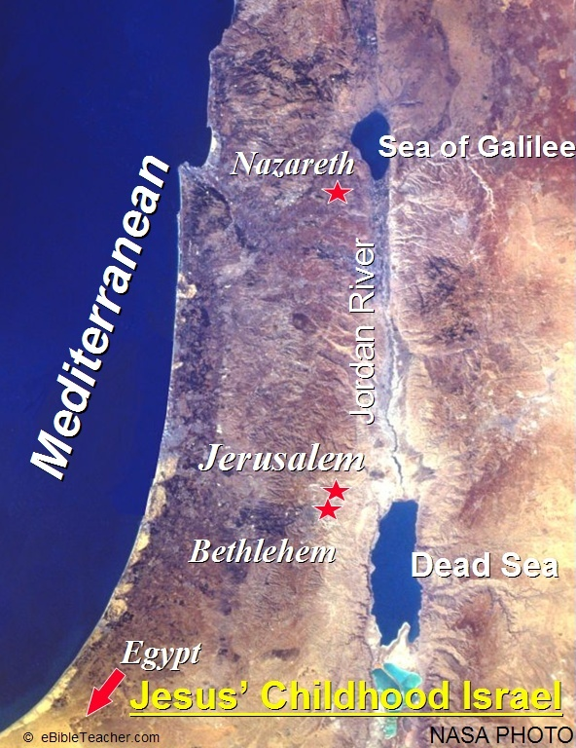

Slide 52
For Prayer & Reflection:
Read the Gospel for the Mass on Christmas Eve (Joseph’s Dream): What is God saying to us here?
Read the Gospel for the Mass on Epiphany Sunday (Visit of the Magi): What is God saying to us here?
How does Matthew’s Infancy Narrative strike you overall? What part affects you the most?
How can we be like Joseph: listening to God, acting on God’s directives, protecting women & children?
How can we be like Magi: seeking & adoring Jesus?

Slide 53

Questions & Break
Questions?
  Please “raise your hands” (electronically)
  Or open your microphone and ask…
Break
  We will continue in 10 minutes.

Slide 54
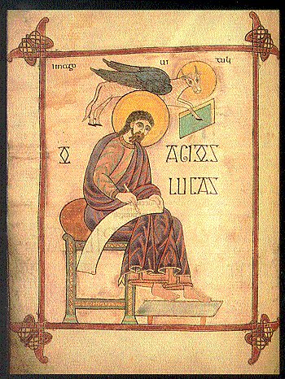
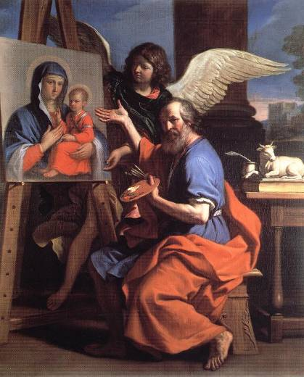
Gospel acc. to Luke

Slide 55
Content/Outline of LUKE 1—2
1:1-4 - Literary introduction to the Gospel
1:5-25 - Angel Gabriel announces John the Baptist’s birth
1:26-38 - Angel Gabriel announces Jesus’ birth to Mary while awake
1:39-56 - Mary visits Elizabeth (incl. “Magnificat”)
1:57-58 - Elizabeth gives birth to her son (John the Baptist)
1:59-80 - John the Baptist is circumcised & named (incl. “Benedictus”)
2:1-5 - Joseph & Mary journey to Bethlehem for the census
2:6-7 - Mary gives birth to her son in Bethlehem of Judea
2:8-14 - Angels appear to some shepherds (incl. the angels' "Gloria")
2:15-20 - Shepherds visit Mary & Joseph & the infant lying in a manger
2:21 - The infant is circumcised & named Jesus
2:22-38 - Jesus is presented to God in the Temple (incl. "Nunc Dimittis")
2:39-40 - The family returns to Nazareth
2:41-52 - At age twelve, Jesus & his parents visit the Jerusalem Temple

Slide 56
Luke 1:1-4 – “Prologue”
“Since many have undertaken to set down an orderly account of the events that have been fulfilled among us, ² just as they were handed on to us by those who from the beginning were eyewitnesses and servants of the word, ³ I too decided, after investigating everything carefully from the very first, to write an orderly account for you, most excellent Theophilus, ⁴ so that you may know the truth concerning the things about which you have been instructed.”
Content & Purpose:
  Events “fulfilled” (by Jesus? by God in Jesus?),
  “many” previous narratives; “accurate” inquiry
  “written” account; “orderly” sequence
  To give certainty for teachings already received

Slide 57
Luke’s Prologue (1:1-4)
Finely crafted literary intro; one sentence!
  Stages of traditions (lit. “handing on”):
  “Eyewitnesses” (1st generation “Apostles”)
  → “Servants/Ministers of the Word” (2nd gen. disciples)
  Luke to Theophilus (“Lover of God” = “Christian”)
Use in Lectionary:
  Not in Christmas Season
  Only 3rd Sunday, Ordinary Time, Year C
    Luke 1:1-4; 4:14-21 – Inauguration of Jesus’ Public Ministry

Slide 58
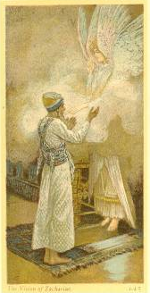
Luke 1:5-25 – Zechariah & Elizabeth
Dec. 19 only
Angel Gabriel appears to Zechariah in Jerusalem Temple
  Intro: Zechariah & Elizabeth are “righteous” & “blameless”
  priestly heritage, elderly couple, childless
  While serving a rotation in Jerusalem Temple:
  Angel Gabriel appears; says they’ll have a child,
  who will be great, have “spirit/power of Elijah”
  Zechariah doubts/objects: wife & I are old!
  Zechariah struck mute b/c he didn’t believe!
  Exits temple; gestures to people
  Returns home (village of Ein Karem, near Jerusalem?)
  Elizabeth conceives, goes into seclusion, prays

Slide 59
Luke 1:5-25 – Zechariah & Elizabeth
⁵ In the days of Herod, King of Judea, there was a priest named Zechariah of the priestly division of Abijah; his wife was from the daughters of Aaron, and her name was Elizabeth. ⁶ Both were righteous in the eyes of God, observing all the commandments and ordinances of the Lord blamelessly. ⁷ But they had no child, because Elizabeth was barren and both were advanced in years.
⁸ Once when he was serving as priest in his division's turn before God, ⁹ according to the practice of the priestly service, he was chosen by lot to enter the sanctuary of the Lord to burn incense. ¹⁰ Then, when the whole assembly of the people was praying outside at the hour of the incense offering, ¹¹ the angel of the Lord appeared to him, standing at the right of the altar of incense. ¹² Zechariah was troubled by what he saw, and fear came upon him. ¹³ But the angel said to him, "Do not be afraid, Zechariah, because your prayer has been heard. Your wife Elizabeth will bear you a son, and you shall name him John. ¹⁴ And you will have joy and gladness, and many will rejoice at his birth, ¹⁵ for he will be great in the sight of the Lord. He will drink neither wine nor strong drink. He will be filled with the holy Spirit even from his mother's womb, ¹⁶ and he will turn many of the children of Israel to the Lord their God. ¹⁷ He will go before him in the spirit and power of Elijah to turn the hearts of fathers toward children and the disobedient to the understanding of the righteous, to prepare a people fit for the Lord."
¹⁸ Then Zechariah said to the angel, "How shall I know this? For I am an old man, and my wife is advanced in years." ¹⁹ And the angel said to him in reply, "I am Gabriel, who stand before God. I was sent to speak to you and to announce to you this good news. ²⁰ But now you will be speechless and unable to talk until the day these things take place, because you did not believe my words, which will be fulfilled at their proper time."
²¹ Meanwhile the people were waiting for Zechariah and were amazed that he stayed so long in the sanctuary.
²² But when he came out, he was unable to speak to them, and they realized that he had seen a vision in the sanctuary. He was gesturing to them but remained mute. ²³ Then, when his days of ministry were completed, he went home. ²⁴ After this time his wife Elizabeth conceived, and she went into seclusion for five months, saying,
²⁵ "So has the Lord done for me at a time when he has seen fit to take away my disgrace before others."

Slide 60
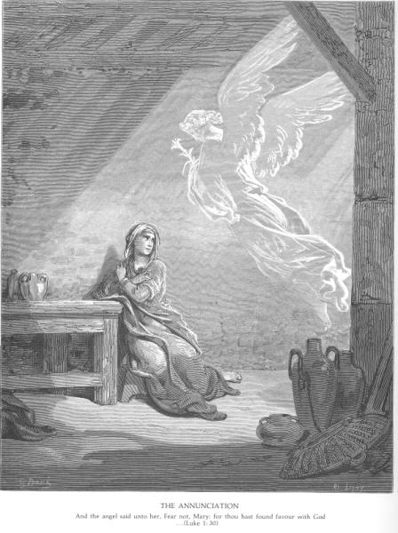
Luke 1:26-38
The Annunciation
4th Advent Sun. Year C & Dec. 20
Gabriel’s Words
  “Hail, favored one!
  Lord is with you!”
  “You’ll bear a son: Jesus”
Mary’s Response:
  “How?”
  “May it be done to me according to your word!”

Slide 61
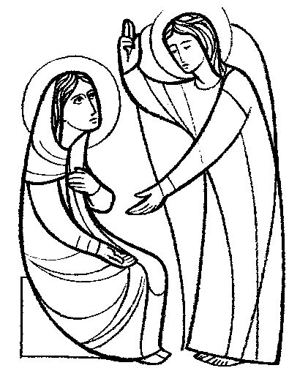
4th Sunday of Advent, Year B & Dec. 20
Luke 1:26-38 (“The Annunciation”)
The angel Gabriel was sent from God to a town of Galilee called Nazareth,
to a virgin betrothed to a man named Joseph, of the house of David,
and the virgin’s name was Mary.
And coming to her, he said, “Hail, full of grace! The Lord is with you.”
But she was greatly troubled at what was said
and pondered what sort of greeting this might be.
Then the angel said to her, “Do not be afraid, Mary, for you have found favor with God.
“Behold, you will conceive in your womb and bear a son, and you shall name him Jesus.
He will be great and will be called Son of the Most High,
and the Lord God will give him the throne of David his father,
and he will rule over the house of Jacob forever,
and of his kingdom there will be no end.”
But Mary said to the angel, “How can this be, since I have no relations with a man?”
And the angel said to her in reply,
“The Holy Spirit will come upon you, and the power of the Most High will overshadow you.
Therefore the child to be born will be called holy, the Son of God.
And behold, Elizabeth, your relative, has also conceived a son in her old age,
and this is the sixth month for her who was called barren; for nothing will be impossible for God.”
Mary said, “Behold, I am the handmaid of the Lord.
May it be done to me according to your word.”
Then the angel departed from her.

Slide 62
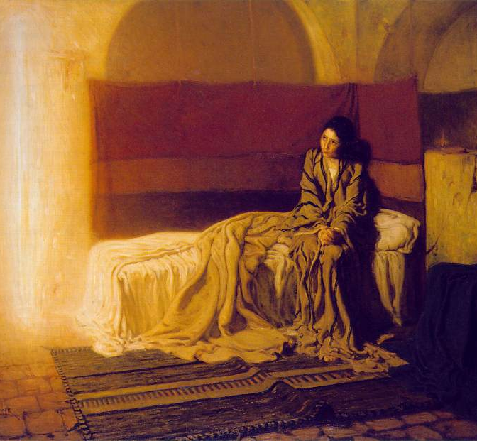
The Annunciation
Henry
Ossawa
Tanner,
1898
Philadelphia Museum

Slide 63
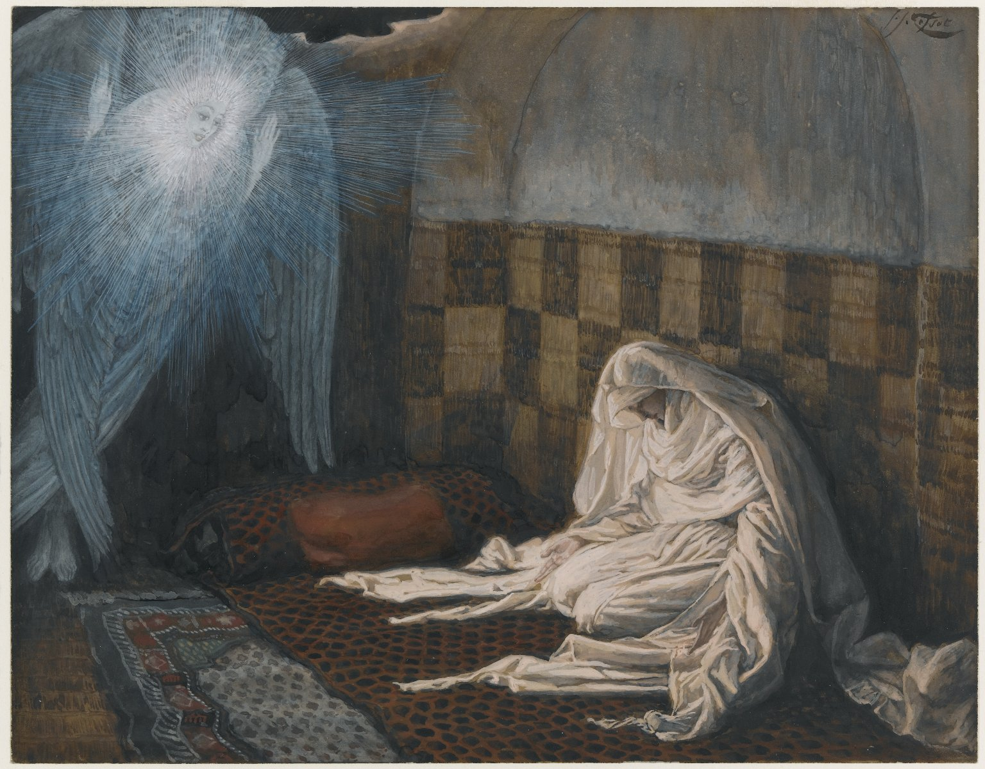
The Annunciation
James
Tissot,
1886-94
Brooklyn
Museum

Slide 64
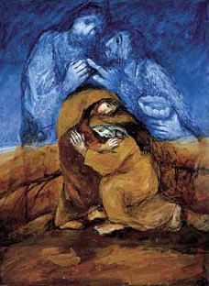
Luke 1:39-56
Visitation
4th Advent Sun., Year C & Dec. 21
Elizabeth & Mary meet
[so also John & Jesus]
“Blessed are you among
women, and blessed is
the fruit of your womb.”
“Blessed are you who
believed…”

Slide 65
Visitation: Mary & Elizabeth
Mary travels “in haste” to visit Elizabeth
  When? – Just after Annunciation (Eliz.’s 6th month)
  How? – Alone? Helpers? Pilgrims?
  Why? – To help Eliz? Fleeing from Nazareth?
Inter-relational Dynamics:
  Mary enters house & GREETS Elizabeth
  Elizabeth HEARS; her child “leaps” in the womb
  FILLED with HOLY SPIRIT, Elizabeth proclaims…
  “Blessed” (3x); Awe, Joy, Faith!

Slide 66
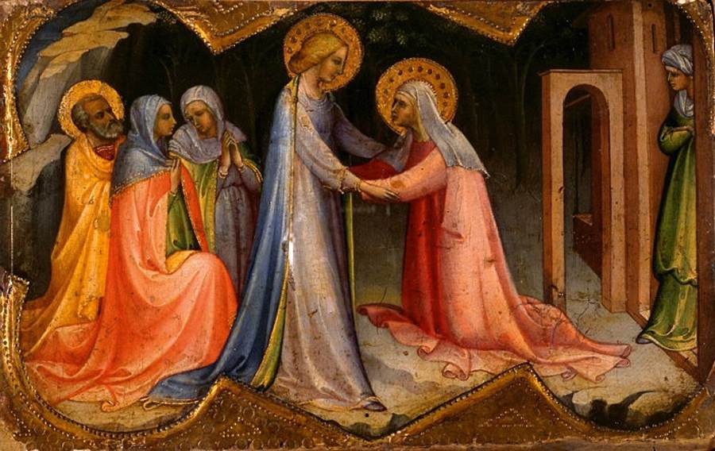

Slide 67
4th Sunday of Advent, Year C & Dec. 21
Luke 1:39-45 – The Visitation
[During those days] Mary set out and traveled to the hill country in haste to a town of Judah, ⁴⁰where she entered the house of Zechariah and greeted Elizabeth.
⁴¹When Elizabeth heard Mary’s greeting, the infant leaped in her womb,
and Elizabeth, filled with the Holy Spirit,
⁴²cried out in a loud voice and said,
“Blessed are you among women,
and blessed is the fruit of your womb.
⁴³And how does this happen to me,
that the mother of my Lord should come to me?
⁴⁴For at the moment the sound of your greeting reached my ears,
the infant in my womb leaped for joy.
⁴⁵Blessed are you who BELIEVED
that what was spoken to you by the Lord would be fulfilled.”

Slide 68
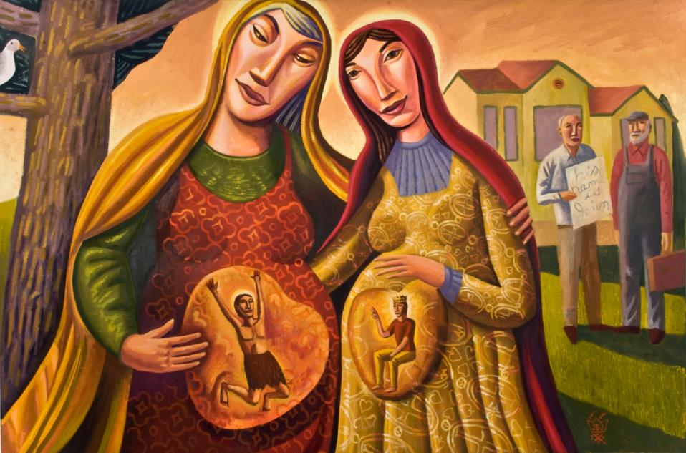

Slide 69
Luke 1:46-56 – The Magnificat
Dec. 22 & Marian Feasts
⁴⁶ And Mary said:
"My soul proclaims the greatness of the Lord;
⁴⁷ my spirit rejoices in God my savior.
⁴⁸ For he has looked upon his handmaid's lowliness;
behold, from now on will all ages call me blessed.
⁴⁹ The Mighty One has done great things for me, and holy is his name.
⁵⁰ His mercy is from age to age to those who fear him.
⁵¹ He has shown might with his arm, dispersed the arrogant of mind and heart.
⁵² He has thrown down the rulers from their thrones but lifted up the lowly.
⁵³ The hungry he has filled with good things; the rich he has sent away empty.
⁵⁴ He has helped Israel his servant, remembering his mercy,
⁵⁵ according to his promise to our fathers,
to Abraham and to his descendants forever."
⁵⁶ Mary remained with her about three months and then returned to her home.

Slide 70
Magnificat (Luke 1:46-55)
Mary’s Hymn of Praise
  To begin, Mary rejoices & praises God
  with her whole being/soul/spirit:
  “Holy is God’s name”
  Why? For all God has done in the past
  and all God promises to do in the future!
Luke’s Theme of Reversal:
  proud dispersed / lowly lifted
  hungry filled / rich sent away empty
Similar to Hannah’s Song

Slide 71
Hannah, Mother of Samuel
Story of Hannah (1 Sam 1)
  Childless woman prays for a son
  Vows to dedicate him to God as a Nazirite
  Hannah’s dialogue with the priest Eli
  Hannah conceives and gives birth: Samuel
Prayer of Hannah (1 Sam 2)
  "My heart exults in the LORD (YHWH);
  my strength is exalted in my God…”
  Theme of reversal: vindication over her detractors

Slide 72

Holy Is God’s Name
In the Hebrew Bible:
  “God” = El; Elohim; El-Shaddai…
  YHWH = God’s proper name (Exod 3)
  Adonai = “The Lord” (also “Master; Mister; Sir”)
  If YHWH appears in the biblical text,
  it is substituted by Adonai when reading aloud.
  In English Bibles, it is sometimes written
  in small caps: Lord
  or in all caps: LORD

Slide 73
Holy Is His Name (John Michael Talbot)
My soul proclaims the greatness of the Lord
And my spirit exults in God my Savior.
For He has looked with mercy on my lowliness
And my name will be forever exalted.
For the mighty God has done great things for me
And His mercy will reach from age to age.
And Holy, Holy, Holy is God’s name.
And Holy, Holy, Holy is God’s name.
He has mercy in ev'ry generation,
He has revealed His power and His glory.
He has cast down the mighty in their arrogance,
And has lifted up the meek and the lowly.
He has come to help His servant Israel;
He remembers His promise to our fathers.
And Holy, Holy, Holy is God’s name…

Slide 74
Luke 1:57-66 – Birth of John the Baptist
Dec. 23
⁵⁷ When the time arrived for Elizabeth to have her child she gave birth to a son.
⁵⁸ Her neighbors and relatives heard that the Lord had shown his great mercy toward her, and they rejoiced with her.
⁵⁹ When they came on the eighth day to circumcise the child, they were going to call him Zechariah after his father, ⁶⁰ but his mother said in reply, "No. He will be called John."
⁶¹ But they answered her, "There is no one among your relatives who has this name."
⁶² So they made signs, asking his father what he wished him to be called.
⁶³ He asked for a tablet and wrote, "John is his name," and all were amazed.
⁶⁴ Immediately his mouth was opened, his tongue freed, and he spoke blessing God.
⁶⁵ Then fear came upon all their neighbors, and all these matters were discussed throughout the hill country of Judea.
⁶⁶ All who heard these things took them to heart, saying, "What, then, will this child be?" For surely the hand of the Lord was with him.

Slide 75
Luke 1:67-79 – The Benedictus
Dec. 24, Morning Mass
Zechariah’s Blessing of God
  “Blessing” = “speaking good words” ≈ praise and thanks, for God’s covenantal faithfulness
  “God bless you/me” vs. “We bless God!”
    Ps 34 – “I will bless the Lord at all times…”
    Ps 103 & 104 – “Bless the Lord, my soul…”
    Ps 134; 135 – “Come, bless the Lord…”
    Many other Psalms give thanks, praise, glorify, etc.
  Jewish Berakah prayers: “Blessed are you,
  Lord our God, ruler of all, for you have…”

Slide 76
Luke 1:67-79 – Zechariah’s Benedictus
⁶⁸ "Blessed be the Lord, the God of Israel,
for he has visited and brought redemption to his people.
⁶⁹ He has raised up a horn for our salvation within the house of David his servant,
⁷⁰ even as he promised through the mouth of his holy prophets from of old:
⁷¹ salvation from our enemies and from the hand of all who hate us,
⁷² to show mercy to our fathers and to be mindful of his holy covenant
⁷³ and of the oath he swore to Abraham our father, and to grant us that,
⁷⁴ rescued from the hand of enemies, without fear we might worship him
⁷⁵ in holiness and righteousness before him all our days.
⁷⁶ And you, child, will be called prophet of the Most High,
for you will go before the Lord to prepare his ways,
⁷⁷ to give his people knowledge of salvation through the forgiveness of their sins,
⁷⁸ because of the tender mercy of our God by which the daybreak from on high will visit us
⁷⁹ to shine on those who sit in darkness and death's shadow,
to guide our feet into the path of peace."
⁸⁰ The child grew and became strong in spirit,
and he was in the desert until the day of his manifestation to Israel.
[Note: v. 80 is read only on June 24, Nativity of John the Baptist.]

Slide 77
Luke 2:1-20 – Birth of Jesus
2:1-14 Christmas Night; 2:15-20 Christmas Dawn
Census: Joseph & Mary go to Bethlehem
Mary gives birth to her “first-born”
  No room in the “inn”; lay the baby in a “manger”
Angel proclaims to shepherds:
  "Do not be afraid… good news of great joy for all the people: to you is born… a Savior, who is the Messiah, the Lord."
  Angel chorus: "Glory to God in the highest heaven,
  and on earth peace among those whom God favors!"
Shepherds discuss and go to Bethlehem
  Visit the baby; return praising God!

Slide 78
Luke 2:1-14 – Birth of Jesus
¹ In those days a decree went out from Caesar Augustus that the whole world should
be enrolled. ² This was the first enrollment, when Quirinius was governor of Syria. ³ So all went to be enrolled, each to his own town. ⁴ And Joseph too went up from Galilee from the town of Nazareth to Judea, to the city of David that is called Bethlehem, because he was of the house and family of David, ⁵ to be enrolled with Mary, his betrothed, who was with child.
⁶ While they were there, the time came for her to have her child, ⁷ and she gave birth to her firstborn son. She wrapped him in swaddling clothes and laid him in a manger, because there was no room for them in the inn.
⁸ Now there were shepherds in that region living in the fields and keeping the night watch over their flock. ⁹ The angel of the Lord appeared to them and the glory of the Lord shone around them, and they were struck with great fear. ¹⁰ The angel said to them, "Do not be afraid; for behold, I proclaim to you good news of great joy that will be for all the people. ¹¹ For today in the city of David a savior has been born for you who is Messiah and Lord. ¹² And this will be a sign for you: you will find an infant wrapped in swaddling clothes and lying in a manger.”
¹³ And suddenly there was a multitude of the heavenly host with the angel, praising God and saying: ¹⁴ "Glory to God in the highest and on earth peace to those on whom his favor rests."

Slide 79
Luke 2:15-20 & 21– Jesus’ Birth (cont.)
¹⁵ When the angels went away from them to heaven, the shepherds said to one
another, "Let us go, then, to Bethlehem to see this thing that has taken place,
which the Lord has made known to us."
¹⁶ So they went in haste and found Mary and Joseph, and the infant lying in the manger. ¹⁷ When they saw this, they made known the message that had been told them about this child. ¹⁸ All who heard it were amazed by what had been told them by the shepherds.
¹⁹ And Mary kept all these things, reflecting on them in her heart.
²⁰ Then the shepherds returned, glorifying and praising God for all they had heard and seen, just as it had been told to them.
²¹ When eight days were completed for his circumcision, he was named Jesus, the name given him by the angel before he was conceived in the womb.
Luke 2:15-20 – Dec. 25, Christmas Mass at Dawn
Luke 2:16-21 – Jan. 1, Mary Mother of God = Octave of Christmas:
Circumcision and Naming of Jesus (acc. to Jewish tradition)

Slide 80
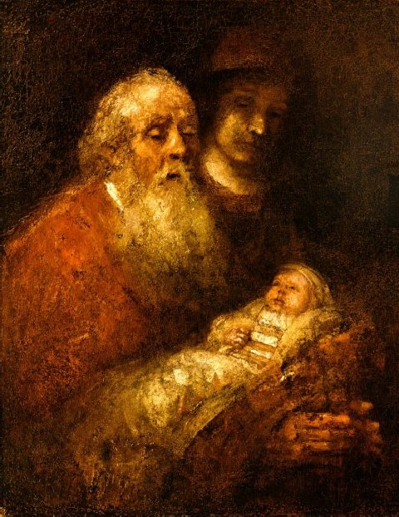
Luke 2:22-40 – Presentation in Temple
Holy Family Sunday, Year B & Dec. 29&30 & Feb. 2
40th Day after Child’s Birth
  Purification of Mother
  Presentation of Child
Simeon & Anna
  Simeon speaks to parents
  Prays Nunc Dimitis : “Lord, now let your servant go in peace”
  Anna speaks to other people
  about the child

Slide 81
Luke 2:22-40 – Presentation in Temple
²² When the days were completed for their purification according to the law of Moses, they took him up to Jerusalem to present him to the Lord, ²³ just as it is written in the law of the Lord, "Every male that opens the womb shall be consecrated to the Lord," ²⁴ and to offer the sacrifice of "a pair of turtledoves or two young pigeons," in accordance with the dictate in the law of the Lord.
²⁵ Now there was a man in Jerusalem whose name was Simeon. This man was righteous and devout, awaiting the consolation of Israel, and the holy Spirit was upon him. ²⁶ It had been revealed to him by the holy Spirit that he should not see death before he had seen the Messiah of the Lord.
²⁷ He came in the Spirit into the temple; and when the parents brought in the child Jesus to perform the custom of the law in regard to him, ²⁸ he took him into his arms and blessed God, saying:

Slide 82
Luke 2:22-40 – Presentation in Temple
²⁹ “Now, Master, you may let your servant go in peace, according to your word,
³⁰ for my eyes have seen your salvation, ³¹ which you prepared in sight of all the peoples,
³² a light for revelation to the Gentiles, and glory for your people Israel.”
³³ The child's father and mother were amazed at what was said about him;
³⁴ and Simeon blessed them and said to Mary his mother, “Behold, this child is destined for the fall and rise of many in Israel, and to be a sign that will be contradicted ³⁵ (and you yourself a sword will pierce) so that the thoughts of many hearts may be revealed.”
³⁶ There was also a prophetess, Anna, the daughter of Phanuel, of the tribe of Asher.
She was advanced in years, having lived seven years with her husband after her marriage, ³⁷ and then as a widow until she was eighty-four. She never left the temple,
but worshiped night and day with fasting and prayer. ³⁸ And coming forward at that very time, she gave thanks to God and spoke about the child to all who were awaiting the redemption of Jerusalem.
³⁹ When they had fulfilled all the prescriptions of the law of the Lord, they returned to Galilee, to their own town of Nazareth. ⁴⁰ The child grew and became strong, filled with wisdom; and the favor of God was upon him.

Slide 83
Luke 2:41-52 – Jesus in Jerusalem, age 12
Holy Family Sunday, Year C
Parents go to Jerusalem annually for Passover
  At age 12, Jesus goes with them
  While returning home, they assume he’s in the caravan
  Not finding him, they return to Jerusalem to look
After three days, parents find Jesus in the Temple
  All are astounded by Jesus’ Q&A
  Mother: “Your father and I have been looking…”
  Jesus: “Didn’t you know… my Father’s house?”
They return to Nazareth
  Jesus is obedient; Mary ponders everything; Jesus grows
Also read March 19: St. Joseph, Husband of Mary
& 3rd Saturday after Pentecost: Immaculate Heart of Mary

Slide 84
Luke 2:41-52 – Jesus at Age 12
⁴¹ Each year his parents went to Jerusalem for the feast of Passover,
⁴² and when he was twelve years old, they went up according to festival custom.
⁴³ After they had completed its days, as they were returning, the boy Jesus remained behind in Jerusalem, but his parents did not know it. ⁴⁴ Thinking that he was in the caravan, they journeyed for a day and looked for him among their relatives and acquaintances, ⁴⁵ but not finding him, they returned to Jerusalem to look for him.
⁴⁶ After three days they found him in the temple, sitting in the midst of the teachers, listening to them and asking them questions, ⁴⁷ and all who heard him were astounded at his understanding and his answers.
⁴⁸ When his parents saw him, they were astonished, and his mother said to him, "Son, why have you done this to us? Your father and I have been looking for you with great anxiety." ⁴⁹ And he said to them, "Why were you looking for me? Did you not know that I must be in my Father's house?" ⁵⁰ But they did not understand what he said to them.
⁵¹ He went down with them and came to Nazareth, and was obedient to them; and his mother kept all these things in her heart. ⁵² And Jesus advanced in wisdom and age and favor before God and man.

Slide 85
Review: Infancy Narratives
MATT:
  MEN: Abraham, David, Joseph, Herod, Magi…
  Power, status, politics, intrigue, obstacles, murder
  Jesus’ ancestry is Jewish Royalty
  OT: Dreams of Joseph & Birth of Moses
LUKE:
  WOMEN: Elizabeth, Mary, Anna
  & Old/Poor Men: Zechariah, shepherds, Simeon
  Glory, praise, joy, hymns; poverty, humility, faith
  Jesus’ ancestry is Universal Humanity
  OT: Birth of Samson; Birth of Samuel (&Hannah’s Song)

Slide 86
For Your Prayer & Reflection:
Hear Gabriel say to me:
“Hail, (my name), full of grace! The Lord is with YOU!”
Hear Elizabeth say to me:
“Blessed are YOU among (wo)men!”
“Blessed are YOU who believed!”
With which character do I identify most closely:
Elizabeth? Zechariah? Mary? Joseph? Simeon? Anna? Why?
Does my prayer begin with praise & blessing of God,
as modeled by Hannah & Mary & Elizabeth?
Creative Exercise: Write your own Magnificat or Benedictus, your own prayer of praise and blessing for all that God has done, based on the models of Hannah, or Mary, or Zechariah.

Slide 87
Questions & Break
Questions?
  Please “raise your hands” (electronically)
  Or open your microphone and ask…
Break
  We will continue in 10 minutes.

Slide 88
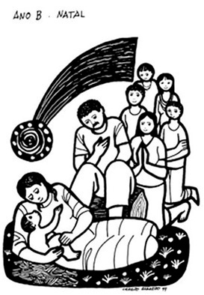
Gospels of Christmas EVE & DAY
FOUR Masses of Christmas:
Vigil Mass
  Matt 1:1-25 (or 1:18-25) – Joseph’s Dreams
Mass during the Night
  Luke 2:1-14 – Angels appear to Shepherds
Mass at Dawn
  Luke 2:15-20 – Shepherds visit Bethlehem
Mass during the Day
  John 1:1-18 (or vv.1-5, 9-14) – John’s Prologue

Slide 89
Feasts in the Christmas SEASON:
Dec. 26: St. Stephen, Martyr
Dec. 27: St. John, Apostle & Evangelist
Dec. 28: Holy Innocents, Martyrs
Sunday after Christmas: Holy Family
Jan. 1: Solemnity of Mary, Mother of God
Sunday, Jan. 2-8: Epiphany of the Lord
  Traditionally on Jan. 6, no matter what day of the week
Sunday, Jan. 9-13: Baptism of the Lord
  Or Monday, Jan. 8 or 9, if Epiphany is Jan. 7 or 8, respectively

Slide 90
Memorials in the Christmas Season:
Dec. 29 – St. Thomas Becket
Dec. 31 – St. Sylvester I
Jan. 2 – Sts. Basil the Great & Gregory Nazianzen
Jan. 3 – Most Holy Name of Jesus
Jan. 4 – St. Elizabeth Ann Seton
Jan. 5 – St. John Neumann
Jan. 6 – Bl. Andre Bessette
Jan. 7 – St. Raymond of Penafort
Note: The readings for the corresponding Christmas Weekday should normally still be used on these days.

Slide 91
First Readings on Christmas Weekdays https://catholic-resources.org/Lectionary/John-Epistles.htm
Lect. # | Day – Feast | First Reading
697 | Dec. 27 – Feast of St. John, Apostle and Evangelist | 1 John 1:1-4
698 | Dec. 28 – Feast of the Holy Innocents, Martyrs | 1 John 1:5—2:2
202 | Dec. 29 – 5th Day in the Octave of Christmas | 1 John 2:3-11
203 | Dec. 30 – 6th Day in the Octave of Christmas | 1 John 2:12-17
204 | Dec. 31 – 7th Day in the Octave of Christmas | 1 John 2:18-21
205 | Jan. 2 – Christmas Weekday (if before Epiphany) | 1 John 2:22-28
206 | Jan. 3 – Christmas Weekday (if before Epiphany) | 1 John 2:29—3:6
207 | Jan. 4 – Christmas Weekday (if before Epiphany) | 1 John 3:7-10
208 | Jan. 5 – Christmas Weekday (if before Epiphany) | 1 John 3:11-21
212 | Monday after Epiphany (or Jan. 7) | 1 John 3:22—4:6
213 | Tuesday after Epiphany (or Jan. 8) | 1 John 4:7-10
214 | Wednesday after Epiphany (or Jan. 9) | 1 John 4:11-18
215 | Thursday after Epiphany (or Jan. 10) | 1 John 4:19—5:4
209/ 216 | Jan. 6, if Epiphany is celebrated Jan. 7 or 8 or Friday after Epiphany (or Jan. 11) | 1 John 5:5-13
210/ 217 | Jan. 7, if Epiphany is celebrated Jan. 8 or Saturday after Epiphany (or Jan. 12) | 1 John 5:14-21

Slide 92
Gospels on Christmas Weekdays
Lect. # | Day - Feast | Gospel
696 | Dec. 26 – Feast of St. Stephen | Matt 10:17-22 – Jesus Says to Expect Persecutions
697 | Dec. 27 – Feast of St. John | John 20:1a, 2-8 – Peter & B.D. Run to Jesus’ Tomb
698 | Dec. 28 – Feast of Holy Innocents | Matt 2:13-18 – Babies Are Slaughtered in Bethlehem
202 | Dec. 29 – 5th Day in Xmas Octave | Luke 2:22-35 – Presentation in Temple: Simeon
203 | Dec. 30 – 6th Day in Xmas Octave | Luke 2:36-40 - Presentation in Temple: Anna
204 | Dec. 31 – 7th Day in Xmas Octave | John 1:1-18 – Johannine Prologue
205 | Jan. 2 – Christmas Weekday | John 1:19-28 – John the Baptist’s Testimony
206 | Jan. 3 – Christmas Weekday | John 1:29-34 – “Behold the Lamb of God”
207 | Jan. 4 – Christmas Weekday | John 1:35-42 – Jesus’ First Three Disciples
208 | Jan. 5 – Christmas Weekday | John 1:43-51 – Disciples Philip & Nathanael
209 | Jan. 6, if Epiphany is Jan. 7 or 8 | Mark 1:7-11 – John’s Testimony & Jesus’ Baptism or Luke 3:23-38 – Genealogy of Jesus or Luke 3:23, 31-34, 36, 38 – Genealogy (excerpts)
210 | Jan. 7, if Epiphany is Jan. 8 | John 2:1-11 – Wedding at Cana
212 | Monday after Epiphany (or Jan. 7) | Matt 4:12-17, 23-25 – Jesus Preaches in Galilee
213 | Tuesday after Epiphany (or Jan. 8) | Mark 6:34-44 – Jesus Feeds 5000
214 | Wednesday after Epiphany (or Jan. 9) | Mark 6:45-52 – Jesus Walks on Water
215 | Thursday after Epiphany (or Jan. 10) | Luke 4:14-22a – Jesus Preaches at Nazareth
216 | Friday after Epiphany (or Jan. 11) | Luke 5:12-16 – Jesus Cleanses a Leper
217 | Saturday after Epiphany (or Jan. 12) | John 3:22-30 – John B. Testifies more about Jesus

Slide 93
Christmas Season – Lect. Intro
Re. Weekdays of the Christmas Season:
"From 29 December on, there is a continuous reading of the whole of the First Letter of John, which actually begins earlier, on 27 December, the Feast of St. John the Evangelist, and on 28 December, the Feast of the Holy Innocents."
"The Gospels relate manifestations of the Lord: events of Jesus' childhood from the Gospel of Luke (29-30 Dec.); passages from the first chapter of the Gospel of John
(31 Dec. - 5 Jan.); other manifestations of the Lord from the four Gospels (7-12 Jan.)."
(Lectionary for Mass, "Introduction," chap. 5, par. 96.)

Slide 94
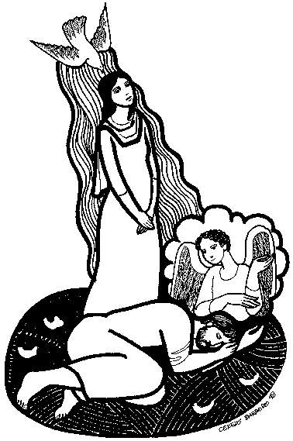
Dec. 24 – Christmas: Vigil Mass
1st Reading: Isa 62:1-5
  “The Lord delights in you.”
Responsorial Psalm: Ps 89:4-5, 16-17, 27+29
  “For ever I will sing the goodness of the Lord.”
2nd Reading: Acts 13:16-17, 22-25
  “Paul bears witness to Christ, the Son of David.”
Alleluia:
  “Tomorrow the wickedness of the earth will be destroyed:
  the Savior of the world will reign over us.”
Gospel: Matt 1:1-25 or Matt 1:18-25
  “The genealogy of Jesus Christ, the Son of David.”
  “Mary will give birth to a son, and you are to name him Jesus.”

Slide 95
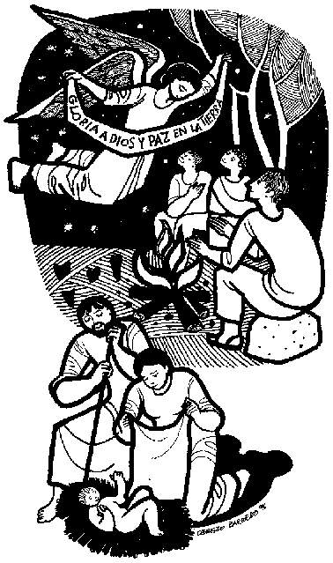
Dec. 24 – Christmas: During the Night
1st Reading: Isa 9:1-6
  “A son is given us.”
Responsorial Psalm: Ps 96:1-2a, 2b-3, 11-12, 13
  “Today is born our Savior, Christ the Lord.”
2nd Reading: Titus 2:11-14
  “The grace of God has appeared to all.”
Alleluia:
  “I proclaim to you good news of great joy: today
  a Savior is born for us, Christ the Lord.” (Luke 2:10-11)
Gospel: Luke 2:1-14
  “Today a Savior has been born for you.”

Slide 96
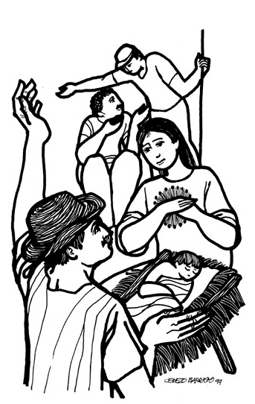
Dec. 24 – Christmas: At Dawn
1st Reading: Isa 62:11-12
  “Behold, you Savior comes!”
Responsorial Psalm: Ps 97:1+6, 11-12
  “A light will shine on us this day: the Lord is born for us.”
2nd Reading: Titus 3:4-7
  “Because of his mercy, he saved us.”
Alleluia:
  “Glory to God in the highest, and on earth peace to those on whom his favor rests.” (Luke 2:14)
Gospel: Luke 2:15-20
  “The shepherds found Mary and Joseph and the infant.”

Slide 97

Dec. 24 – Christmas: During the Day
1st Reading: Isa 52:7-10
  “All the ends of the earth will behold the salvation of our God.”
Responsorial Psalm: Ps 98:1, 2-3a, 3b-4, 5-6
  “All the ends of the earth have seen the saving power of God.”
2nd Reading: Heb 1:1-6
  “God has spoken to us through the Son.”
Alleluia:
  “A holy day has dawned upon us. Come, you nations, and adore
  the Lord. For today a great light has come upon the earth.”
Gospel: John 1:1-18, or 1:1-5, 9-14
  “The Word became flesh
  and made his dwelling among us.”

Slide 98
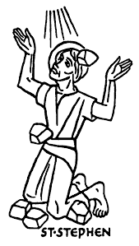
Dec. 26 – St. Stephen
1st Reading: Acts 6:8-10; 7:54-59
  “I see the heavens opened”
  (Account of Stephen’s Martyrdom)
Responsorial Psalm: Ps 31:3cd-4, 6+8ab, 16bc+17
  “Into your hands, O Lord, I commend my spirit.”
Alleluia:
  “Blessed is he who comes in the name of the LORD:
  the LORD is God and has given us light.” (Ps 118:26a+27a)
Gospel: Matt 10:17-22
  “For it will not be you who speak
  but the Spirit of your Father.”

Slide 99
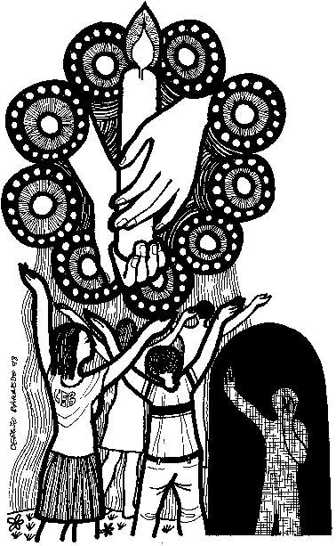
Dec. 27 – St. John
1st Reading: 1 John 1:1-4
  “What we have seen and heard
  we proclaim now to you.”
Responsorial Psalm: Ps 97:1-2, 5-6, 11-12
  “Rejoice in the Lord, you just!”
Alleluia:
  “We praise you, O God, we acclaim you as Lord;
  the glorious company of Apostles praise you.” (See Te Deum)
Gospel: John 20:1a+2-8
  “The other disciple ran faster than Peter
  and arrived at the tomb first.”

Slide 100
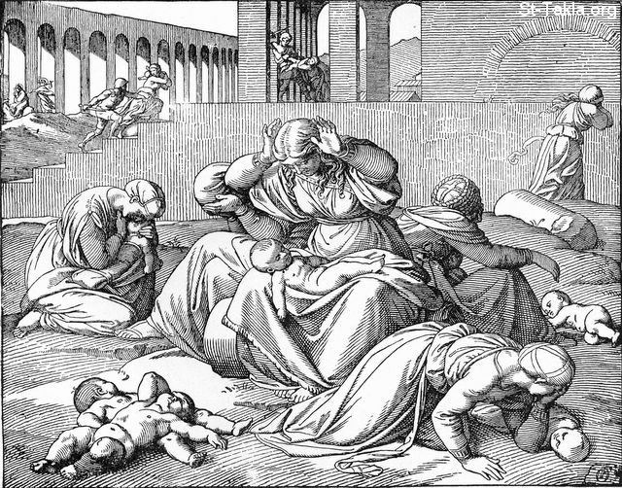
Dec. 28 – Holy Innocents
1st Reading: 1 John 1:5—2:2
  “The Blood of his Son Jesus Christ cleanses us from all sin.”
Responsorial Psalm: Ps 124:2-3, 4-5, 7b-8
  “Our soul has been rescued like a bird from the fowler’s snare.”
Alleluia:
  “We praise you, O God, we acclaim you as Lord;
  the white robed army of martyrs praise you.” (See Te Deum)
Gospel: Matt 2:13-18
  “He ordered the massacre
  of all boys in Bethlehem.”

Slide 101
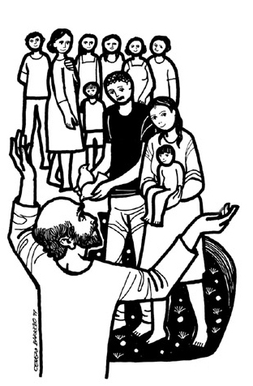
Sunday after Christmas – Holy Family (A)
1st Reading: Sir 3:3-7, 14-17a (Greek 3:2-6, 12-14)
  “Those who fear the Lord honor their parents.”
Responsorial Psalm: Ps 128:1-2, 3, 4-5
  “Blessed are those who fear the Lord and walk in his ways.”
2nd Reading: Col 3:12-21, or 3:12-17
  “Family life in the Lord.”
Alleluia:
  “Let the peace of Christ control your heats; let the word of Christ dwell in you richly.” (Col 3:15a+16a)
Gospel: Matt 2:13-15, 19-23
  “Take the child and his mother, and flee into Egypt.”

Slide 102
Sunday after Christmas – Holy Family (B)
1st Reading (opt.): Gen 15:1-6; 21:1-3
  “Your own issue shall be your heir.”
Responsorial Psalm (opt.): Ps 105:1-2, 3-4, 5-6, 8-9
  “The Lord remembers his covenant for ever.”
2nd Reading (opt.): Heb 11:8, 11-12, 17-19
  “The faith of Abraham, Sarah, and Isaac.”
Alleluia (opt.):
  “In the past God spoke to our ancestors through the prophets; in these last day, he has spoken to us through the Son.” (Heb 1:1-2)
Gospel: Luke 2:22-40, or 2:22, 39-40
  “The child grew and became strong, filled with wisdom.”

Slide 103
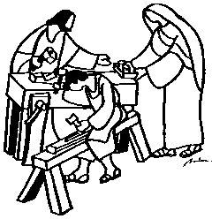
Sunday after Christmas – Holy Family (C)
1st Reading (opt.): 1 Sam 1:20-22, 24-28
  “Samuel, as long as he lives, shall be dedicated to the Lord.”
Responsorial Psalm (opt.): Ps 84:2-3, 5-6, 9-10
  “Blessed are they who dwell in your house, O Lord.”
2nd Reading (opt.): 1 John 3:1-2, 21-24
  “We are called children of God. And so we are.”
Alleluia (opt.):
  “Open our hearts, O Lord, to listen to the words of your Son.” (cf. Acts 16:14b)
Gospel: Luke 2:41-52
  “His parents found Jesus sitting
  in the midst of the teachers.”

Slide 104
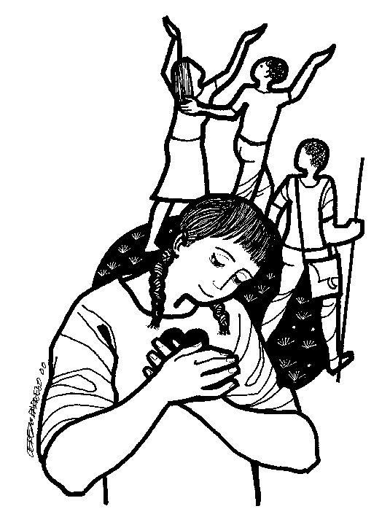
Jan. 1 – Mary, Mother of God
1st Reading: Num 6:22-27
  “They shall invoke my name upon the Israelites,
  and I will bless them.”
Responsorial Psalm: Ps 67:2-3, 5, 6+8
  “May God bless us in his mercy.”
2nd Reading: Gal 4:4-7
  “God sent his Son, born of a woman.”
Alleluia:
  “In the past God spoke to our ancestors through the prophets;
  in these last days, he has spoken to us through the Son.” (Heb 1:1-2)
Gospel: Luke 2:16-21
  “They found Mary and Joseph and the infant.
  When the eight days were completed, he was named Jesus.”

Slide 105
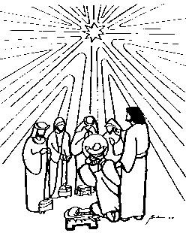
Sunday (Jan. 2-8) – Epiphany
1st Reading: Isa 60:1-6
  “The glory of the Lord shines upon you.”
Responsorial Psalm: Ps 72:1-2, 7-8, 10-11, 12-13
  “Lord, every nation on earth will adore you.”
2nd Reading: Eph 3:2-3a, 5-6
  “Now it has been revealed that the Gentiles are coheirs of the promise.”
Alleluia:
  “We saw his star at its rising and have come to do him homage.”
  (Matt 2:2)
Gospel: Matt 2:1-12
  “We saw his star at its rising and have come to do him homage.”

Slide 106
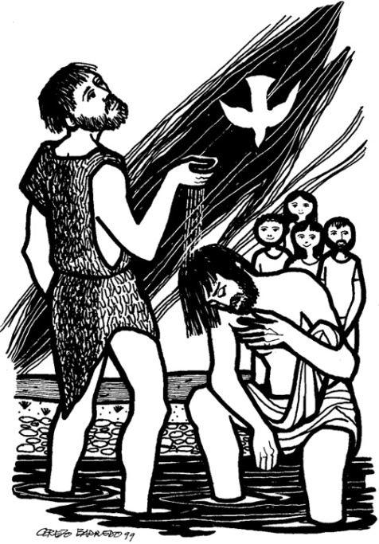
Sunday – Baptism of the Lord (A)
1st Reading: Isa 42:1-4, 6-7
  “Behold my servant with whom I am well pleased.”
Responsorial Psalm: Ps 29:1-2, 3-4, 3b+9b-10
  “The Lord will bless his people with peace.”
2nd Reading: Acts 10:34-38
  “God anointed him with the Holy Spirit.”
Alleluia:
  “The heavens were opened and the voice of the Father thundered: This is my beloved Son, listen to him.” (cf. Mark 9:7)
Gospel: Matt 3:13-17
  “After Jesus was baptized, he saw the Spirit of God coming upon him.”

Slide 107
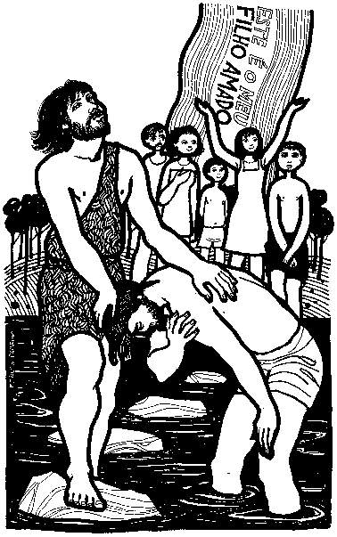
Sunday – Baptism of the Lord (B)
1st Reading (opt.): Isa 55:1-11
  “Come to the waters: listen, that you may have life.”
Responsorial Psalm (opt.): Isa 12:2-3, 4bcd, 5-6
  “You will draw water joyfully from the springs of salvation.”
2nd Reading (opt.): 1 John 5:1-9
  “The Spirit and the water and the blood.”
Alleluia (opt.):
  “John saw Jesus approaching him, and said: Behold
  the Lamb of God who takes away the sin of the world.” (cf. John 1:29)
Gospel: Mark 1:7-11
  “You are my beloved Son, with you I am well pleased.”

Slide 108
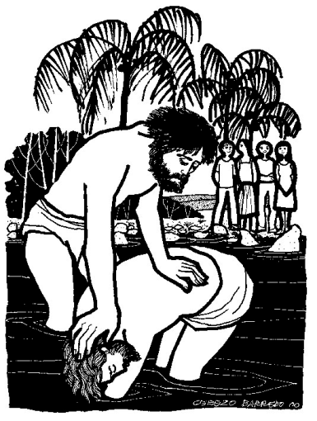
Sunday – Baptism of the Lord (C)
1st Reading (opt.): Isa 40:1-5, 9-11
  “The glory of the Lord shall be revealed and all people shall see it.”
Responsorial Psalm (opt.): Ps 104:1b-2, 3-4, 24-25, 27-28, 29b-30
  “O bless the Lord, my soul.”
2nd Reading (opt.): Titus 2:11-14; 3:4-7
  “Jesus Christ saved us through the bath of rebirth and renewal by the Holy Spirit.”
Alleluia (opt.):
  “John said: One mightier than I is coming; he will baptize you
  with the Holy Spirit and with fire.” (cf. Luke 3:16)
Gospel: Luke 3:15-16, 21-22
  “When Jesus had been baptized and was praying,
  heaven was opened.”

Slide 109

1 John in the Lectionary
Weekdays of Christmas Season
    From Dec. 27 (St. John) to Baptism of the Lord
Sundays of Easter, Year B
    Also a few other feast days each year (optional)
Only Biblical Book included 100%
    But a few texts are omitted each year, due to some moveable feasts in the Christmas Season.

Slide 110
1 John in the Lectionary https://catholic-resources.org/Lectionary/John-Epistles.htm
Lect. # | Day – Feast | First Reading
697 | Dec. 27 - Feast of St. John, Apostle and Evangelist | 1 John 1:1-4
698 | Dec. 28 - Feast of the Holy Innocents, Martyrs | 1 John 1:5—2:2
202 | Dec. 29 - Fifth Day in the Octave of Christmas | 1 John 2:3-11
203 | Dec. 30 - Sixth Day in the Octave of Christmas | 1 John 2:12-17
204 | Dec. 31 - Seventh Day in the Octave of Christmas | 1 John 2:18-21
205 | Jan. 2 - Weekday in the Christmas Season | 1 John 2:22-28
206 | Jan. 3 - Weekday in the Christmas Season (if before Epiphany) | 1 John 2:29—3:6
207 | Jan. 4 - Weekday in the Christmas Season (if before Epiphany) | 1 John 3:7-10
208 | Jan. 5 - Weekday in the Christmas Season (if before Epiphany) | 1 John 3:11-21
212 | Monday after Epiphany (or Jan. 7) | 1 John 3:22—4:6
213 | Tuesday after Epiphany (or Jan. 8) | 1 John 4:7-10
214 | Wednesday after Epiphany (or Jan. 9) | 1 John 4:11-18
215 | Thursday after Epiphany (or Jan. 10) | 1 John 4:19—5:4
209/ 216 | Jan. 6, if Epiphany is celebrated Jan. 7 or 8 or Friday after Epiphany (or Jan. 11) | 1 John 5:5-13
210/ 217 | Jan. 7, if Epiphany is celebrated Jan. 8 or Saturday after Epiphany (or Jan. 12) | 1 John 5:14-21

Slide 111
First Letter of John (1 John)
Composition-historical Issues
    Not a “letter” (no opening); more of a “treatise”
Outline & Contents
    Two main parts? or Three main parts?
Literary Features of 1 John
    Similar to Gospel in vocab & themes
Theological Issues of 1 John
    Teachings about Jesus & God
    Oppose False Teachings

Slide 112
Possible Outlines of 1 John
Two-Part Body (R. Brown)
Three-Part Body (C.H. Dodd)
Prologue (1:1-4)
Walk in the Light of God
(1:5—3:10)
Walk as Children of the
God of Love (3:11—5:12)
Epilogue (5:13-21)
Prologue (1:1-4)
What is Christianity?
(1:5—2:28)
Life in the Family of God (2:29—4:12)
The Certainty of Faith
(4:13—5:13)
Epilogue (5:14-21)

Slide 113
1 John 1:1-4 (NAB) – Dec. 27
What we have seen and heard we proclaim now to you.
Prologue: The Word of Life
¹What was from the beginning,
what we have heard,
what we have seen with our eyes,
what we looked upon
and touched with our hands
concerns the Word of life—
²for the life was made visible;
we have seen it and testify to it
and proclaim to you the eternal life
that was with the Father and was made visible to us—
³what we have seen and heard
we proclaim now to you,
so that you too may have fellowship with us;
for our fellowship is with the Father
and with his Son, Jesus Christ.
⁴We are writing this so that our joy may be complete.

Slide 114
1 John 1:5-10; 2:1-2 (NAB) - Dec. 28
The Blood of his Son Jesus Christ cleanses us from all sin.
God Is Light
⁵Now this is the message that we have heard from him and proclaim to you: God is light, and in him there is no darkness at all.
⁶If we say, “We have fellowship with him,” while we continue to walk in darkness, we lie and do not act in truth.
⁷But if we walk in the light as he is in the light, then we have fellowship with one another, and the blood of his Son Jesus cleanses us from all sin.
⁸If we say, “We are without sin,” we deceive ourselves, and the truth is not in us.
⁹If we acknowledge our sins, he is faithful and just and will forgive our sins and cleanse us from every wrongdoing.
¹⁰If we say, “We have not sinned,” we make him a liar, and his word is not in us.
Chap. 2: Christ and His Commandments
¹My children, I am writing this to you so that you may not commit sin. But if anyone does sin, we have an Advocate with the Father, Jesus Christ the righteous one.ª ²He is expiation for our sins, and not for our sins only but for those of the whole world.^{b}

Slide 115
1 John 2:3-11 (NAB)
Those who love their brother remain in the light.
³The way we may be sure that we know him is to keep his commandments.^{c} ⁴Whoever says, “I know him,” but does not keep his commandments is a liar, and the truth is not in him.^{d} ⁵But whoever keeps his word, the love of God is truly perfected in him. This is the way we may know that we are in union with him:^{e} ⁶whoever claims to abide in him ought to live [just] as he lived.
The New Commandment
⁷Beloved, I am writing no new commandment to you but an old commandment that you had from the beginning. The old commandment is the word that you have heard.^{f} ⁸And yet I do write a new commandment to you, which holds true in him and among you, for the darkness is passing away, and the true light is already shining.^{g} ⁹Whoever says he is in the light, yet hates his brother, is still in the darkness.^{h} ¹⁰Whoever loves his brother remains in the light, and there is nothing in him to cause a fall.^{i} ¹¹Whoever hates his brother is in darkness; he walks in darkness and does not know where he is going because the darkness has blinded his eyes.

Slide 116
1 John 2:12-17 (NAB)
Those who do the will of God remain forever.
Members of the Community
¹² I am writing to you, children, because your sins have been forgiven^{j} for his name’s sake.
¹³ I am writing to you, fathers, because you know him who is from the beginning.
I am writing to you, young men, because you have conquered the evil one.^{k}
¹⁴ I write to you, children, because you know the Father.
I write to you, fathers, because you know him who is from the beginning.
I write to you, young men, because you are strong and the word of God remains in you, and you have conquered the evil one.
¹⁵Do not love the world or the things of the world. If anyone loves the world, the love of the Father is not in him.^{l} ¹⁶For all that is in the world, sensual lust, enticement for the eyes, and a pretentious life, is not from the Father but is from the world. ¹⁷Yet the world and its enticement are passing away. But whoever does the will of God remains forever.^{m}

Slide 117
1 John 2:18-21 (NAB)
You have the anointing that comes from the Holy One, and you have all knowledge.
Antichrists
¹⁸Children, it is the last hour; and just as you heard that the antichrist was coming, so now many antichrists have appeared. Thus we know this is the last hour.^{n} ¹⁹They went out from us, but they were not really of our number; if they had been, they would have remained with us. Their desertion shows that none of them was of our number. ²⁰But you have the anointing that comes from the holy one, and you all have knowledge.º
²¹I write to you not because you do not know the truth but because you do, and because every lie is alien to the truth.^{p}

Slide 118
1 John 2:22-28 (NAB)
Let what you heard from the beginning remain in you.
²² Who is the liar? Whoever denies that Jesus is the Christ. Whoever denies the Father and the Son, this is the antichrist.^{q} ²³No one who denies the Son has the Father, but whoever confesses the Son has the Father as well.^{r}
Life from God’s Anointing
^{24s} Let what you heard from the beginning remain in you. If what you heard from the beginning remains in you, then you will remain in the Son and in the Father. ²⁵And this is the promise that he made us: eternal life.^{t} ²⁶I write you these things about those who would deceive you. ²⁷As for you, the anointing that you received from him remains in you, so that you do not need anyone to teach you. But his anointing teaches you about everything and is true and not false; just as it taught you, remain in him.
Children of God
²⁸ And now, children, remain in him, so that when he appears we may have confidence and not be put to shame by him at his coming.

Slide 119
1 John 2:29; 3:1-6 (NAB)
No one who remains in him sins.
²⁹If you consider that he is righteous, you also know that everyone who acts in righteousness is begotten by him.
^{3:1} See what love the Father has bestowed on us that we may be called the children of God. Yet so we are. The reason the world does not know us is that it did not know him.ª ²Beloved, we are God’s children now; what we shall be has not yet been revealed. We do know that when it is revealed we shall be like him, for we shall see him as he is.^{b} ³Everyone who has this hope based on him makes himself pure, as he is pure.^{c}
Avoiding Sin
⁴Everyone who commits sin commits lawlessness, for sin is lawlessness. ⁵You know that he was revealed to take away sins, and in him there is no sin.^{d} ⁶No one who remains in him sins; no one who sins has seen him or known him.

Slide 120
1 John 3:7-10 (NAB)
Those who are begotten by God commit no sin.
⁷Children, let no one deceive you. The person who acts in righteousness is righteous, just as he is righteous. ⁸Whoever sins belongs to the devil, because the devil has sinned from the beginning. Indeed, the Son of God was revealed to destroy the works of the devil.^{e} ⁹No one who is begotten by God commits sin, because God’s seed remains in him; he cannot sin because he is begotten by God. ¹⁰In this way, the children of God and the children of the devil are made plain; no one who fails to act in righteousness belongs to God, nor anyone who does not love his brother.

Slide 121
1 John 3:11-21 (NAB)
We have passed from death to life because we love out brothers.
Love for One Another
¹¹ For this is the message you have heard from the beginning: we should love one another,^{f} ¹²unlike Cain who belonged to the evil one and slaughtered his brother. Why did he slaughter him? Because his own works were evil, and those of his brother righteous.^{g} ¹³Do not be amazed, [then,] brothers, if the world hates you.^{h} ¹⁴We know that we have passed from death to life because we love our brothers. Whoever does not love remains in death.^{i} ¹⁵Everyone who hates his brother is a murderer, and you know that no murderer has eternal life remaining in him.^{j} ¹⁶The way we came to know love was that he laid down his life for us; so we ought to lay down our lives for our brothers.^{k} ¹⁷If someone who has worldly means sees a brother in need and refuses him compassion, how can the love of God remain in him?^{l} ¹⁸Children, let us love not in word or speech but in deed and truth.^{m}
Confidence before God
¹⁹[Now] this is how we shall know that we belong to the truth and reassure our hearts before him ²⁰in whatever our hearts condemn, for God is greater than our hearts and knows everything. ²¹Beloved, if [our] hearts do not condemn us, we have confidence in God…

Slide 122
1 John 3:22-24; 4:1-6 (NAB)
Test the spirits to see whether they belong to God.
²²[and] We receive from him whatever we ask, because we keep his commandments and do what pleases him.^{n} ²³And his commandment is this: we should believe in the name of his Son, Jesus Christ, and love one another just as he commanded us.º ²⁴Those who keep his commandments remain in him, and he in them, and the way we know that he remains in us is from the Spirit that he gave us.^{p}
Testing the Spirits
¹Beloved, do not trust every spirit but test the spirits to see whether they belong to God, because many false prophets have gone out into the world.ª ²This is how you can know the Spirit of God: every spirit that acknowledges Jesus Christ come in the flesh belongs to God,^{b} ³and every spirit that does not acknowledge Jesus does not belong to God. This is the spirit of the antichrist that, as you heard, is to come, but in fact is already in the world.^{c} ⁴You belong to God, children, and you have conquered them, for the one who is in you is greater than the one who is in the world. ⁵They belong to the world; accordingly, their teaching belongs to the world, and the world listens to them.^{d} ⁶We belong to God, and anyone who knows God listens to us, while anyone who does not belong to God refuses to hear us. This is how we know the spirit of truth and the spirit of deceit.^{e}

Slide 123
1 John 4:7-10 (NAB)
God is love.
God’s Love and Christian Life
⁷ Beloved, let us love one another, because love is of God; everyone who loves is begotten by God and knows God. ⁸Whoever is without love does not know God, for God is love. ⁹In this way the love of God was revealed to us: God sent his only Son into the world so that we might have life through him.^{f} ¹⁰In this is love: not that we have loved God, but that he loved us and sent his Son as expiation for our sins.^{g}

Slide 124
1 John 4:11-18 (NAB)
If we love one another, God remains in us.
¹¹Beloved, if God so loved us, we also must love one another. ¹²No one has ever seen God. Yet, if we love one another, God remains in us, and his love is brought to perfection in us.^{h}
¹³This is how we know that we remain in him and he in us, that he has given us of his Spirit. ¹⁴Moreover, we have seen and testify that the Father sent his Son as savior of the world. ¹⁵Whoever acknowledges that Jesus is the Son of God, God remains in him and he in God. ¹⁶We have come to know and to believe in the love God has for us.
God is love, and whoever remains in love remains in God and God in him. ¹⁷In this is love brought to perfection among us, that we have confidence on the day of judgment because as he is, so are we in this world.^{i} ¹⁸There is no fear in love, but perfect love drives out fear because fear has to do with punishment, and so one who fears is not yet perfect in love.

Slide 125
1 John 4:19-21; 5:1-4 (NAB)
Those who love God must also love their brother and sister.
¹⁹We love because he first loved us. ²⁰If anyone says, “I love God,” but hates his brother, he is a liar; for whoever does not love a brother whom he has seen cannot love God whom he has not seen.^{j} ²¹This is the commandment we have from him: whoever loves God must also love his brother.^{k}
Faith is Victory over the World
^{5:1} Everyone who believes that Jesus is the Christ is begotten by God, and everyone who loves the father loves [also] the one begotten by him. ²In this way we know that we love the children of God when we love God and obey his commandments. ³For the love of God is this, that we keep his commandments. And his commandments are not burdensome, ⁴for whoever is begotten by God conquers the world. And the victory that conquers the world is our faith.

Slide 126
1 John 5:5-13 (NAB)
The Spirit, the water, and the blood.
⁵Who indeed is the victor over the world but the one who believes that Jesus is the Son of God?
⁶This is the one who came through water and blood, Jesus Christ, not by water alone, but by water and blood. The Spirit is the one that testifies, and the Spirit is truth. ⁷So there are three that testify, ⁸the Spirit, the water, and the blood, and the three are of one accord. ⁹If we accept human testimony, the testimony of God is surely greater. Now the testimony of God is this, that he has testified on behalf of his Son. ¹⁰Whoever believes in the Son of God has this testimony within himself. Whoever does not believe God has made him a liar by not believing the testimony God has given about his Son. ¹¹And this is the testimony: God gave us eternal life, and this life is in his Son. ¹²Whoever possesses the Son has life; whoever does not possess the Son of God does not have life.
Epilogue: Prayer for Sinners
¹³ I write these things to you so that you may know that you have eternal life, you who believe in the name of the Son of God.

Slide 127
1 John 5:14-21, Epilogue (NAB)
God hears us in regard to whatever we ask.
¹⁴[And] we have this confidence in him, that if we ask anything according to his will, he hears us. ¹⁵And if we know that he hears us in regard to whatever we ask, we know that what we have asked him for is ours. ¹⁶If anyone sees his brother sinning, if the sin is not deadly, he should pray to God and he will give him life. This is only for those whose sin is not deadly. There is such a thing as deadly sin, about which I do not say that you should pray. ¹⁷All wrongdoing is sin, but there is sin that is not deadly.
¹⁸We know that no one begotten by God sins; but the one begotten by God he protects, and the evil one cannot touch him. ¹⁹We know that we belong to God, and the whole world is under the power of the evil one. ²⁰We also know that the Son of God has come and has given us discernment to know the one who is true. And we are in the one who is true, in his Son Jesus Christ. He is the true God and eternal life. ²¹Children, be on your guard against idols.

Slide 128
Questions about 1 John?

Slide 129
John 1:1-5, 9-14
In the beginning was the Word,
and the Word was with God, and the Word was God.
He was in the beginning with God.
All things came to be through him, and without him nothing came to be.
What came to be through him was life,
and this life was the light of the human race;
the light shines in the darkness, and the darkness has not overcome it.
The true light, which enlightens everyone, was coming into the world.
He was in the world, and the world came to be through him,
but the world did not know him.
He came to what was his own, but his own people did not accept him.
But to those who did accept him he gave power to become children of God,
to those who believe in his name, who were born not by natural generation
nor by human choice nor by a man’s decision but of God.
And the Word became flesh and made his dwelling among us,
and we saw his glory, the glory as of the Father’s only Son, full of grace and truth.

Slide 130
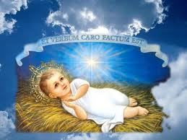
Highlight of John’s Prologue?
Common Opinion:
  It’s all about Jesus! Central point in verse 14:
  “The word became flesh and dwelt among us”

Slide 131
John’s Prologue in the Lectionary
Third Sunday of Advent, Year B
  John 1:6-8, 19-28 (Witness of John the Baptizer)
Christmas, Mass during the Day
  John 1:1-18 (or shorter, 1:1-5, 9-14)
  Also for 2nd Sunday after Christmas,
  but omitted if Epiphany is transferred to Sunday
Dec. 31: Weekday in Christmas Season
  John 1:1-18
Roman Missal before Vatican II
  “Second Gospel” read at end of every Mass

Slide 132


Johann Christoph Weigel, 1695
John 1:1 John 1:14

Slide 133
Johannine Christology
Titles for Jesus from the Synoptic Gospels
  Christ / Messiah; Lord / Sir / Master; Savior
  Rabbi / Rabbouni; Teacher
  Son of God; Son of Man
  Son of David; King of the Jews; King of Israel
New Titles for Jesus in the Fourth Gospel
  Logos/Word of God; Unique/One-of-a-kind Son
  One who comes from above
  One sent from the Father
  Lamb of God, Passover Lamb
  Equal to God; I AM

Slide 134
Main Message of John’s Gospel
Not just Christology, but also Discipleship
  Not just about JESUS, but also about US!
  How do WE respond to the message about Him?
  To understand this, let’s analyze
  the literary structure of John’s Prologue
John 1:1-18 is written as a CHIASM
  Are you familiar with “Chiastic” structures?

Slide 135
Literary Structures: CHIASM
“Chiasm” or “Chiasmus” or “Chiastic Text”
  Greek letter Chi (shaped “X”): look at left side only
  Ancient rhetorical style: helps in memorizing texts
  First & second halves balanced: in reverse order
  Highlight in the Middle: not like today, climax at end
    A B A’
    A B C B’ A’
    A B C D C’ B’ A’
    A B C D E D’ C’ B’ A’
    A B C D E F G H I J K J’ I’ H’ G’ F’ E’ D’ C’ B’ A’
    etc.

Slide 136
Literary Structures: CHIASM
Χ
A
  B
    C
      D
      E
      D’
    C’
  B’
A’

Slide 137
Examples of Ancient Chiasms
Χ
Old Testament:
  Gen 17:1-25
  Exod 3:7-20
  Deut 32
  Isaiah (several)
  Eccl 11:3—12:2
New Testament:
  2 Thess 2:1-14
  Col? Eph?
  Phlm?
  Hebr 12:1-2

Slide 138
Examples of Chiasms in John
Χ
John 1:1-18
John 2:13-22
John 6:1-15
John 6:16-25
John 13:1-21
John 17:1-28
All of John 13–17
John 21:1-14
Many more

Slide 139
The Johannine Prologue (on H.O.)
A) 1-2: The Divine LOGOS was with God eternally
  B) 3: All things came into being through him (the Logos)
    C) 4-5: In him was life and light, which darkness did not overcome
      D) 6-8: [John was not the light, but came to testify about the light]
        E) 9-10: The True Light was in the world, but the world did not recognize him
        F) 11-13: He came into his own realm, but his own people did not accept him
        G) 12: THOSE WHO BELIEVE IN HIM BECOME CHILDREN OF GOD
        F’) 13: These believers are not ordinary human offspring, but are born of God
        E’) 14: The Incarnate LOGOS reveals God’s glory, full of grace and truth
      D’) 15: [John testified about the priority of the one coming after him]
    C’) 16: Out of his (the Logos’) fullness, we all received grace upon grace
  B’) 17: Grace and truth came into being through JESUS CHRIST
A’) 18: The unique SON has revealed God/Father

Slide 140
Central Point of John’s Prologue
Verse 12:
  “But as many as did receive him,
  he gave to them authority
  to become children of God,
  to those who believe in his name”
Jesus Presents Everyone with a CHOICE:
  Receive / Accept / Confess / Believe / See / Know / Remain / Live / Dwell / Abide / etc.
  Vs. Reject / Deny / Not believe / Go / Die / etc.

Slide 141
Results of Believing
Becoming "children of God" (1:12)
Having "eternal life" already now (3:15-16, 36; 5:24; 6:40, 47)
"Not perishing" (3:16); "not being condemned" (3:18); "not coming under judgment" (5:24); never being "hungry" or "thirsty" (6:35)
"Knowing" Jesus and the Father (4:42; 6:64, 69; 10:38)
Passing from death to life (5:24); living and never dying (11:25-26)
Abiding/living/remaining in Jesus & in God (6:56; 14:17; 15:4-10)
Having "living water" flow out of one's heart (7:38)
Receiving the Holy Spirit (7:39; 14:26; 15:26; 16:13; 20:22)
Being "disciples" of Jesus (8:31); being Jesus' "friends“ (15:14-15)
Seeing the "glory of God" (11:40); seeing "greater things" (1:50)
Becoming "children of light" (12:36); not "remaining in darkness" (12:46)
Doing the works that Jesus does, or even "greater works" (14:12)
Having "life in his name" (20:31)

Slide 142
Wrap-Up
Questions? Comments?
  Please “RAISE YOUR HANDS” (electronically)
  OR Type a Comment/Question in the “Chat”
Overview of Christmas:
  http://catholic-resources.org/Lectionary/1998USL-Christmas.htm
More on Biblical Texts:
  http://catholic-resources.org/Bible/
Next Session: Gospel of Mark (Lect. Year B)
  Sat., Jan. 9, 2021

Slide 143

Give Us This Day
Monthly Missalette
  from Liturgical Press (Benedictines, Collegeville, MN)
  Daily MP & EP (2 pages each)
  Daily Mass Readings & Prayers
  Daily Reflections on the Readings (1 page each)
  Daily “Blessed among Us” (1 page each)
  Weekly “Within the Word” Articles (2 pages each)
  Monthly articles on other topics of prayer/spirituality
  In Print and/or smart-phone APP
Free Samples:
  https://giveusthisday.org/frfelix
  Request a print copy of an issue to be mailed to you,
  or download the app with free use for 30 days

Slide 144


Audio CD Programs by Fr. Felix
New Testament: Guided Tour
The Lectionary for Mass
What Is Faith?
Retreat with Gospel of Mark
Retreat with Gospel Matthew
Retreat with Gospel of Luke
Retreat with Gospel of John
Available on CD from Fr. Felix Just, SJ,
or downloadable files from Learn 25;
prices vary by length of program
Learn 25

Slide 145
“Living Word” Webinar Series
Zoom Webinars on the Lectionary for Mass
  Saturdays, 9:00 a.m. – 12:30 p.m. (Pacific Time)
  Open to the Public (feel free to invite others)
  FREE (but donations appreciated)
Monthly, from Nov. 2020 to April 2021
  Nov. 21, 2020 – Readings of Advent
  Dec. 19, 2020 – Readings of the Christmas Season
  Jan. 9, 2021 – Gospel of Mark (Liturgical Year B)
  Feb. 13, 2021 – Readings of Lent
  March 27, 2021 – Readings of Holy Week & Triduum
  April 17, 2021 – Readings of the Easter Season

Slide 146
DONATIONS
If you’d like to support MSMU’s Ecclesia program and Living Word Catholic Biblical Ministries, please make a tax-deductible donation, so that we can offer more webinars and other programs to anyone, regardless of their financial circumstances.
  We cannot accept online donations yet, but hope to enable this feature soon.
Please make your check payable to "LMU Jesuit Community."
Then mail your check to:
  Fr. Felix Just, SJ
  LMU Jesuit Community
  PO Box 45041
  Los Angeles, CA 90045

Slide 147
Upcoming Pilgrimages
In the Footsteps of Jesus:
Pilgrimage to the Holy Land (Israel & Palestine)
  Dec. 26, 2021 to Jan. 9, 2022
The Oberammergau Passion Play:
Pilgrimage to Austria and Germany
  May 14-22, 2022
May 2023
  In the Footsteps of St. Paul: Pilgrimage to Turkey
May 2024
  In the Footsteps of Jesus: Pilgrimage to the Holy Land
May 2025
  In the Footsteps of St. Paul: Pilgrimage to Greece

Slide 148
Closing: Christmas Prayer
God and Father of Jesus,
You sent your Son to be our Savior,
Our Light in the darkness,
Our Hope in the face of threat,
Our Peace amid turmoil.
In Word and Sacrament we have seen him
And we know that your promises are true.
Send us forth to live in hope and peace,
Until we gather again – here, and at the Table.
May Christmas Blessings bring us comfort and joy.
Amen.

Slide 149
IMAGE CREDITS
https://catholic-resources.org/Art/
http://www.4catholiceducators.com/
http://www.mscperu.org/grafic/graficoslit/adviento_navidad/indexgraf_advnav.htm
http://www.servicioskoinonia.org/cerezo/indexBgraf.html
https://catholicartworks.com/Product_Pages/look_learn/llco076.htm
https://www.usccb.org/prayer-and-worship/liturgical-year-and-calendar/advent
https://www.google.com/search?
New:
https://onlineministries.creighton.edu/CollaborativeMinistry/Advent/O-Antiphons.html

Slide 150
God Bless You!
Thanks for participating today!
  More Questions or Comments?
  Feel Free to Stay Online
  May you have a
  Blessed Christmas
  and a
  Joyful New Year!

