Slide 1
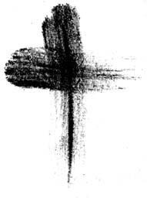
Mount Saint Mary’s University “Ecclesia” Program Presents:
Living Word: Scriptures of the 2021 Liturgical Year
Lectionary Readings for the
Season of Lent
Fr. Felix Just, S.J., Ph.D.
Living Word Catholic Biblical Ministries
http://catholic-resources.org

Slide 2
Welcome to “Living Word”!
Zoom Webinars Series co-sponsored by:
  “Ecclesia” Program of Mount Saint Mary’s University, LA
    Gail Gresser, Director of Campus Ministry
    “Serving those who serve the Church”
  “Living Word Catholic Biblical Ministries,” Los Angeles
    New name for Fr. Felix’s adult faith-formation programs
Welcome to All, especially :
  Prior “Ecclesia” program participants
  Prior and Future “Holy Land Pilgrims”
  Bible Institute Participants from CA, AZ, and Michigan!
  Other NEW folks, here for the first time!

Slide 3

Opening Prayer: for Ash Wednesday
Merciful God,
you called us forth from the dust of the earth;
you claimed us for Christ in the waters of baptism.
Look upon us as we enter these Forty Days bearing the mark of ashes,
and bless our journey through the desert of Lent to the font of rebirth.
May our fasting be hunger for justice;
our alms, a making of peace;
our prayer, the chant of humble and grateful hearts.
All that we do and pray is in the name of Jesus,
for in his cross you proclaim your love
for ever and ever. Amen.
— Catholic Household Blessings and Prayers

Slide 4
“Living Word” Webinar Series
Zoom Webinars on the Catholic Lectionary for Mass
  Saturdays, 9:00 a.m. – 12:30 p.m. (Pacific Time)
  Open to the Public (feel free to invite others)
  FREE (but donations appreciated)
Monthly, from Nov. 2020 to April 2021
  Nov. 21, 2020 – Readings of Advent
  Dec. 19, 2020 – Readings of the Christmas Season
  Jan. 9, 2021 – Gospel of Mark (Liturgical Year B)
  Feb. 13, 2021 – Readings of Lent
  March 27, 2021 – Readings of Holy Week & Triduum
  April 17, 2021 – Readings of the Easter Season

Slide 5
DONATIONS
Please support MSMU’s Ecclesia program and Living Word Catholic Biblical Ministries. Make a tax-deductible donation, so that we can offer more webinars and other programs to anyone, regardless of their financial circumstances.
  Online donations can be made through VenMo: @Jesuits-LMU
  and soon hope to accept donations through PayPal also.
Or, make your check payable to "LMU Jesuit Community."
  Please write "Ecclesia Webinars" or "Living Word Series" in the memo field.
Then mail your check to:
  Fr. Felix Just, SJ
  LMU Jesuit Community
  PO Box 45041
  Los Angeles, CA 90045
THANKS!

Slide 6
Lectionary Readings
Basic Questions of This Year’s Webinar Series:
WHICH biblical texts are read at Catholic Masses?
  Seasons: Advent; Christmas; Lent; Easter; Ordinary Time
  Sundays/Feasts: 1st Reading, Psalm, 2nd Reading, Alleluia, Gospel
  Weekdays: 1st Reading, Psalm, Alleluia, Gospel
WHY were the assigned readings chosen?
  Brief “Rationale” in Lectionary’s “Introduction” (in printed editions)
    Chap. 2 in 1969 edition; or Chap. 5 in 1981 edition.
    Season by season; first Sundays/Feasts, then Weekdays
For charts, handouts, more info, see my website:
http://catholic-resources.org/Lectionary/
  Also has the full text of the 1981 “Introduction”

Slide 7
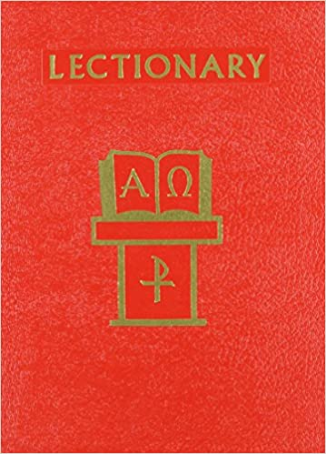
Liturgical Season of LENT
Outline of Today’s Webinar:
  Intro & Overview: Lenten Sunday Gospels, ABC
  Lent Sundays: Readings for 2021 (Year B)
  Lent Weekdays: Readings used each year
  Ten minute breaks after each part.
Lectionary for Mass Website:
  http://catholic-resources.org/Lectionary

Slide 8
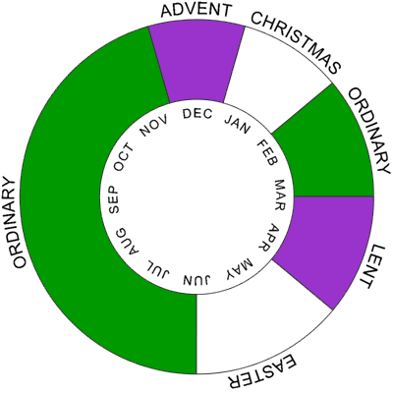
Christian Liturgical Year
Based on Life of Jesus:
  Advent
  CHRISTMAS
  Ordinary Time I
    After Epiphany/Baptism
  Lent
  EASTER
  Ordinary Time II
    After Pentecost
Some Confusions:
  Fitting ~33 years of his life into each calendar year today.

Slide 9
What is “Lent”?
Latin Quadragesima = “Fortieth”
Spanish Cuaresma; Portuguese quaresma;
Italian Cuaresima; French Car ême
German Fasten-zeit
Danish faste; Dutch Vasten
“LENT” < Old English lencten ;
<Germanic “lengthening of the days” (in Spring)
cf. Dutch lente = Spring
So, LENT = “Forty Days of Fasting in Spring”?
  Fasting, Prayer, Almsgiving; Repentance & Penance!
  But also Preparation for Easter, esp. Catechumens about to be Baptized

Slide 10
How Long Is Lent?
Forty Days? – Really?
  Ash Wednesday to Holy Saturday are actually 46 days!
Drop Sundays?
  Common idea: “Sundays are day of, but not in Lent”?
  No, because Lent ends Holy Thursday, not Saturday
Answer: Lent got longer over the centuries!
  Originally 3 days of fasting & prayer for catechumens
  just before their baptisms at the Easter Vigil
  Then extended to one week of fasting & preparation (Holy Week)
  Then lengthened to forty days (begins on 1st Sunday)
  Then four more days added at the beginning (Ash Wed.)
  So now actually 44 days! (incl. Sundays, but ending Holy Thurs.)

Slide 11
Meaning of “40”?
Acc. to Synoptics, Jesus spent "forty days" in the desert before his public ministry
(Mark 1:13; Luke 4:2). Matthew specifies it was "forty days and forty nights" (Matt 4:2).
Whether it was precisely forty days is theologically irrelevant, since "forty" is highly symbolic in the Bible, representing "a long time," esp. as a time of trial or testing.
FORTY DAYS:
  Story of Noah and Great Flood: it rains for "forty days and forty nights" (Gen 7:4, 12, 17; 8:6).
  Full forty days to embalm the body of Jacob, according to Egyptian practice (Gen 50:3).
  Moses spends "forty days and forty nights" on Mount Sinai when receiving the Law from God
  (Exod 24:18; cf. Deut 9:9-25).
  Moses spends another "forty days and forty nights" on the mountain, encountering God a second time
  (Exod 34:28; cf. Deut 10:10)
  The Israelite spies scout out the Promised Land for forty days (Num 13:25, 34); but due to their lack of faith, God requires the Israelites to wander in the desert for forty years (see below).
  Philistine Goliath taunts the Israelite army for forty days before David fights him (1 Sam 17:16).
  Prophet Elijah travels forty days and forty nights to Mount Horeb to encounter God (1 Kings 19:8).
  Prophet Ezekiel lies on his right side for forty days to symbolize the sins of the people of Judah (Ezek 4:6).
  Prophet Jonah preaches to Assyrians, "Forty days more, and Nineveh shall be overthrown" (Jonah 3:4).
  After his resurrection, Jesus appears to his disciples for forty days, before ascending into heaven (Acts 1:3).

Slide 12
Meaning of “40”?
FORTY YEARS:
  Moses & Israelites wandered in desert for forty years, mentioned in many biblical texts (Exod 16:35; Num 14:33-34; 32:13; Deut 2:7; 8:2-4; 29:5; Josh 5:6; Neh 9:21; Ps 95:10; Amos 2:10; 5:25; Acts 7:36, 42; 13:18; Heb 3:10, 17).
  Several biblical figures are forty years old when they marry (Isaac in Gen 25:20; Esau in Gen 26:34),
  or when other life-changing events take place (Joshua in Josh 14:7).
  After some Israelite spies scout out the Promised Land for forty days (see above),
  God requires the Israelites to wander in the desert for forty years, due to their lack of faith (Num 14:33-34).
  Several "Judges" enable the land of Israel to have "rest" for forty years, including Othniel (Judg 3:11), Deborah (5:31), Gideon (8:28), and Eli (1 Sam 4:18).
  When Israelites sin, God lets enemies dominate/harrass them for forty years (the Philistines in Judg 13:1).
  Ezekiel prophesies that Egyptians will also be punished for forty years (Ezek 29:11-13).
  Several great kings reign over Israel for forty years, including David (2 Sam 5:4; 1 Kgs 2:11; 1 Chron 29:27), Solomon (1 Kgs 11:42; 2 Chron 9:30), Jehoash (2 Kgs 12:1; aka Joash, 2 Chron 24:1).
  Forty years is an especially prominent time period in the Acts of the Apostles:
    a man healed by Peter and John is said to be "more than forty years old" (Acts 4:22);
    Moses was forty years old when he killed the Egyptian (7:23);
    Moses' encounter with God in the burning bush takes place forty years later (7:30);
    the Israelites spent forty years in the desert (7:36, 42; 13:18);
    and King Saul supposedly ruled over Israel for forty years (13:21).

Slide 13

Main Parts of Lent
First Four Days:
  Ash Wednesday & 3 days “after Ash Wednesday”
Five Main Weeks of Lent:
  sequentially numbered: 1, 2, 3, 4, 5
Holy Week (only in part):
  Palm/Passion Sunday to Holy Thursday afternoon
Note:
  The Easter Triduum is part of “Holy Week,” but not part of “Lent”
  Lent technically ends at sunset on Holy Thursday

Slide 14
Catholic Lectionary for Mass
https://catholic-resources.org/Lectionary/
  Large section of my website
    Explains both pre-Vatican II and post-Vatican II Lectionaries
    Other websites have “Revised Common Lectionary” (mainline Protestants)
  Charts of Readings for each Liturgical Season
    Advent, Christmas, Lent, Easter, Ordinary Time, Saints, Rituals, etc.
    Study the tables either horizontally or vertically.
Connections between readings
  Horizontal: Connect the various readings used on one day.
    See the “headings” above each reading in a printed Lectionary
  Vertical: Consider all the readings of one type per season.
    All the Gospels of Advent, all the first readings of Easter, etc.

Slide 15


Lectionary Structure: Sundays
Three-Year Cycle:
  Matthew (2020)
  Mark (2021)
  Luke (2022)
  Lent & Easter ABC: JOHN
Three Main Readings:
  OT Reading
  + Responsorial Psalm
  NT Epistles
  + Gospel Acclamation
  NT Gospel
See https://catholic-resources/Lectionary

Slide 16
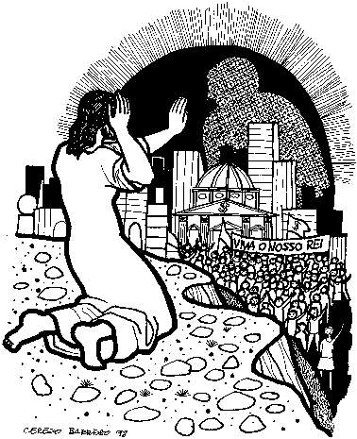
1st Sunday of Lent – Year A
1st Reading: Gen 2:7-9; 3:1-7
  “The creation of our first parents, and sin.”
Responsorial: Psalm 51:3-4, 5-6, 12-13, 14+17
  “Be merciful, O Lord, for we have sinned.”
2nd Reading: Rom 5:12-19, or 5:12, 17-19
  “Where sin increased, there grace increased all the more.”
Verse before the Gospel: Matt 4:4b
  “One does not live on bread alone,
  but on every word that comes forth from the mouth of God.”
Gospel: Matt 4:1-11
  “Jesus fasted for forty days and forty nights and was tempted.”

Slide 17
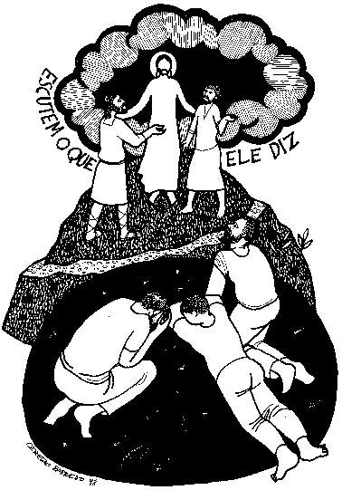
2nd Sunday of Lent – Year A
1st Reading: Gen 12:1-4a
  “The call of Abraham, the father of God’s people.”
Responsorial: Psalm 33:4-5, 18-19, 20+22
  “Lord, let your mercy be on us, as we place our trust in you.”
2nd Reading: 2 Tim 1:8b-10
  “God has saved us and called us to be holy.”
Verse before the Gospel: cf. Matt 17:5
  “From the shining cloud the Father’s voice is heard:
  This is my beloved Son, hear him.”
Gospel: Matt 17:1-9
  “Jesus’ face shone like the sun.”

Slide 18
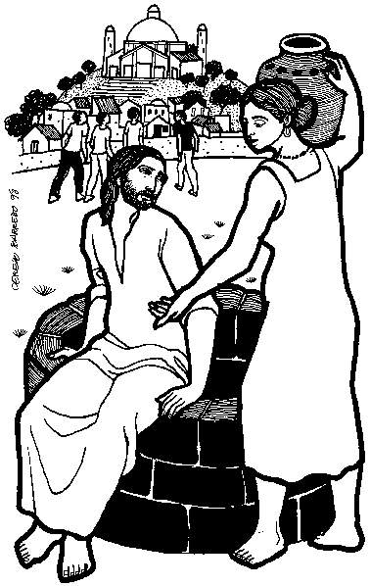
3rd Sunday of Lent – Year A
1st Reading: Exod 17:3-7
  “Give us water, so that we may drink.”
Responsorial: Psalm 95:1-2, 6-7b, 7c-9
  “If today you hear his voice, harden not your hearts.”
2nd Reading: Rom 5:1-2, 5-8
  “The love of God has been poured into our hearts
  through the Holy Spirit that has been given to us.”
Verse before the Gospel: cf. John 4:42+15
  “Lord, you are truly the savior of the world;
  give me living water, that I may never thirst again.”
Gospel: John 4:5-42,
or 4:5-15, 19b-26, 39a, 40-42
  “The water that I shall give will become a spring of eternal life.”

Slide 19
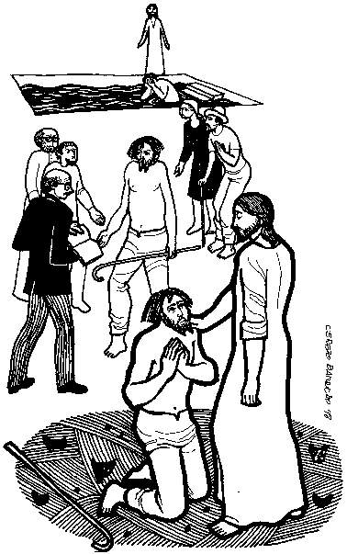
4th Sunday of Lent – Year A
1st Reading: 1 Sam 16:1b, 6-7, 10-13a
  “David is anointed as king of Israel.”
Responsorial: Psalm 23:1-3a, 3b-4, 5, 6
  “The Lord is my shepherd; there is nothing I shall want.”
2nd Reading: Eph 5:8-14
  “Arise from the dead, and Christ will give you light.”
Verse before the Gospel: John 8:12
  “I am the light of the world, says the Lord;
  whoever follows me will have the light of life.”
Gospel: John 9:1-41,
or 9:1, 6-9, 13-17, 34-38
  “The man who was blind went off
  and washed himself and came back able to see.”

Slide 20
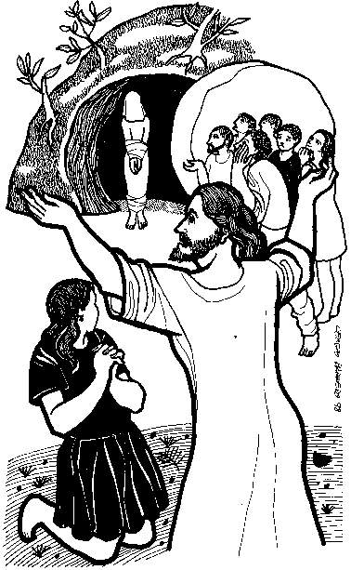
5th Sunday of Lent – Year A
1st Reading: Ezek 37:12-14
  “I will put my spirit in you that you may live.”
Responsorial: Psalm 130:1-2, 3-4, 5-6, 7-8
  “With the Lord there is mercy and fullness of redemption.”
2nd Reading: Rom 8:8-11
  “The Spirit of the One who raised Jesus from the dead dwells in you.”
Verse before the Gospel: John 11:25a+26
  “I am the resurrection and the life, says the Lord;
  whoever believes in me, even if he dies, will never die.”
Gospel: John 11:1-45,
or 11:3-7, 17, 20-27, 33b-45
  “I am the resurrection and the life.”

Slide 21
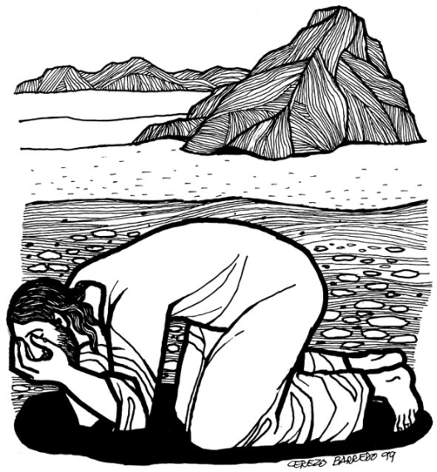
1st Sunday of Lent – Year B
1st Reading: Gen 9:8-15
  “God’s covenant with Noah when he was delivered from the flood.”
Responsorial: Psalm 25:4-5, 6-7, 8-9
  “Your ways, O Lord, are love and truth to those who keep your covenant.”
2nd Reading: 1 Pet 3:18-22
  “The water of the flood prefigured baptism, which saves you now.”
Verse before the Gospel: Matt 4:4b
  “One does not live on bread alone,
  but on every word that comes forth from the mouth of God.”
Gospel: Mark 1:12-15
  “Jesus was tempted by Satan,
  and the angels ministered to him.”

Slide 22
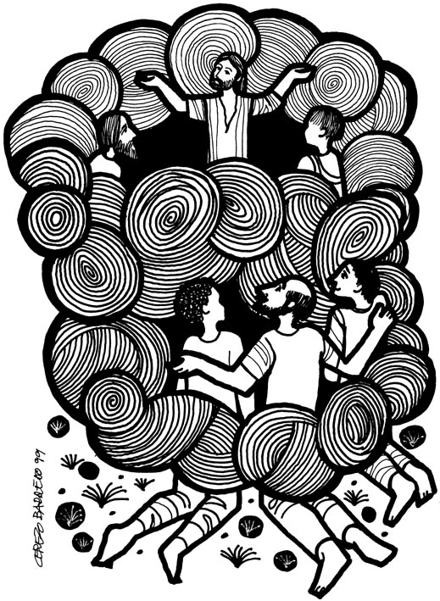
2nd Sunday of Lent – Year B
1st Reading: Gen 22:1-2, 9a, 10-13, 15-18
  “The sacrifice of Abraham, our father in faith.”
Responsorial: Psalm 116:10+15, 16-17, 18-19
  “I will walk before the Lord, in the land of the living.”
2nd Reading: Rom 8:31b-34
  “God did not spare his own Son.”
Verse before the Gospel: cf. Matt 17:5
  “From the shining cloud the Father’s voice is heard:
  This is my beloved Son, hear him.”
Gospel: Mark 9:2-10
  “This is my beloved Son.”

Slide 23
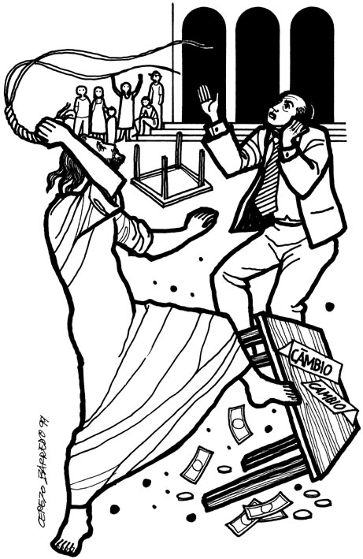
3rd Sunday of Lent – Year B
1st Reading: Exod 20:1-17, or 20:1-3, 7-8, 12-17
  “The law was given through Moses.”
Responsorial: Psalm 19:8, 9, 10, 11
  “Lord, you have the words of everlasting life.”
2nd Reading: 1 Cor 1:22-25
  “We proclaim Christ crucified, a stumbling block to many,
  but to those who are called, the wisdom of God.”
Verse before the Gospel: John 3:16
  “God so loved the world that he gave his only Son,
  so that everyone who believes in him might have eternal life.”
Gospel: John 2:13-25
  “Destroy this temple, and in three days I will raise it up.”

Slide 24
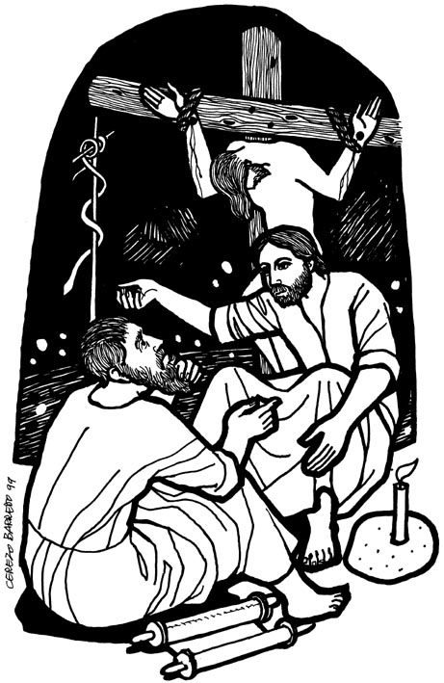
4th Sunday of Lent – Year B
1st Reading: 2 Chr 36:14-16, 19-23
  “The wrath and the mercy of the Lord are revealed
  in the exile and liberation of his people.”
Responsorial: Psalm 137:1-2, 3, 4-5, 6
  “Let my tongue be silenced, if I ever forget you.”
2nd Reading: Eph 2:4-10
  “Though dead in your transgressions,
  by grace you have been saved.”
Verse before the Gospel: John 3:16
  “God so loved the world that he gave his only Son,
  so that everyone who believes in him might have eternal life.”
Gospel: John 3:14-21
  “God sent his Son so that the world might be saved through him.”

Slide 25
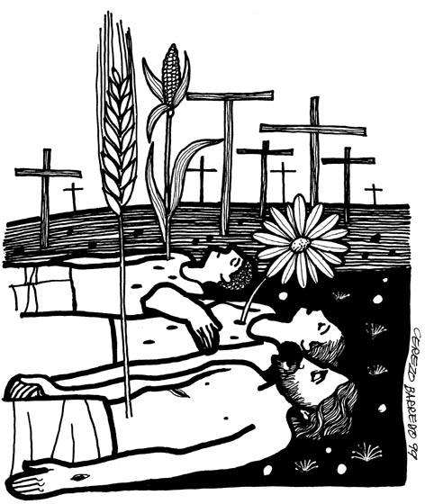
5th Sunday of Lent – Year B
1st Reading: Jer 31:31-34
  “I will make a new covenant and remember their sin no more.”
Responsorial: Psalm 51:3-4, 12-13, 14-15
  “Create a clean heart in me, O God.”
2nd Reading: Heb 5:7-9
  “Christ learned obedience and became the source of eternal salvation.”
Verse before the Gospel: John 12:26
  “Whoever serves me must follow me, says the Lord;
  and where I am, there also will my servant be.”
Gospel: John 12:20-33
  “If a grain of wheat falls to the ground and dies,
  it produces much fruit.”

Slide 26
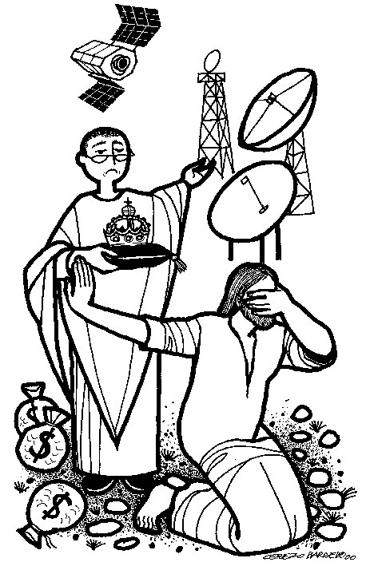
1st Sunday of Lent – Year C
1st Reading: Deut 26:4-10
  “The confession of faith of the chosen people.”
Responsorial: Psalm 91:1-2, 10-11, 12-13, 14-15
  “Be with me, Lord, when I am in trouble.”
2nd Reading: Rom 10:8-13
  “The confession of faith of all believers in Christ.”
Verse before the Gospel: Matt 4:4b
  “One does not live on bread alone,
  but on every word that comes forth from the mouth of God.”
Gospel: Luke 4:1-13
  “Jesus was led by the Spirit into the desert and was tempted.”

Slide 27
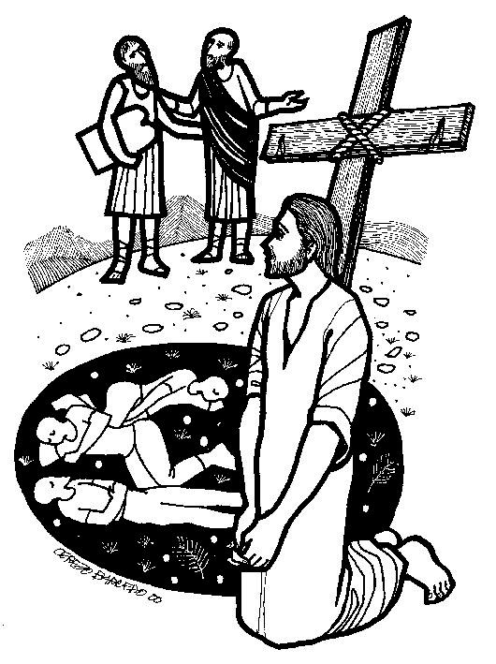
2nd Sunday of Lent – Year C
1st Reading: Gen 15:5-12, 17-18
  “God made a covenant with Abraham, his faithful servant.”
Responsorial: Psalm 27:1, 7-8a, 8b-9, 13-14
  “The Lord is my light and my salvation.”
2nd Reading: Phil 3:17–4:1, or 3:20–4:1
  “Christ will change our lowly body to conform with his glorified body.”
Verse before the Gospel: cf. Matt 17:5
  “From the shining cloud the Father’s voice is heard:
  This is my beloved Son, hear him.”
Gospel: Luke 9:28b-36
  “While he was praying his face changed in appearance
  and his clothing became dazzling white.”

Slide 28
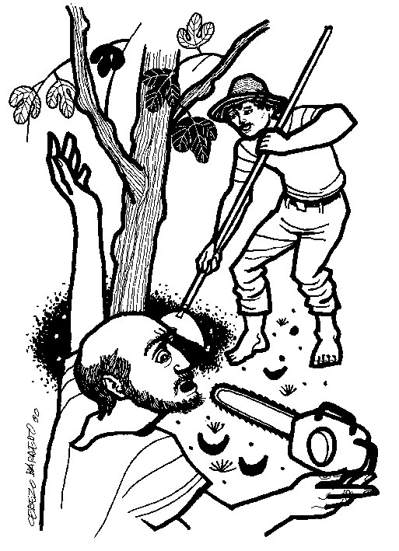
3rd Sunday of Lent – Year C
1st Reading: Exod 3:1-8a, 13-15
  “ ‘I AM’ sent me to you.”
Responsorial: Psalm 103:1-2, 3-4, 6-7, 8+11
  “The Lord is kind and merciful.”
2nd Reading: 1 Cor 10:1-6, 10-12
  “The life of the people with Moses in the desert
  was written down as a warning to us.”
Verse before the Gospel: Matt 4:17
  “Repent, says the Lord; the kingdom of heaven is at hand.”
Gospel: Luke 13:1-9
  “If you do not repent, you will all perish as they did.”

Slide 29
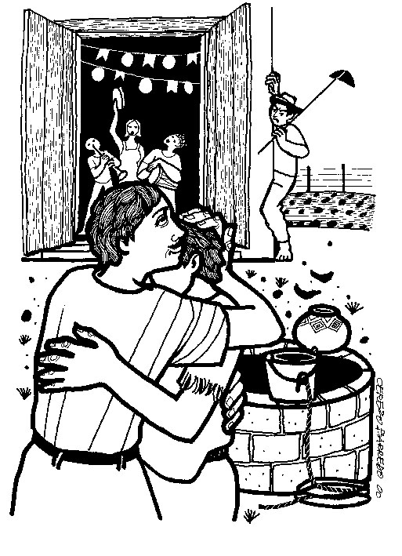
4th Sunday of Lent – Year C
1st Reading: Josh 5:9a, 10-12
  “The people of God entered the promised land and there kept the Passover.”
Responsorial: Psalm 34:2-3, 4-5, 6-7
  “Taste and see the goodness of the Lord.”
2nd Reading: 2 Cor 5:17-21
  “God reconciled us to himself through Christ.”
Verse before the Gospel: Luke 15:18
  “I will get up and go to my Father and shall say to him:
  Father, I have sinned against heaven and against you.”
Gospel: Luke 15:1-3, 11-3
  “Your brother was dead and has come to life again.”

Slide 30
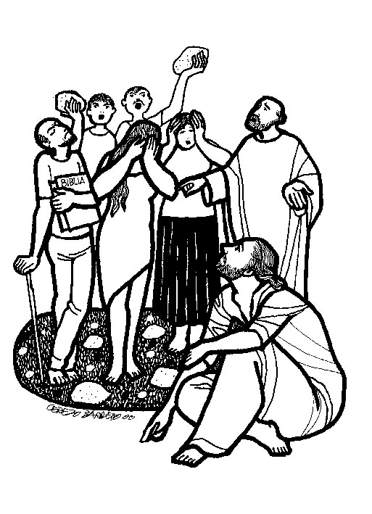
5th Sunday of Lent – Year C
1st Reading: Isa 43:16-21
  “See, I am doing something new and I give my people drink.”
Responsorial: Psalm 126:1-2a, 2b-3, 4-5, 6
  “The Lord has done great things for us; we are filled with joy.”
2nd Reading: Phil 3:8-14
  “Because of Christ, I consider everything as a loss, being conformed to his death.”
Verse before the Gospel: Joel 2:12-13
  “Even now, says the Lord, return to me with your whole heart;
  for I am gracious and merciful.”
Gospel: John 8:1-11
  “Let the one among you who is without sin
  be the first to throw a stone at her.”

Slide 31
Another Approach: Seasonal Overviews
Consider all Lent readings of one type together:
All the Gospels (incl. the “Alleluia Verse”)
All the First Readings (OT Prophets)
All the Responsorial “Psalms and Canticles”
All the Second Readings (NT Epistles)
This corresponds to using my tables vertically.

Slide 32

Lectionary, "Intro," chap. 5, par. 97
The Gospel readings are arranged as follows:
  The first and second Sundays maintain the accounts
  of the Temptation and Transfiguration of the Lord,
  with readings, however, from all three Synoptics.
  [pre-Vat.II: always Matthew’s versions]
  On the next three Sundays, the Gospels about the Samaritan woman, the man born blind, and the raising of Lazarus have been restored in Year A. Because these Gospels are of major importance in regard to Christian initiation, they may also be read in Year B and Year C, especially in places where there are catechumens.

Slide 33

Lectionary, "Intro," chap. 5, par. 97
[Sundays of Lent, Gospels, cont.]
  Other texts, however, are provided for Year B and Year C:
  for Year B, a text from John about Christ's coming glorification through his Cross and Resurrection,
  and for Year C, a text from Luke about conversion.
  On Palm Sunday of the Lord's Passion
  the texts for the procession are selections
  from the Synoptic Gospels concerning
  the Lord's solemn entry into Jerusalem.
  For the Mass the reading is the account
  of the Lord's Passion.

Slide 34
Lenten Sunday Gospels -Year A
TEMPTATION: MATTHEW 4:1-11
TRANSFIGURATION: MATTHEW 17:1-9
John 4:5-42 [or 4:5-15, 19b-26, 39a, 40-42]
  Jesus & the Samaritan Woman: WATER
John 9:1-41 [or 9:1, 6-9, 13-17, 34-38]
  Giving (In)Sight to the Man Born Blind: LIGHT
John 11:1-45 [or 11:3-7, 17, 20-27, 33b-45]
  Martha, Mary, Lazarus: LIFE

Slide 35
Lenten Sunday Gospels -Year B
TEMPTATION: MARK 1:12-15
TRANSFIGURATION: MARK 9:2-10
John 2:13-25
  “Destroy this temple, and in three days I will raise it up.”
John 3:14-21
  “God sent his Son so that the world might be saved through him.”
John 12:20-33
  “If a grain of wheat falls to the ground and dies, it produces much fruit.”
  “…a text from John about Christ's coming glorification through his Cross and Resurrection”?

Slide 36
Lenten Sunday Gospels -Year C
TEMPTATION: LUKE 4:1-13
TRANSFIGURATION: LUKE 9:28b-36
Luke 13:1-9 – Two Tragedies & Fig Tree Parable
  “If you do not repent, you will all perish as they did.”
Luke 15:1-3, 11-32 – Prodigal/Lost Son
  “Your brother was dead and has come to life again.”
JOHN 8:1-11 – Adulterous Woman
  “Let the one among you who is without sin
  be the first to throw a stone at her.”
  “…for Year C, a text from Luke about conversion”?

Slide 37

1st Sunday of Lent – Temptation
Year A: MATTHEW 4:1-11
Year C: LUKE 4:1-13
Year B: MARK 1:12-15
  The Spirit drove Jesus out into the desert,
  and he remained in the desert for forty days,
  tempted by Satan.
  He was among wild beasts,
  and the angels ministered to him.
  After John had been arrested,
  Jesus came to Galilee
  proclaiming the gospel of God:
  “This is the time of fulfillment.
  The kingdom of God is at hand.
  Repent, and believe in the gospel.”

Slide 38
2nd Sunday of Lent – Transfiguration
Year A: Matthew 17:1-9
Year C: Luke 9:28b-36
Year B: MARK 9:2-10
  Jesus took Peter, James, and John and led them up
  a high mountain apart by themselves.
  And he was transfigured before them,
  and his clothes became dazzling white, such as no fuller on earth could bleach them.
  Then Elijah appeared to them along with Moses, and they were conversing with Jesus.
  Then Peter said to Jesus in reply, “Rabbi, it is good that we are here!
  Let us make three tents: one for you, one for Moses, and one for Elijah.”
  He hardly knew what to say, they were so terrified.
  Then a cloud came, casting a shadow over them;
  from the cloud came a voice, “This is my beloved Son. Listen to him.”
  Suddenly, looking around, they no longer saw anyone but Jesus alone with them.
  As they were coming down from the mountain,
  he charged them not to relate what they had seen to anyone,
  except when the Son of Man had risen from the dead.
  So they kept the matter to themselves, questioning what rising from the dead meant.

Slide 39
3rd Sun. Lent, B – John 2:13-25
Since the Passover of the Jews was near, Jesus went up to Jerusalem.
He found in the temple area those who sold oxen, sheep, and doves,
as well as the money changers seated there. He made a whip out of cords
and drove them all out of the temple area, with the sheep and oxen,
and spilled the coins of the money changers and overturned their tables,
and to those who sold doves he said,
“Take these out of here, and stop making my Father’s house a marketplace.”
His disciples recalled the words of Scripture, Zeal for your house will consume me. (Ps 69:10)
At this the Jews answered and said to him, “What sign can you show us for doing this?”
Jesus answered and said to them, “Destroy this temple and in three days I will raise it up.”
The Jews said, “This temple has been under construction for forty-six years,
and you will raise it up in three days?”
But he was speaking about the temple of his body.
Therefore, when he was raised from the dead, his disciples remembered that he had said this,
and they came to believe the Scripture and the word Jesus had spoken.
While he was in Jerusalem for the feast of Passover,
many began to believe in his name when they saw the signs he was doing.
But Jesus would not trust himself to them because he knew them all,
and did not need anyone to testify about human nature. He himself understood it well.

Slide 40
4th Sun. Lent, B – John 3:14-21
Jesus said to Nicodemus:
“Just as Moses lifted up the serpent in the desert, (cf. Num 21:9)
so must the Son of Man be lifted up,
so that everyone who believes in him may have eternal life.”
For God so loved the world that he gave his only Son,
so that everyone who believes in him might not perish
but might have eternal life.
For God did not send his Son into the world to condemn the world,
but that the world might be saved through him.
Whoever believes in him will not be condemned,
but whoever does not believe has already been condemned,
because he has not believed in the name of the only Son of God.
And this is the verdict, that the light came into the world,
but people preferred darkness to light, because their works were evil.
For everyone who does wicked things hates the light
and does not come toward the light,
so that his works might not be exposed.
But whoever lives the truth comes to the light,
so that his works may be clearly seen as done in God.

Slide 41

5th Sun. Lent, B – John 12:20-33
Some Greeks who had come to worship at the Passover Feast
came to Philip, who was from Bethsaida in Galilee,
and asked him, “Sir, we would like to see Jesus.”
Philip went and told Andrew; then Andrew and Philip went and told Jesus.
Jesus answered them, “The hour has come for the Son of Man to be glorified.
Amen, amen, I say to you, unless a grain of wheat falls to the ground and dies,
it remains just a grain of wheat; but if it dies, it produces much fruit.
Whoever loves his life loses it,
and whoever hates his life in this world will preserve it for eternal life.
Whoever serves me must follow me, and where I am,
there also will my servant be. The Father will honor whoever serves me.
“I am troubled now. Yet what should I say? ‘Father, save me from this hour’?
But it was for this purpose that I came to this hour. Father, glorify your name.”
Then a voice came from heaven, “I have glorified it and will glorify it again.”
The crowd there heard it and said it was thunder;
but others said, “An angel has spoken to him.”
Jesus answered and said, “This voice did not come for my sake but for yours.
Now is the time of judgment on this world; now the ruler of this world will be driven out.
And when I am lifted up from the earth, I will draw everyone to myself.”
He said this indicating the kind of death he would die.

Slide 42

Questions & Break
Questions?
  Please “raise your hands” (electronically)
  Or open your mic
Break
  We will continue in 10 minutes.

Slide 43
Mount Saint Mary’s University “Ecclesia” Program Presents:
Living Word: Scriptures of the 2021 Liturgical Year
Lectionary Readings for the
Season of Lent
Fr. Felix Just, S.J., Ph.D.
Living Word Catholic Biblical Ministries
http://catholic-resources.org

Slide 44
1st Sunday of Lent – Preface
It is truly right and just,
our duty and our salvation,
always and everywhere to give you thanks,
Lord, holy Father, almighty and eternal God, through Christ our Lord.
By abstaining forty long days from earthly food,
he consecrated through his fast
the pattern of our Lenten observance and,
by overturning all the snares of the ancient serpent,
taught us to cast out the leaven of malice,
so that, celebrating worthily the Paschal Mystery,
we might pass over at last to the eternal paschal feast.
And so, with the company of Angels and Saints,
we sing the hymn of your praise, as without end we acclaim:

Slide 45
2nd Sunday of Lent – Preface
It is truly right and just,
our duty and our salvation,
always and everywhere to give you thanks,
Lord, holy Father, almighty and eternal God, through Christ our Lord.
For after he had told the disciples of his coming Death,
on the holy mountain he manifested to them his glory,
to show, even by the testimony of the law and the prophets,
that the Passion leads to the glory of the Resurrection.
And so, with the Powers of heaven,
we worship you constantly on earth,
and before your majesty without end we acclaim:

Slide 46
3rd Sunday of Lent – Preface
It is truly right and just,
our duty and our salvation,
always and everywhere to give you thanks,
Lord, holy Father, almighty and eternal God, through Christ our Lord.
For when he asked the Samaritan woman for water to drink,
he had already created the gift of faith within her
and so ardently did he thirst for her faith,
that he kindled in her the fire of divine love.
And so we, too, give you thanks
and with the Angels praise your mighty deeds,
as we acclaim:

Slide 47
4th Sunday of Lent – Preface
It is truly right and just,
our duty and our salvation,
always and everywhere to give you thanks,
Lord, holy Father, almighty and eternal God, through Christ our Lord.
By the mystery of the Incarnation,
he has led the human race that walked in darkness
into the radiance of the faith
and he brought those born in slavery to ancient sin
through the waters of regeneration
to make them your adopted children.
Therefore, all creatures of heaven and earth
sing a new song in adoration,
and we, with all the host of Angels,
cry out, and without end acclaim:

Slide 48
5th Sunday of Lent – Preface
It is truly right and just,
our duty and our salvation,
always and everywhere to give you thanks,
Lord, holy Father, almighty and eternal God, through Christ our Lord.
For as true man he wept for Lazarus his friend
and as eternal God raised him from the tomb,
just as, taking pity on the human,
he leads us by sacred mysteries to new life.
Through him the host of Angels adores your majesty
and rejoices in your presence for ever.
May our voices, we pray,
join with theirs in one chorus of exultant praise,
as we acclaim:

Slide 49
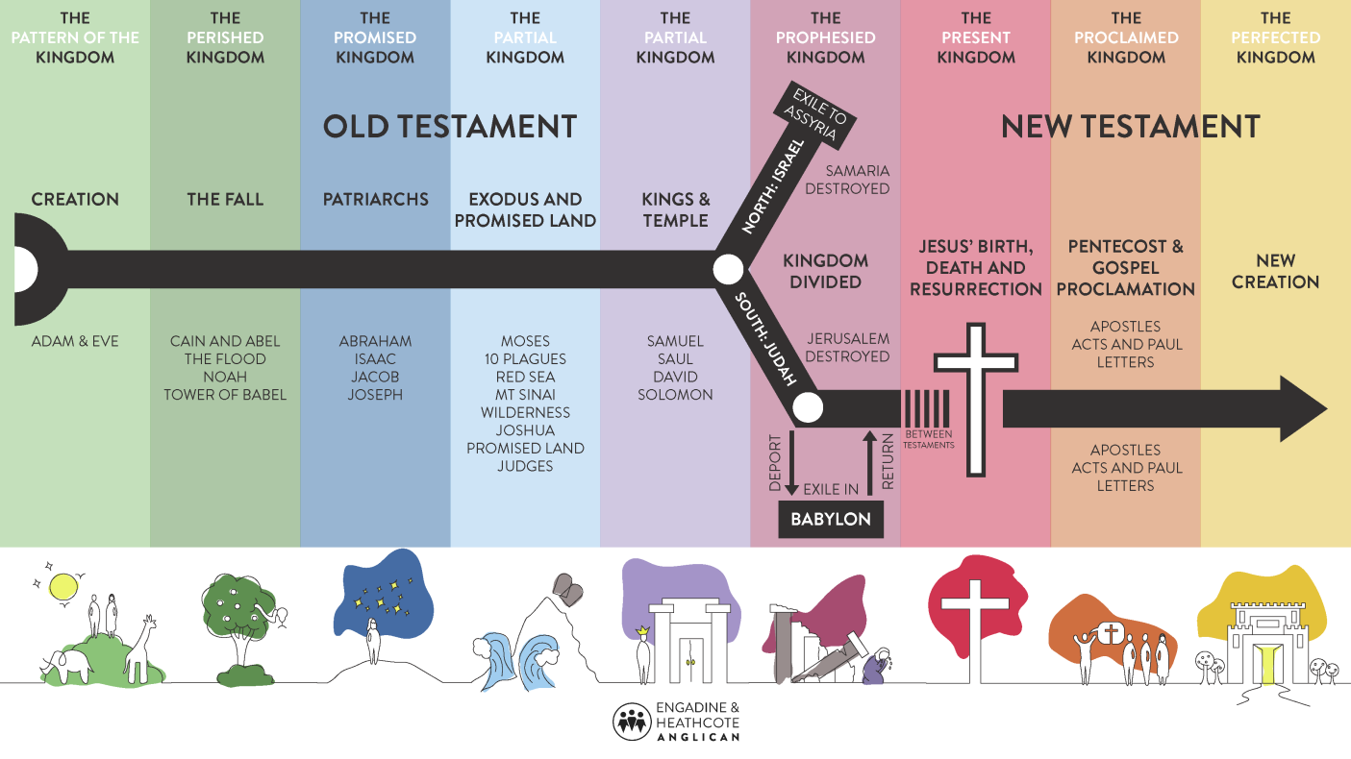
Lectionary, "Intro," chap. 5, par. 97
[Sundays of Lent, cont.]
The Old Testament readings are about the history of salvation, which is one of the themes proper to the catechesis of Lent. The series of texts for each Year presents the main elements of salvation history from its beginning until the promise of the New Covenant.

Slide 50
Sundays of LENT: First Readings
 | Year A | Year B | Year C | Salvation History
1st | Gen 2:7-9; 3:1-7 | Gen 9:8-15 | Deut 26:4-10 | Human Origins
2nd | Gen 12:1-4a | Gen 22:1-2,9a,10-13,15-18 | Gen 15:5-12, 17-18 | Abraham/Patriarchs
3rd | Exod 17:3-7 | Exod 20:1-17 or shorter | Exod 3:1-8a, 13-15 | Moses/Israelites
4th | 1 Sam 16:1b,6-7,10-13a | 2 Chr 36:14-16, 19-23 | Josh 5:9a, 10-12 | Monarchy/Exile
5th | Ezek 37:12-14 | Jer 31:31-34 | Isa 43:16-21 | Prophecy/Restoration

Slide 51
Lent-A, Sundays 1-5: OT Readings
Gen 2:7-9; 3:1-7
  ADAM & EVE: First Sin
Gen 12:1-4a
  ABRAM: Call to leave homeland
Exod 17:3-7
  MOSES: Murmuring for Water in Desert
1 Sam 16:1b, 6-7, 10-13a
  DAVID: Anointed as King of Israel
Ezek 37:12-14
  PROPHET: “I will open your graves…”

Slide 52
Lent-A, Sundays 1-5: Resp. Psalms
Ps 51:3-4, 5-6, 12-13, 14+17
  “BE MERCIFUL, O Lord, for we have sinned.”
Ps 33:4-5, 18-19, 20+22
  “Lord, let your MERCY be on us, as we place our trust in you.”
Ps 95:1-2, 6-7b, 7c-9
  “If today you hear his voice, harden not your hearts.”
Ps 23:1-3a, 3b-4, 5, 6
  “The Lord is my shepherd; there is nothing I shall want.”
Ps 130:1-2, 3-4, 5-6, 7-8
  “With the Lord there is MERCY and fullness of redemption.”

Slide 53
Lent-B, Sundays 1-5: OT Readings
Gen 9:8-15
  God’s covenant with NOAH after the Flood
Gen 22:1-2, 9a, 10-13, 15-18
  Sacrifice of ABRAHAM, our father in faith
Exod 20:1-17
  The law was given through MOSES (Decalogue)
2 Chron 36:14-16, 19-23
  God’s wrath & mercy seen in exile & liberation
Jer 31:31-34
  New covenant, written on their hearts.

Slide 54
Lent-B, Sundays 1-5: Resp. Psalms
Ps 25:4-5, 6-7, 8-9
  “Your ways, O Lord, are love and truth to those who keep your covenant.”
Ps 116:10+15, 16-17, 18-19
  “I will walk before the Lord, in the land of the living.”
Ps 19:8, 9, 10, 11
  “Lord, you have the words of everlasting life.”
Ps 137:1-2, 3, 4-5, 6
  “Let my tongue be silenced, if I ever forget you.”
Ps 51:3-4, 12-13, 14-15
  “Create a clean heart in me, O God.”

Slide 55
Lent-C, Sundays 1-5: OT Readings
Deuteronomy 26:4-10
  The confession of faith of the chosen people.
Genesis 15:5-12, 17-18
  God made a covenant with ABRAHAM, his faithful servant.
Exodus 3:1-8a, 13-15
  “I AM” sent me to you. [God & MOSES at Burning Bush]
Joshua 5:9a, 10-12
  The people of God entered the promised land and there kept the Passover.
Isaiah 43:16-21
  See, I am doing something new and I give my people drink.

Slide 56
Lent-C, Sundays 1-5: Resp. Psalms
Ps 91:1-2, 10-11, 12-13, 14-15
  “Be with me, Lord, when I am in trouble.”
Ps 27:1, 7-8a, 8b-9, 13-14
  “The Lord is my light and my salvation.”
Ps 103:1-2, 3-4, 6-7, 8+11
  “The Lord is kind and merciful.”
Ps 34:2-3, 4-5, 6-7
  “Taste and see the goodness of the Lord.”
Ps 126:1-2a, 2b-3, 4-5, 6
  “The Lord has done great things for us; we are filled with joy.”

Slide 57
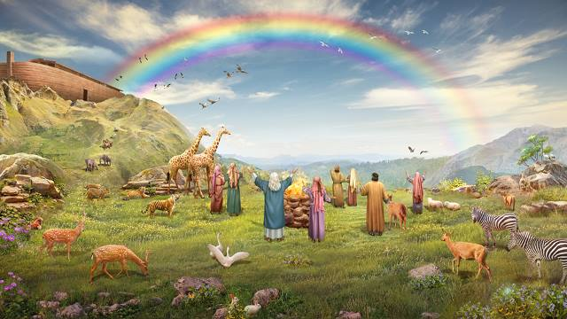
1st Sun. Lent, B: Gen 9:8-15
God said to Noah and to his sons with him:
“See, I am now establishing my covenant with you
and your descendants after you
and with every living creature that was with you:
all the birds, and the various tame and wild animals
that were with you and came out of the ark.
I will establish my covenant with you,
that never again shall all bodily creatures
be destroyed by the waters of a flood;
there shall not be another flood to devastate the earth.”
God added: “This is the sign that I am giving for all ages to come,
of the covenant between me and you and every living creature with you:
I set my bow in the clouds to serve as a sign
of the covenant between me and the earth.
When I bring clouds over the earth,
and the bow appears in the clouds,
I will recall the covenant I have made
between me and you and all living beings,
so that the waters shall never again become
a flood to destroy all mortal beings.”

Slide 58
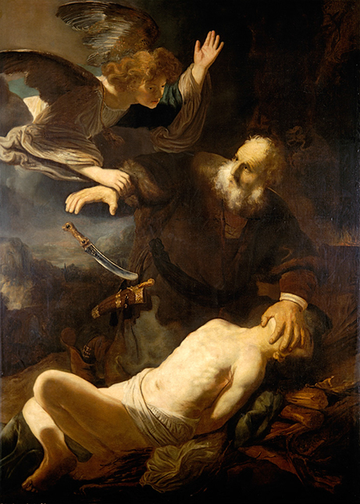
2nd Sun. Lent, B: Gen 22:1-2, 9a, 10-13, 15-18
God put Abraham to the test. He called to him, “Abraham!”
“Here I am!” he replied. / Then God said:
“Take your son Isaac, your only one, whom you love, and go to the land of Moriah.
There you shall offer him up as a holocaust on a height that I will point out to you.”
When they came to the place of which God had told him,
Abraham built an altar there and arranged the wood on it.
Then he reached out and took the knife to slaughter his son.
But the LORD’s messenger called to him from heaven, “Abraham, Abraham!”
“Here I am!” he answered. “Do not lay your hand on the boy,” said the messenger.
“Do not do the least thing to him. I know now how devoted you are to God,
since you did not withhold from me your own beloved son.”
As Abraham looked about, he spied a ram caught by its horns in the thicket.
So he went and took the ram and offered it up as a holocaust in place of his son.
Again the LORD’s messenger called to Abraham from heaven and said:
“I swear by myself, declares the LORD, that because you acted as you did
in not withholding from me your beloved son,
I will bless you abundantly and make your descendants as countless
as the stars of the sky and the sands of the seashore;
your descendants shall take possession of the gates of their enemies,
and in your descendants all the nations of the earth
shall find blessing—all this because you obeyed my command.”

Slide 59
3rd Sun. Lent, B: Exod 20:1-17
In those days, God delivered all these commandments:
“I, the LORD, am your God, who brought you out of the land of Egypt, that place of slavery.
You shall not have other gods besides me.
You shall not carve idols for yourselves in the shape of anything in the sky above
or on the earth below or in the waters beneath the earth;
you shall not bow down before them or worship them.
For I, the LORD, your God, am a jealous God, inflicting punishment for their fathers’ wickedness
on the children of those who hate me, down to the third and fourth generation;
but bestowing mercy down to the thousandth generation
on the children of those who love me and keep my commandments.
“You shall not take the name of the LORD, your God, in vain.
For the LORD will not leave unpunished the one who takes his name in vain.
“Remember to keep holy the sabbath day.
Six days you may labor and do all your work,
but the seventh day is the sabbath of the LORD, your God.
No work may be done then either by you, or your son or daughter,
or your male or female slave, or your beast, or by the alien who lives with you.
In six days the Lord made the heavens and the earth, the sea and all that is in them;
but on the seventh day he rested.
That is why the LORD has blessed the sabbath day and made it holy.
[Note: Text in smaller type above is omitted in the shorter version of this reading, Exod 20:1-3, 7-8, 12-17)

Slide 60
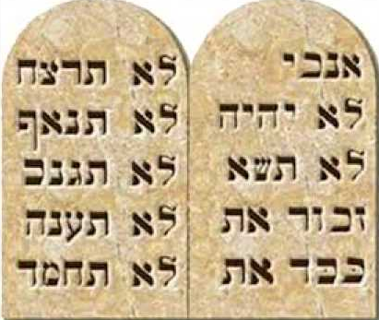
Exod 20:1-17 (cont.)
“Honor your father and your mother,
that you may have a long life in the land
which the LORD, your God, is giving you.
You shall not kill.
You shall not commit adultery.
You shall not steal.
You shall not bear false witness
against your neighbor.
You shall not covet your neighbor’s house.
You shall not covet your neighbor’s wife,
nor his male or female slave, nor his ox or ass,
nor anything else that belongs to him.”
See https://catholic-resources.org/Bible/Decalogue.htm

Slide 61
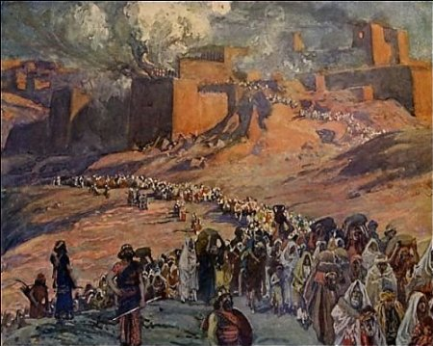
4th Sun. Lent, B: 2 Chron 36:14-16, 19-23
In those days, all the princes of Judah, the priests, and the people
added infidelity to infidelity, practicing all the abominations of the nations
and polluting the LORD’s temple which he had consecrated in Jerusalem.
Early and often did the LORD, the God of their fathers, send his messengers to them,
for he had compassion on his people and his dwelling place.
But they mocked the messengers of God,
despised his warnings,
and scoffed at his prophets,
until the anger of the LORD against his people
was so inflamed that there was no remedy.
Their enemies burnt the house of God,
tore down the walls of Jerusalem,
set all its palaces afire,
and destroyed all its precious objects.

Slide 62
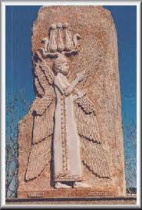
2 Chron 36:14-16, 19-23 (cont.)
Those who escaped the sword were carried captive to Babylon,
where they became servants of the king of the Chaldeans and his sons
until the kingdom of the Persians came to power.
All this was to fulfill the word of the LORD spoken by Jeremiah:
“Until the land has retrieved its lost sabbaths,
during all the time it lies waste it shall have rest
while seventy years are fulfilled.”
In the first year of Cyrus, king of Persia,
in order to fulfill the word of the LORD spoken by Jeremiah,
the LORD inspired King Cyrus of Persia
to issue this proclamation throughout his kingdom,
both by word of mouth and in writing:
“Thus says Cyrus, king of Persia:
All the kingdoms of the earth
the LORD, the God of heaven, has given to me,
and he has also charged me to build him a house
in Jerusalem, which is in Judah.
Whoever, therefore, among you belongs to any part of his people,
let him go up, and may his God be with him!”

Slide 63
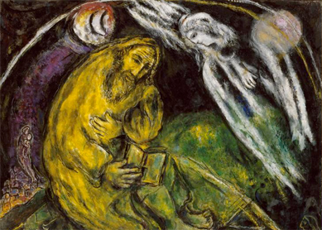
5th Sun. Lent, B: Jer 31:31-34
The days are coming, says the LORD,
when I will make a new covenant
with the house of Israel and the house of Judah.
It will not be like the covenant I made with their fathers
the day I took them by the hand
to lead them forth from the land of Egypt;
for they broke my covenant,
and I had to show myself their master, says the LORD.
But this is the covenant that I will make
with the house of Israel after those days, says the LORD.
I will place my law within them and write it upon their hearts;
I will be their God, and they shall be my people.
No longer will they have need to teach their friends and relatives
how to know the LORD.
All, from least to greatest, shall know me, says the LORD,
for I will forgive their evildoing and remember their sin no more.

Slide 64
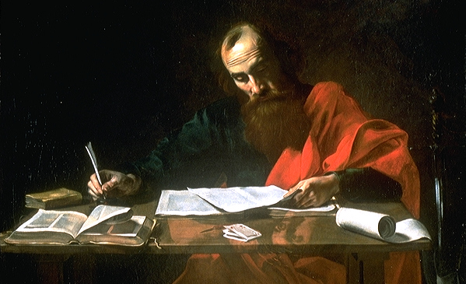
Lectionary, "Intro," chap. 5, par. 97
[Sundays of Lent, cont.]
The readings from the Letters of the Apostles have been selected to fit the Gospel and the Old Testament readings and, to the extent possible, to provide a connection between them.

Slide 65
Lent-A, Sundays 1-5: NT Epistles
Rom 5:12-19 [or 5:12, 17-19]
  Adam’s disobedience vs. Jesus’ righteous obedience
2 Tim 1:8b-10
  God has saved us & called us to be holy.
Rom 5:1-2, 5-8
  God’s love has been poured into our hearts
Eph 5:8-14
  Rise from the dead; Christ will shine on you.
Rom 8:8-11
  Spirit raised Jesus from the dead; will raise us also

Slide 66
Lent-B, Sundays 1-5: NT Epistles
1 Pet 3:18-22
  “The water of the flood prefigured baptism, which saves you now.”
Rom 8:31b-34
  “God did not spare his own Son.”
1 Cor 1:22-25
  “We proclaim Christ crucified, a stumbling block to many,
  but to those who are called, the wisdom of God.”
Eph 2:4-10
  “Though dead in your transgressions, by grace you have been saved.”
Heb 5:7-9
  “Christ learned obedience and became the source of eternal salvation.”

Slide 67
Lent-C, Sundays 1-5: NT Epistles
Rom 10:8-13
  The confession of faith of all believers in Christ.
Phil 3:17–4:1 or 3:20–4:1
  Christ will change our lowly body to conform to his glorified body.
1 Cor 10:1-6, 10-12
  The life of the people with Moses in the desert
  was written down as a warning to us.
2 Cor 5:17-21
  God reconciled us to himself through Christ.
Phil 3:8-14
  Because of Christ, I consider everything as a loss,
  being conformed to his death.

Slide 68
1st Sun. Lent, B: 1 Pet 3:18-22
Beloved: Christ suffered for sins once,
the righteous for the sake of the unrighteous,
that he might lead you to God.
Put to death in the flesh,
he was brought to life in the Spirit.
In it he also went to preach to the spirits in prison,
who had once been disobedient
while God patiently waited in the days of Noah
during the building of the ark,
in which a few persons, eight in all,
were saved through water.
This prefigured BAPTISM, which saves you now.
It is not a removal of dirt from the body
but an appeal to God for a clear conscience,
through the resurrection of Jesus Christ,
who has gone into heaven and is at the right hand of God,
with angels, authorities, and powers subject to him.

Slide 69
1st Sunday of Lent – Year B
1st Reading: Gen 9:8-15
  “God’s covenant with Noah when he was delivered from the flood.”
Responsorial: Psalm 25:4-5, 6-7, 8-9
  “Your ways, O Lord, are love and truth to those who keep your covenant.”
2nd Reading: 1 Pet 3:18-22
  “The water of the flood prefigured baptism, which saves you now.”
Verse before the Gospel: Matt 4:4b
  “One does not live on bread alone,
  but on every word that comes forth from the mouth of God.”
Gospel: Mark 1:12-15
  “Jesus was tempted by Satan,
  and the angels ministered to him.”

Slide 70
2nd Sun. Lent, B: Rom 8:31b-34
Brothers and sisters:
If God is for us, who can be against us?
He who did not spare his own Son
but handed him over for us all,
how will he not also give us everything else along with him?
Who will bring a charge against God’s chosen ones?
It is God who acquits us, who will condemn?
Christ Jesus it is who died—or, rather, was raised—
who also is at the right hand of God,
who indeed intercedes for us.

Slide 71
2nd Sunday of Lent – Year B
1st Reading: Gen 22:1-2, 9a, 10-13, 15-18
  “The sacrifice of Abraham, our father in faith.”
Responsorial: Psalm 116:10+15, 16-17, 18-19
  “I will walk before the Lord, in the land of the living.”
2nd Reading: Rom 8:31b-34
  “God did not spare his own Son.”
Verse before the Gospel: cf. Matt 17:5
  “From the shining cloud the Father’s voice is heard:
  This is my beloved Son, hear him.”
Gospel: Mark 9:2-10
  “This is my beloved Son.”

Slide 72
3rd Sun. Lent, B: 1 Cor 1:22-25
Brothers and sisters:
Jews demand signs and Greeks look for wisdom,
but we proclaim Christ crucified,
a stumbling block to Jews and foolishness to Gentiles,
but to those who are called, Jews and Greeks alike,
Christ the power of God and the wisdom of God.
For the foolishness of God is wiser than human wisdom,
and the weakness of God is stronger than human strength.

Slide 73
3rd Sunday of Lent – Year B
1st Reading: Exod 20:1-17, or 20:1-3, 7-8, 12-17
  “The law was given through Moses.”
Responsorial: Psalm 19:8, 9, 10, 11
  “Lord, you have the words of everlasting life.”
2nd Reading: 1 Cor 1:22-25
  “We proclaim Christ crucified, a stumbling block to many,
  but to those who are called, the wisdom of God.”
Verse before the Gospel: John 3:16
  “God so loved the world that he gave his only Son,
  so that everyone who believes in him mighty have eternal life.”
Gospel: John 2:13-25
  “Destroy this temple, and in three days I will raise it up.”

Slide 74
4th Sun. Lent, B: Eph 2:4-10
Brothers and sisters:
God, who is rich in mercy,
because of the great love he had for us,
even when we were dead in our transgressions,
brought us to life with Christ — by grace you have been saved —,
raised us up with him,
and seated us with him in the heavens in Christ Jesus,
that in the ages to come
He might show the immeasurable riches of his grace
in his kindness to us in Christ Jesus.
For by grace you have been saved through faith,
and this is not from you; it is the gift of God;
it is not from works, so no one may boast.
For we are his handiwork, created in Christ Jesus for the good works
that God has prepared in advance,
that we should live in them.

Slide 75
4th Sunday of Lent – Year B
1st Reading: 2 Chr 36:14-16, 19-23
  “The wrath and the mercy of the Lord are revealed
  in the exile and liberation of his people.”
Responsorial: Psalm 137:1-2, 3, 4-5, 6
  “Let my tongue be silenced, if I ever forget you.”
2nd Reading: Eph 2:4-10
  “Though dead in your transgressions,
  by grace you have been saved.”
Verse before the Gospel: John 3:16
  “God so loved the world that he gave his only Son,
  so that everyone who believes in him mighty have eternal life.”
Gospel: John 3:14-21
  “God send his Son so that the world might be saved through him.”

Slide 76
5th Sun. Lent, B: Heb 5:7-9
In the days when Christ Jesus was in the flesh,
he offered prayers and supplications with loud cries and tears
to the one who was able to save him from death,
and he was heard because of his reverence.
Son though he was, he learned obedience from what he suffered;
and when he was made perfect,
he became the source of eternal salvation for all who obey him.

Slide 77
5th Sunday of Lent – Year B
1st Reading: Jer 31:31-34
  “I will make a new covenant and remember their sin no more.”
Responsorial: Psalm 51:3-4, 12-13, 14-15
  “Create a clean heart in me, O God.”
2nd Reading: Heb 5:7-9
  “Christ learned obedience and became the source of eternal salvation.”
Verse before the Gospel: John 12:26
  “Whoever serves me must follow me, says the Lord;
  am where I am, there also will my servant be.”
Gospel: John 12:20-33
  “If a grain of wheat falls to the ground
  and dies, it produces much fruit.”

Slide 78
Rfeview: Lenten Sundays 1 to 5
Gospels
  1: Temptation; 2: Transfiguration; 3–5: misc.
1st Readings (OT)
  History of Salvation (not directly tied to Gospels!)
Responsorial Psalms
  Complementary (thematically related to OT Readings)
2nd Readings (Epistles)
  Complementary (selected to “fit” & “bridge” other readings)

Slide 79
Key Themes of Lent ?
What are the main “Themes of Lent”
that we have seen in all of these readings?
  Repentance, renewal, restoration, death/life, etc.
  Preparation for Baptism: Overview of “Salvation History”
Comments? Questions?

Slide 80
Questions & Break
Questions?
  Please “raise your hands” (electronically)
  Or open your mic
Break
  We will continue in 10 minutes.

Slide 81
Mount Saint Mary’s University “Ecclesia” Program Presents:
Living Word: Scriptures of the 2021 Liturgical Year
Lectionary Readings for the
Season of Lent
Fr. Felix Just, S.J., Ph.D.
Living Word Catholic Biblical Ministries
http://catholic-resources.org

Slide 82
Lent Commons: Verses before the Gospel
Biblical Ref. | Lectionary Translation
Ps 51:12a+14a | A clean heart create for me, O God; give me back the joy of your salvation.
See Ps 95:8ab | If today you hear his voice, harden not your hearts.
Ps 130:5+7bc | I hope in the LORD, I trust in his word; with him there is kindness and plenteous redemption.
Ezek 18:31ab | Cast away from you all the crimes you have committed, says the Lord, and make for yourselves a new heart and a new spirit.
See Ezek 33:11 | I take no pleasure in the death of the wicked man, says the Lord, but rather in his conversion, that he may live.
Joel 2:12ab+13c | Even now, says the LORD, return to me with your whole heart; for I am gracious and merciful.
See Amos 5:14 | Seek good and not evil so that you may live, and the LORD will be with you.
Matt 4:4b | One does not live on bread alone, but on every word that comes forth from the mouth of God.
Matt 4:17 | Repent, says the Lord; the Kingdom of heaven is at hand.
See Luke 8:15 | Blessed are they who have kept the word with a generous heart and yield a harvest through perseverance.
Luke 15:18 | I will get up and go to my father and shall say to him: Father, I have sinned against heaven and against you.
John 3:16 | God so loved the world that he have his only-begotten Son, so that everyone who believes in him might have eternal life.
See John 6:63c, 68c | Your words, Lord, are Spirit and life; you have the words of everlasting life.
John 8:12 | I am the light of the world, says the Lord; whoever follows me will have the light of life.
John 11:25a+26 | I am the resurrection and the life, says the Lord; whoever believes in me will never die.
2 Cor 6:2b | Behold, now is a very acceptable time; behold, now is the day of salvation.
(no bibl. ref.) | The seed is the word of God, Christ is the sower; all who come to him will live forever.

Slide 83
Lent Commons: Responsorial Psalms
Lect #175
5) Ps 51:3-4, 5-6a, 12-13, 14+17
  “Be merciful, O Lord, for we have sinned.” (cf. v. 3a)
6) Ps 91:1-2, 10-11, 12-13, 14-15
  “Be with me, Lord, when I am in trouble.” (cf. v. 15b)
7) Ps 130:1-2, 3-4, 5-6ab, 7bc-8
  “With the Lord there is mercy,
  and fullness of redemption.” (v. 7bc)

Slide 84
Gospel Acclamations
1) Glory and praise to you, Lord Jesus Christ!
2) Glory to you, Lord Jesus Christ, Wisdom of God the Father!
3) Glory to you, Word of God, Lord Jesus Christ!
4) Glory to you, Lord Jesus Christ, Son of the Living God!
5) Praise and honor to you, Lord Jesus Christ!
6) Praise to your, Lord Jesus Christ, King of endless glory!
7) Marvelous and great are your works, O Lord!
8) Salvation, glory, and power to the Lord Jesus Christ!

Slide 85
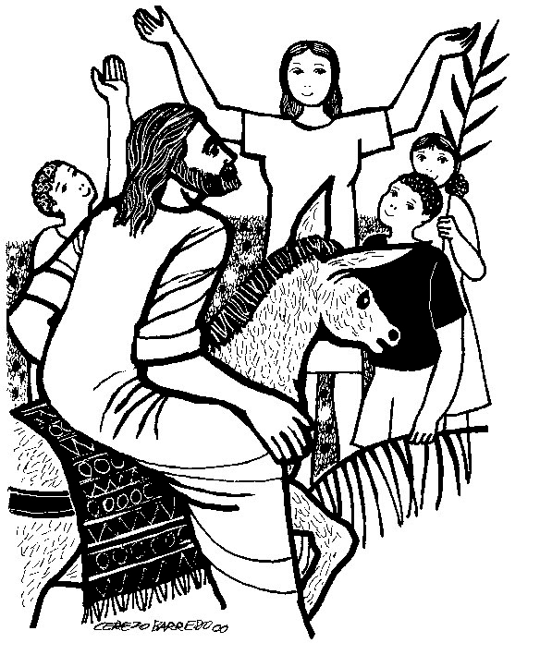
Palm Sunday – First Gospel
At the Procession with Palms:
  ABC: “Blessed is he who comes
  in the name of the Lord.”
Year A:
  Matt 21:1-11 – like Mark, but 2 animals; adds Zech 9:9
Year B:
  Mark 11:1-10 – “Blessed is the kingdom of our father David that is coming!”
  or John 12:12-16 – only Gospel to mention “palm” trees
Year C:
  Luke 19:28-40 – “Peace in heaven and glory in the highest!”

Slide 86
Palm Sunday – Years ABC
1st Reading: Isa 50:4-7 (3rd “Suffering Servant Song”)
  “My face I did not shield from buffets and spitting
  knowing that I shall not be put to shame.”
Responsorial: Psalm 22:8-9, 17-18, 19-20, 23-24
  “My God, my God, why have you abandoned me?”
2nd Reading: Phil 2:6-11
  “Christ humbled himself. Because of this God greatly exalted him.”
Verse before the Gospel: Phil 2:8-9
  “Christ became obedient to the point of death, even death on a cross.
  Because of this, God greatly exalted him and bestowed on him the name
  which is above every name.”

Slide 87

Palm Sunday – Gospel / Passion
  “The Passion of our Lord Jesus Christ.”
Year A: Matt 26:14 – 27:66
  or 27:11-54
Year B: Mark 14:1 – 15:47
  or 15:1-39
Year C: Luke 22:14 – 23:56
  or 23:1-49
  [John 18 – 19, each year on Good Friday]

Slide 88

Lectionary Structure:Weekdays
Two-Year Cycle:
  Odd Years
  Even Years
  Only applies to Ordinary Time
  Same readings each year for Advent, Xmas, Lent, Easter
Two Main Readings:
  First Reading (NT/OT)
  + Responsorial Psalm
  + “Second Reading” on some special days, like Ash Wednesday!
  Gospel
  preceded by “Verse before the Gospel”

Slide 89
Lectionary, "Intro," chap. 5, par. 98
Lent: Weekdays
"The readings from the Gospels and the Old Testament were selected because they are related to each other. They treat various themes of the Lenten catechesis that are suited to the spiritual significance of this season.
Beginning with Monday of the Fourth Week of Lent, there is a semicontinuous reading of the Gospel of JOHN, made up of texts that correspond more closely to the themes proper to Lent.
Because the readings about the Samaritan woman, the man born blind, and the raising of Lazarus are now assigned to Sundays, but only for Year A (in Year B and Year C they are optional), provision has been made for their use on weekdays.
Thus at the beginning of the Third, Fourth, and Fifth Weeks of Lent optional Masses with these texts for the Gospel have been inserted and may be used in place of the readings of the day on any weekday of the respective week.
In the first days of Holy Week the readings are about the mystery of Christ's passion.
For the Chrism Mass the readings bring out both Christ's Messianic mission and its continuation in the Church by means of the sacraments."

Slide 90
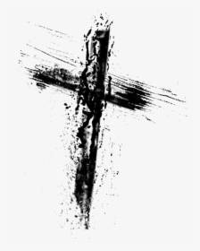
Ash Wednesday (every year)
1st Reading: Joel 2:12-18
  Rend your hearts, not your garments.
Responsorial: Psalm 51:3-4, 5-6ab, 12-13, 14+17
  “Be MERCIFUL, O Lord, for we have sinned.”
2nd Reading: 2 Cor 5:20—6:2
  Be reconciled to God; now is the acceptable time.
Verse before the Gospel: see Ps 95:8
  If today your hear his voice, harden not your hearts.
Gospel: Matt 6:1-6, 16-18
  Almsgiving, praying, fasting “in secret”

Slide 91
Days after Ash Wednesday
Thursday:
  Deut 30:15-20 – Choosing Blessing vs. Curse
  Ps 1:1-2, 3, 4+6
  Luke 9:22-25 – First “Passion Prediction”
Friday:
  Isa 58:1-9a – Manner of Fasting acceptable to God
  Ps 51:3-4, 5-6ab, 18-19
  Matt 9:14-15 – Fasting: John & Pharisees vs. Jesus’ disciples
Saturday:
  Isa 58:9b-14 – Remove oppression; care for the needy
  Ps 86:1-2, 3-4, 5-6
  Luke 5:27-32 – Call of Levi; call of sinners, not the righteous

Slide 92
Optional Masses
3rd Week of Lent (opt. any day)
  1st Reading: Exodus 17:1-7
  Responsorial: Ps 95:1-2, 6-7ab, 7c-9
  Before Gospel: See John 4:42, 15
  Gospel: John 4:5-42 – Samaritan Woman
4th Week of Lent (opt. any day)
  1st Reading: Micah 7:7-9
  Responsorial: Ps 26:1, 7-8a, 8b-9abc, 13-14
  Before Gospel: John 8:12
  Gospel: John 9:1-41 – Man Born Blind
5th Week of Lent (opt. any day)
  1st Reading: 2 Kings 4:18b-21, 32-37
  Responsorial: Ps 17:1, 6-7, 8b+15
  Before Gospel: John 11:25a+26
  Gospel: John 11:1-45 – Martha, Mary, Lazarus

Slide 93
Second Half of Lent
Fourth Week:
Monday John 4:43-54
Tuesday John 5:1-3a, 5-16
Wednesday John 5:17-30
Thursday John 5:31-47
Friday John 7:1-2, 10, 25-30
Saturday John 7:40-53
Fifth Week:
Monday John 8:1-11 (Year C: John 8:12-20)
Tuesday John 8:21-30
Wednesday John 8:31-42
Thursday John 8:51-59
Friday John 10:31-42
Saturday John 11:45-56

Slide 94
Possible Interruptions
March 19 – St. Joseph, Husband of Mary
  2021: 4th Week of Lent, Friday
March 25 – Annunciation of the Lord
  2021: 5th Week of Lent, Thursday

Slide 95
Holy Week
Holy Week – Monday
  1st Reading: Isaiah 42:1-7
  Responsorial: Psalm 27:1, 2, 3, 13-14
  Gospel: John 12:1-11 – Mary of Bethany anoints Jesus’ feet
Holy Week – Tuesday
  1st Reading: Isaiah 49:1-6
  Responsorial: Psalm 71:1-2, 3-4a, 5-6ab, 15+17
  Gospel: John 13:21-33, 36-38 – Jesus foretells Judas’ Betrayal & Peter’s Denial
Holy Week – Wednesday
  1st Reading: Isaiah 50:4-9a
  Responsorial: Psalm 69:8-10, 21-22, 31+33-34
  Gospel: Matthew 26:14-25 – Judas arranges to betray Jesus; dialogue at Last Supper
Holy Week – Chrism Mass
  1st Reading: Isaiah 61:1-3a, 6a, 8b-9
  Responsorial: Psalm 89:21-22, 25+27
  2nd Reading: Rev 1:5-8
  Gospel: Luke 4:16-21 – “The Spirit of the Lord is upon me… he has anointed me”

Slide 96
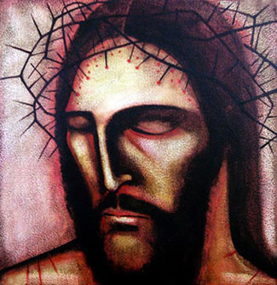
Servant Songs of Isaiah
Monday of Holy Week
  Isaiah 42:1-7
Tuesday of Holy Week
  Isaiah 49:1-6
Wednesday of Holy Week
  Isaiah 50:4-9a
Good Friday
  Isaiah 52:13—53:12

Slide 97
Monday of Holy Week: Isa 42:1-7
Here is my servant whom I uphold,
my chosen one with whom I am pleased,
Upon whom I have put my Spirit;
he shall bring forth justice to the nations,
Not crying out, not shouting,
not making his voice heard in the street.
A bruised reed he shall not break,
and a smoldering wick he shall not quench,
Until he establishes justice on the earth;
the coastlands will wait for his teaching.

Slide 98
Mon. of Holy Week: Isa 42:1-7 (cont.)
Thus says God, the LORD,
who created the heavens and stretched them out,
who spreads out the earth with its crops,
Who gives breath to its people
and spirit to those who walk on it:
I, the LORD, have called you for the victory of justice,
I have grasped you by the hand;
I formed you, and set you as a covenant of the people,
a light for the nations,
To open the eyes of the blind,
to bring out prisoners from confinement,
and from the dungeon, those who live in darkness.

Slide 99
Tuesday of Holy Week: Isa 49:1-6
Hear me, O islands,
listen, O distant peoples.
The Lord called me from birth,
from my mother’s womb he gave me my name.
He made of me a sharp-edged sword
and concealed me in the shadow of his arm.
He made me a polished arrow,
in his quiver he hid me.
You are my servant, he said to me,
Israel, through whom I show my glory.
Though I thought I had toiled in vain,
and for nothing, uselessly, spent my strength,
Yet my reward is with the Lord,
my recompense is with my God.

Slide 100
Tues. of Holy Week: Isa 49:1-6 (cont.)
For now the Lord has spoken
who formed me as his servant from the womb,
That Jacob may be brought back to him
and Israel gathered to him;
And I am made glorious in the sight of the Lord,
and my God is now my strength!
It is too little, he says, for you to be my servant,
to raise up the tribes of Jacob,
and restore the survivors of Israel;
I will make you a light to the nations,
that my salvation may reach to the ends of the earth.

Slide 101
Wed. of Holy Week: Isa 50:4-9a
The Lord GOD has given me a well-trained tongue,
That I might know how to speak to the weary
a word that will rouse them.
Morning after morning he opens my ear that I may hear;
And I have not rebelled,
have not turned back.
I gave my back to those who beat me,
my cheeks to those who plucked my beard;
My face I did not shield from buffets and spitting.

Slide 102
Wed. of Holy Week: Isa 50:4-9a (cont.)
The Lord GOD is my help,
therefore I am not disgraced;
I have set my face like flint,
knowing that I shall not be put to shame.
He is near who upholds my right;
if anyone wishes to oppose me,
let us appear together.
Who disputes my right?
Let him confront me.
See, the Lord GOD is my help;
who will prove me wrong?

Slide 103
Good Friday: Isa 52:13—53:12
See, my servant shall prosper,
he shall be raised high and greatly exalted.
Even as many were amazed at him –
so marred was his look beyond human semblance
and his appearance beyond that of the sons of man –
so shall he startle many nations,
because of him kings shall stand speechless;
for those who have not been told shall see,
those who have not heard shall ponder it.
Who would believe what we have heard?
To whom has the arm of the LORD been revealed?

Slide 104
Good Friday: Isa 52:13—53:12 (cont.)
He grew up like a sapling before him,
like a shoot from the parched earth;
there was in him no stately bearing to make us look at him,
nor appearance that would attract us to him.
He was spurned and avoided by people,
a man of suffering, accustomed to infirmity,
one of those from whom people hide their faces,
spurned, and we held him in no esteem.
Yet it was our infirmities that he bore,
our sufferings that he endured,
while we thought of him as stricken,
as one smitten by God and afflicted.

Slide 105
Good Friday: Isa 52:13—53:12 (cont.)
But he was pierced for our offenses,
crushed for our sins;
upon him was the chastisement that makes us whole,
by his stripes we were healed.
We had all gone astray like sheep,
each following his own way;
but the LORD laid upon him the guilt of us all.
Though he was harshly treated, he submitted
and opened not his mouth;
like a lamb led to the slaughter
or a sheep before the shearers,
he was silent and opened not his mouth.

Slide 106
Good Friday: Isa 52:13—53:12 (cont.)
Oppressed and condemned, he was taken away,
and who would have thought any more of his destiny?
When he was cut off from the land of the living,
and smitten for the sin of his people,
a grave was assigned him among the wicked
and a burial place with evildoers,
though he had done no wrong
nor spoken any falsehood.
But the LORD was pleased to crush him in infirmity.
If he gives his life as an offering for sin,
he shall see his descendants in a long life, and
the will of the LORD shall be accomplished through him.

Slide 107
Good Friday: Isa 52:13—53:12 (cont.)
Because of his affliction
he shall see the light in fullness of days;
through his suffering, my servant shall justify many,
and their guilt he shall bear.
Therefore I will give him his portion among the great,
and he shall divide the spoils with the mighty,
because he surrendered himself to death
and was counted among the wicked;
and he shall take away the sins of many,
and win pardon for their offenses.

Slide 108
Psalm 22
¹ For the leader; according to “The deer of the dawn.” A psalm of David.
² My God, my God, why have you abandoned me?
Why so far from my call for help, from my cries of anguish?
³ My God, I call by day, but you do not answer;
by night, but I have no relief.
⁴ Yet you are enthroned as the Holy One;
you are the glory of Israel.
⁵ In you our fathers trusted;
they trusted and you rescued them.
⁶ To you they cried out and they escaped;
in you they trusted and were not disappointed.
⁷ But I am a worm, not a man,
scorned by men, despised by the people.
⁸ All who see me mock me;
they curl their lips and jeer; they shake their heads at me:
⁹ “He relied on the LORD—let him deliver him;
if he loves him, let him rescue him.”

Slide 109
^{22:10} For you drew me forth from the womb,
made me safe at my mother’s breasts.
¹¹ Upon you I was thrust from the womb;
since my mother bore me you are my God.
¹² Do not stay far from me,
for trouble is near, and there is no one to help.
^{22:13} Many bulls surround me; fierce bulls of Bashan encircle me.
¹⁴ They open their mouths against me, lions that rend and roar.
¹⁵ Like water my life drains away; all my bones are disjointed.
My heart has become like wax, it melts away within me.
¹⁶ As dry as a potsherd is my throat; my tongue cleaves to my palate;
you lay me in the dust of death.
¹⁷ Dogs surround me; a pack of evildoers closes in on me.
They have pierced my hands and my feet
¹⁸ I can count all my bones. They stare at me and gloat;
¹⁹ they divide my garments among them; for my clothing they cast lots.
²⁰ But you, LORD, do not stay far off; my strength, come quickly to help me.
²¹ Deliver my soul from the sword, my life from the grip of the dog.
²² Save me from the lion’s mouth, my poor life from the horns of wild bulls.

Slide 110
^{22:23} Then I will proclaim your name to my brethren;
in the assembly I will praise you:
²⁴ “You who fear the LORD, give praise!
All descendants of Jacob, give honor;
show reverence, all descendants of Israel!
²⁵ For he has not spurned or disdained the misery of this poor wretch,
Did not turn away from me, but heard me when I cried out.
²⁶ I will offer praise in the great assembly;
my vows I will fulfill before those who fear him.
²⁷ The poor will eat their fill;
those who seek the LORD will offer praise.
May your hearts enjoy life forever!”
²⁸ All the ends of the earth will remember and turn to the LORD;
All the families of nations will bow low before him.
²⁹ For kingship belongs to the LORD, the ruler over the nations.
³⁰ All who sleep in the earth will bow low before God;
All who have gone down into the dust will kneel in homage.
³¹ And I will live for the LORD; my descendants will serve you.
³² The generation to come will be told of the Lord,
that they may proclaim to a people yet unborn
the deliverance you have brought.

Slide 111
Psalm 31
¹ For the leader. A psalm of David.
² In you, LORD, I take refuge; let me never be put to shame.
In your righteousness deliver me;
³ incline your ear to me; make haste to rescue me!
Be my rock of refuge, a stronghold to save me.
⁴ For you are my rock and my fortress;
for your name’s sake lead me and guide me.
⁵ Free me from the net they have set for me, for you are my refuge.
⁶ Into your hands I commend my spirit;
you will redeem me, LORD, God of truth.
⁷ You hate those who serve worthless idols, but I trust in the LORD.
⁸ I will rejoice and be glad in your mercy,
once you have seen my misery,
[and] gotten to know the distress of my soul.
⁹ You will not abandon me into enemy hands,
but will set my feet in a free and open space.

Slide 112
^{31:10} Be gracious to me, LORD, for I am in distress;
affliction is wearing down my eyes, my throat and my insides.
¹¹ My life is worn out by sorrow, and my years by sighing.
My strength fails in my affliction; my bones are wearing down.
¹² To all my foes I am a thing of scorn,
and especially to my neighbors a horror to my friends.
When they see me in public, they quickly shy away.
¹³ I am forgotten, out of mind like the dead;
I am like a worn-out tool.
¹⁴ I hear the whispers of the crowd; terrors are all around me.
They conspire together against me; they plot to take my life.
¹⁵ But I trust in you, LORD; I say, “You are my God.”
¹⁶ My destiny is in your hands; rescue me from my enemies,
from the hands of my pursuers.
¹⁷ Let your face shine on your servant;
save me in your mercy.
¹⁸ Do not let me be put to shame,
for I have called to you, LORD.
Put the wicked to shame;
reduce them to silence in Sheol.
¹⁹ Strike dumb their lying lips, which speak arrogantly
against the righteous in contempt and scorn.

Slide 113
^{31:20} How great is your goodness, Lord,
stored up for those who fear you.
You display it for those who trust you,
in the sight of the children of Adam.
²¹ You hide them in the shelter of your presence,
safe from scheming enemies.
You conceal them in your tent,
away from the strife of tongues.
²² Blessed be the LORD,
marvelously he showed to me his mercy in a fortified city.
²³ Though I had said in my alarm,
“I am cut off from your eyes.”
Yet you heard my voice, my cry for mercy,
when I pleaded with you for help.
²⁴ Love the LORD, all you who are faithful to him.
The LORD protects the loyal,
but repays the arrogant in full.
²⁵ Be strong and take heart,
all who hope in the LORD.

Slide 114
Wrap-Up
Questions? Comments?
  Please “RAISE YOUR HANDS” (electronically)
  OR Type a Comment/Question in the “Chat”
Overview of Lent, esp. Year B:
  http://catholic-resources.org/Lectionary/1998USL-Lent.htm
More on Biblical Texts:
  http://catholic-resources.org/Bible/
Next Session: Scriptures for the Easter Triduum
  Sat., March 27, 2021

Slide 115
IMAGE CREDITS
https://catholic-resources.org/Art/
http://www.servicioskoinonia.org/cerezo/indexBgraf.html
https://www.google.com/search?

Slide 116
“Living Word” Webinar Series
Zoom Webinars on the Catholic Lectionary for Mass
  Saturdays, 9:00 a.m. – 12:30 p.m. (Pacific Time)
  Open to the Public (feel free to invite others)
  FREE (but donations requested and appreciated)
Monthly, from Nov. 2020 to April 2021
  Nov. 21, 2020 – Readings of Advent
  Dec. 19, 2020 – Readings of the Christmas Season
  Jan. 9, 2021 – Gospel of Mark (Liturgical Year B)
  Feb. 13, 2021 – Readings of Lent
  March 27, 2021 – Readings of Holy Week & Triduum
  April 17, 2021 – Readings of the Easter Season

Slide 117
DONATIONS
Please support MSMU’s Ecclesia program and Living Word Catholic Biblical Ministries. Make a tax-deductible donation, so that we can offer more webinars and other programs to anyone, regardless of their financial circumstances.
  Online donations can be made through VenMo: @Jesuits-LMU
  and soon hope to accept donations through PayPal also.
Or, make your check payable to "LMU Jesuit Community."
  Please write "Ecclesia Webinars" or "Living Word Series" in the memo field.
Then mail your check to:
  Fr. Felix Just, SJ
  LMU Jesuit Community
  PO Box 45041
  Los Angeles, CA 90045
THANKS!

Slide 118
Upcoming Pilgrimages
In the Footsteps of Jesus:
Pilgrimage to the Holy Land (Israel & Palestine)
  Dec. 26, 2021 to Jan. 9, 2022
The Oberammergau Passion Play:
Pilgrimage to Austria and Germany
  May 14-22, 2022
May 2023
  In the Footsteps of St. Paul:Pilgrimage to Turkey
May 2024
  In the Footsteps of Jesus:Pilgrimage to the Holy Land
May 2025
  In the Footsteps of St. Paul:Pilgrimage to Greece

Slide 119

Closing Prayer
O paradise, garden of delight and beauty,
dwelling-place made perfect by God,
unending gladness and eternal joy,
the hope of the prophets
and the home of the saints:
by the music of your rustling leaves
beseech the Creator of all to open to us
the gates which our sins have closed,
that we may partake of the Tree of Life,
which was given us in the beginning.
Let us receive the announcement of Lent with joy!
Call us back and restore us to Eden!
– Byzantine Vespers

Slide 120
Have a Blessed Lent!
Thanks for participating today!
  More Questions or Comments? – Feel Free to Stay Online

