Slide 1

Mount Saint Mary’s University “Ecclesia” Program Presents:
Living Word: Scriptures of the 2021 Liturgical Year
Lectionary Readings for the
Easter Season
Fr. Felix Just, S.J., Ph.D.
Living Word Catholic Biblical Ministries
http://catholic-resources.org

Slide 2
Welcome to “Living Word”!
Zoom Webinars Series co-sponsored by:
  “Ecclesia” Program of Mount Saint Mary’s University, LA
    Gail Gresser, Director of Campus Ministry
    “Serving those who serve the Church”
  “Living Word Catholic Biblical Ministries,” Los Angeles
    Fr. Felix’s adult faith-formation programs
Welcome to All, especially :
  Prior “Ecclesia” program participants
  Prior and Future “Holy Land Pilgrims”
  Catholic Bible Institute participants from several states & dioceses
  Some NEW folks, here for the first time!

Slide 3
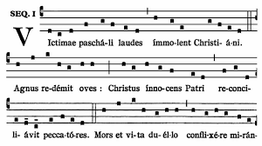
Easter SEQUENCE:
Victimae paschali laudes
Christians, to the Paschal Victim
Offer your thankful praises!
A Lamb the sheep redeems;
Christ, who only is sinless,
Reconciles sinners to the Father.
Death and life have contended in that combat stupendous:
The Prince of life, who died, reigns immortal.
Speak, Mary, declaring
What you saw, wayfaring.
“The tomb of Christ, who is living,
The glory of Jesus’ resurrection;
Bright angels attesting,
The shroud and napkin resting.
Yes, Christ my hope is arisen;
to Galilee he goes before you.”
Christ indeed from death is risen, our new life obtaining.
Have mercy, victor King, ever reigning!
Amen. Alleluia.

Slide 4
“Living Word” Webinar Series
Zoom Webinars on the Roman Catholic Lectionary for Mass
  Saturdays, 9:00 a.m. – 12:30 p.m. (Pacific Time)
  FREE (but donations appreciated)
Monthly, from Nov. 2020 to April 2021
  Nov. 21, 2020 – Readings of Advent
  Dec. 19, 2020 – Readings of the Christmas Season
  Jan. 9, 2021 – Gospel of Mark (Liturgical Year B)
  Feb. 13, 2021 – Readings of Lent
  March 27, 2021 – Readings of Holy Week & Easter Triduum
  April 17, 2021 – Readings of the Easter Season

Slide 5
Lectionary Readings
Basic Questions of This Year’s Webinar Series:
WHICH biblical texts are read at Catholic Masses?
  Seasons: Advent; Christmas; Lent; Easter; Ordinary Time
  Sundays/Feasts: 1st Reading, Psalm, 2nd Reading, Alleluia, Gospel
  Weekdays: 1st Reading, Psalm, Alleluia, Gospel
WHY were the assigned readings chosen?
  Brief “Rationale” in Lectionary’s “Introduction” (in printed editions)
    Chap. 2 in 1969 edition; or Chap. 5 in 1981 edition.
    Season by season; first Sundays/Feasts, then Weekdays
For charts, handouts, more info, see my website:
http://catholic-resources.org/Lectionary/
  Also has the full text of the 1981 “Introduction”

Slide 6
Catholic Lectionary for Mass
https://catholic-resources.org/Lectionary/
  Large section of my website
    Explains both pre-Vatican II and post-Vatican II Lectionaries
    Other websites have “Revised Common Lectionary” (mainline Protestants)
  Charts of Readings for each Liturgical Season
    Advent, Christmas, Lent, Easter, Ordinary Time, Saints, Rituals, etc.
    Study the tables either horizontally or vertically.
Connections between readings
  Horizontal: Connect the various readings used on one day.
    See the “headings” above each reading in a printed Lectionary
  Vertical: Consider all the readings of one type per season.
    All the Gospels of Advent, all the first readings of Easter, etc.

Slide 7

Outline of Today’s Webinar:
Easter Season: Overview & Structure
  Easter Triduum, Sunday, Octave, Season
  Initial Gospels: Empty Tomb & Resurrection Appearances
Easter Sundays & Weekdays (cont.)
  More Gospels: mostly JOHN
  First Readings: ACTS of the Apostles
3a) Second Readings on Sundays
  Year A: 1 Peter; Year C: Revelation
  Year B: 1 John
3b) Ascension & Pentecost
Ten-minute break between each part.
Optional extra Q&A after 12:30 ending.

Slide 8


Lectionary Structure: Sundays
Three-Year Cycle:
  Matthew (2020)
  Mark (2021)
  Luke (2022)
  Lent & Easter ABC: JOHN
Three Main Readings:
  OT Reading
  + Responsorial Psalm
  NT Epistles
  + Gospel Acclamation
  NT Gospel
See https://catholic-resources/Lectionary

Slide 9

Lectionary Structure: Weekdays
Two-Year Cycle:
  Odd Years
  Even Years
  Applies only to Ordinary Time
  Same readings each year for Advent, Xmas, Lent, Easter
Two Main Readings:
  First Reading (NT/OT)
  + Responsorial Psalm
  + “Second Reading” on some special days, like Ash Wednesday!
  Gospel
  preceded by “Verse before the Gospel”

Slide 10
Readings for Liturgical Seasons
Season of Advent
  www.catholic-resources.org/Lectionary/1998USL-Advent.htm
Season of Christmas
  www.catholic-resources.org/Lectionary/1998USL-Christmas.htm
Season of Lent
  www.catholic-resources.org/Lectionary/1998USL-Lent.htm
Season of Easter
  www.catholic-resources.org/Lectionary/1998USL-Easter.htm
Ordinary Time
  Year A; Year B; Year C

Slide 11
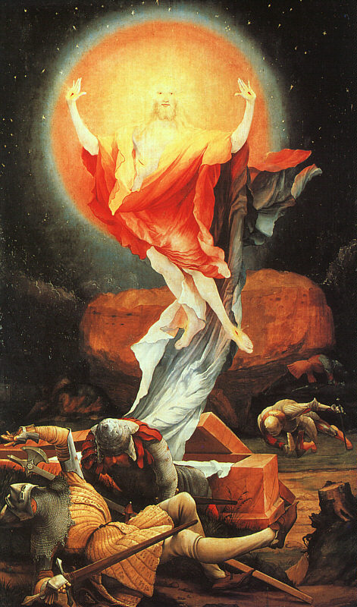
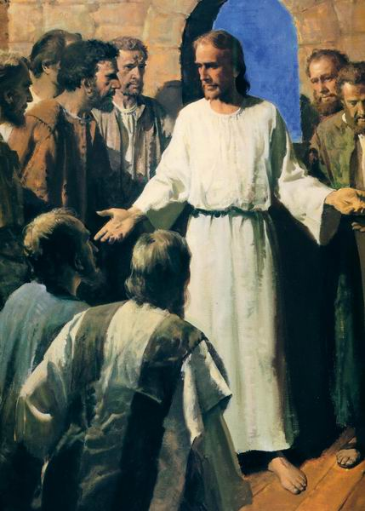
E A S T E R

Slide 12
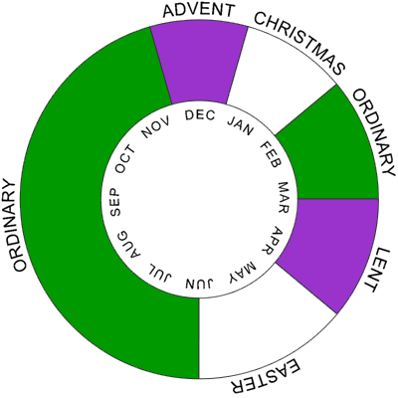
Christian Liturgical Year
Based on Life of Jesus:
  Advent
  CHRISTMAS
  Ordinary Time I
    After Epiphany/Baptism
  Lent
  EASTER
  Ordinary Time II
    After Pentecost
Some Confusions:
  Fitting ~33 years of his life into each calendar year today.

Slide 13
Lent, EASTER, Pentecost
Lent – Preparatory season of fasting & prayer
  Ash Wednesday to Holy Thursday (40 days?)
EASTER – Resurrection of Jesus
  Easter Triduum (3 holy days: Thurs. eve – Sun. eve)
    Holy Thursday (Last Supper); Good Friday (Crucifixion)
    Easter Vigil (Sat. evening; baptism of neophytes)
  Easter Sunday (Sun. after first full moon in Spring)
  Easter Octave (one full week = 8 days; Sun. to Sun.)
  Easter Season (7 weeks = 50 days, till Pentecost)
    Ascension of the Lord (40th day: Thursday; or 6th Sunday)
Pentecost – Coming of Holy Spirit (Acts 2)

Slide 14
General Intro to the Lectionary
(2nd Edition, 1981)
PART 2:
The Structure of the Order of Readings for Mass
Chap. IV: The General Arrangement of Readings for Mass
  The Pastoral Purpose of the Order of Readings for Mass
  The Principles of Composition of the Order of Readings for Mass
  Principles to Be Followed in the Use of the Order of Reading
Chap. V: Description of the Order of Readings
  Advent
  The Christmas Season
  Lent
  The Sacred Triduum and the Easter Season
  “Ordinary Time”

Slide 15
Lectionary for Mass, Intro –
The Sacred Easter Triduum:
On Holy Thursday at the evening Mass the remembrance of the meal preceding the Exodus casts its own special light because of the Christ's example in washing the feet of his disciples and Paul's account of the institution of the Christian Passover in the Eucharist.
On Good Friday the liturgical service has as its center John's narrative of the Passion of him who was proclaimed in Isaiah as the Servant of the Lord and who became the one High Priest by offering himself to the Father.
At the Vigil on the holy night of Easter there are seven Old Testament readings which recall the wonderful works of God in the history of salvation. There are two New Testament readings, the announcement of the Resurrection according to one of the Synoptic Gospels and a reading from St. Paul on Christian baptism as the sacrament of Christ's Resurrection.
The Gospel reading for the Mass on Easter day is from John on the finding of the empty tomb. There is also, however, the option to use the Gospel texts from the Easter Vigil or, when there is an evening Mass on Easter Sunday, to use the account in Luke of the Lord's appearance to the disciples on the road to Emmaus. The first reading is from the Acts of the Apostles, which throughout the Easter season replaces the Old Testament reading. The reading from the Apostle Paul concerns the living out of the paschal mystery in the Church.
(Lectionary for Mass, "Introduction," chap. 5, par. 99. – emphasis added)

Slide 16
Lectionary for Mass, Intro –
The Sundays:
The Gospel readings for the first three Sundays recount the appearances of the risen Christ. The readings about the Good Shepherd are assigned to the Fourth Sunday. On the Fifth, Sixth, and Seventh Sundays, there are excerpts from the Lord's discourse and prayer at the end of the Last Supper.
The first reading is from the Acts of the Apostles, in a three-year cycle of parallel and progressive selections: material is presented on the life of the early Church, its witness, and its growth.
For the reading from the Apostles (i.e., the “second reading”),
the First Letter of Peter is in Year A,
the First Letter of John in Year B,
the Book of Revelation in Year C.
These are the texts that seem to fit in especially well
with the spirit of joyous faith and sure hope proper to this season.
(Lectionary for Mass, "Introduction," chap. 5, par. 100. – bold emphases added)

Slide 17
Lectionary for Mass, Intro –
The Weekdays:
As on the Sundays, the first reading is a semicontinuous reading from the Acts of the Apostles.
The Gospel readings during the Easter octave are accounts of the Lord's appearances. After that there is a semicontinuous reading of the Gospel of John, but with texts that have a paschal character, in order to complete the reading from John during Lent. This paschal reading is made up in large part of the Lord's discourse and prayer at the end of the Last Supper.
(Lectionary for Mass, "Introduction," chap. 5, par. 101.)

Slide 18
Readings for the Easter Triduum
Day/Feast | 1st Reading | 2nd Reading | Gospel
Holy Thursday | Exod 12:1-8, 11-14 | 1 Cor 11:23-26 | John 13:1-15
Good Friday | Isa 52:13 – 53:12 | Heb 4:14-16; 5:7-9 | John 18:1 – 19:42
Easter Vigil | 1) Gen 1:1 – 2:2 or 1:1, 26-31a 2) Gen 22:1-18 (or shorter) 3) Exod 14:15 – 15:1 4) Isa 54:5-14 5) Isa 55:1-11 6) Bar 3:9-15, 32-4:4 7) Ezek 36:16-17a, 18-28 | Rom 6:3-11 | A) Matt 28:1-10 B) Mark 16:1-7 C) Luke 24:1-12
Easter Sunday | Acts 10:34a, 37-43 | Col 3:1-4 or 1 Cor 5:6b-8 | John 20:1-9 or Luke 24:13-35 (for afternoon Masses)

Slide 19
Readings for the Easter Season
Day/Feast | 1st Reading | 2nd Reading | Gospel
Sundays 2-6 (Year A) | Selections from Acts 2, 2, 2, 6, 8 | 1 Peter (excerpts) | 2) John 20:19-31 3) Luke 24:13-35 4) John 10:1-10 5-6) John 14 & 14 (excerpts)
Sundays 2-6 (Year B) | Selections from Acts 4, 3, 4, 9, 10 | 1 John (excerpts) | 2) John 20:19-31 3) Luke 24:35-48 4) John 10:11-18 5-6) John 15 & 15 (excerpts)
Sundays 2-6 (Year C) | Selections from Acts 5, 5, 13, 14, 15 | Revelation (excerpts) | 2) John 20:19-31 3) John 21:1-19 4) John 10:27-30 5-6) John 13 & 14 (excerpts)

Slide 20
Readings for the Easter Season (cont.)
Day/Feast | 1st Reading | 2nd Reading | Gospel
Ascension (now replaces the 7th Sunday) | Acts 1:1-11 | A) Eph 1:17-23 B) Eph 4:1-13 (optional) C) Heb 9:24-28; 10:19-23 (opt.) | A) Matt 28:16-20 B) Mark 16:15-20 C) Luke 24:46-53
Pentecost Vigil (ABC) | Gen 11 or Exod 19 or Ezek 37 or Joel 3 | Rom 8:22-27 | John 7:37-39
Pentecost Sunday (ABC) | Acts 2:1-11 | A) 1 Cor 12 B) Gal 5:16-25 (optional) C) Rom 8:8-17 (optional) | A) John 20:19-23 B) John 15:26-27; 16:12-15 C) John 14:14-16, 23b-26

Slide 21
Easter Sunday: Vigil (ABC)
OT Readings & Psalms
  7 options (minimum 3, or at least 2; always Exod 14:15—15:1)
NT Epistle: Rom 6:3-11
  Christ, raised from the dead, dies no more
Psalm 118:1-2, 16-17, 22-23
  Triple “Alleluia”
Gospel:
  A: Matt 28:1-10
  B: Mark 16:1-7
  C: Luke 24:1-12

Slide 22

Easter Sunday (ABC)
1st Reading: Acts 10:34a, 37-43
Resp. Psalm 118:1-2, 16-17, 22-23
2nd Reading:
  Col 3:1-4
  or 1 Cor 5:6b-8
Gospel:
  John 20:1-9
  or Luke 24:13-35b (afternoon Masses)
  or Gospel from the Easter Vigil (A/B/C)

Slide 23
Easter Sunday: Gospel Options
First Option: John 20:1-9
Afternoon/Evening: Luke 24:13-35
“The Gospel from the Easter Vigil may also be read… at any time of the day.”
  Year A: Matt 28:1-10
  Year B: Mark 16:1-7
  Year C: Luke 24:1-12
  [The “Empty Tomb Narratives” in the Synoptic Gospels]

Slide 24
Easter Sunday Gospel: John 20:1-9
On the first day of the week,
Mary of Magdala came to the tomb early in the morning,
while it was still dark, and saw the stone removed from the tomb.
So she ran and went to Simon Peter
and to the other disciple whom Jesus loved, and told them,
“They have taken the Lord from the tomb, and WE don’t know where they put him.”
So Peter and the other disciple went out and came to the tomb.
They both ran, but the other disciple ran faster than Peter and arrived at the tomb first;
he bent down and saw the burial cloths there, but did not go in.
When Simon Peter arrived after him,
he went into the tomb and saw the burial cloths there,
and the cloth that had covered his head,
not with the burial cloths but rolled up in a separate place.
Then the other disciple also went in,
the one who had arrived at the tomb first, and he saw and believed.
For they did not yet understand the Scripture that he had to rise from the dead.

Slide 25
Easter Sunday – also John 20:10-18?
¹⁰ Then the disciples returned home.
¹¹ But Mary stayed outside the tomb weeping. And as she wept, she bent over into the tomb
¹² and saw two angels in white sitting there, one at the head and one at the feet where the body of Jesus had been.
¹³ And they said to her, "Woman, why are you weeping?"
She said to them, "They have taken my Lord, and I don't know where they laid him."
¹⁴ When she had said this, she turned around and saw Jesus there,
but did not know it was Jesus.
¹⁵ Jesus said to her, "Woman, why are you weeping? Whom are you looking for?"
She thought it was the gardener and said to him,
"Sir, if you carried him away, tell me where you laid him, and I will take him."
¹⁶ Jesus said to her, "Mary!"
She turned and said to him in Hebrew, "Rabbouni," which means Teacher.
¹⁷ Jesus said to her, "Stop holding on to me, for I have not yet ascended to the Father.
But go to my brothers and tell them,
'I am going to my Father and your Father, to my God and your God.'"
¹⁸ Mary of Magdala went and announced to the disciples,
"I have seen the Lord," and what he told her. (NAB)

Slide 26
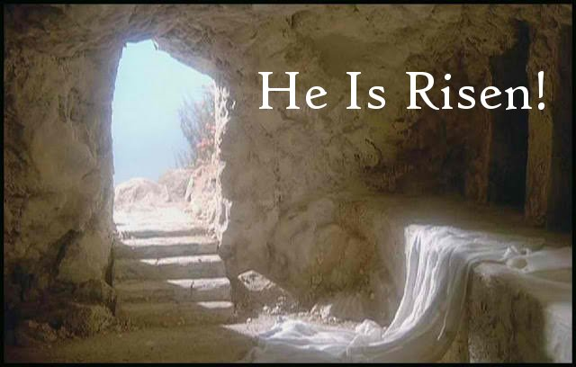
HAPPY EASTER !

Slide 27
Lectionary Intro – Easter Octave
“As on the Sundays, the first reading is a semicontinuous reading from the Acts of the Apostles.
The Gospel readings during the Easter octave are accounts of the Lord's appearances.
After that there is a semicontinuous reading of the Gospel of John, but with texts that have a paschal character, in order to complete the reading from John during Lent. This paschal reading is made up in large part of the Lord's discourse and prayer at the end of the Last Supper.”
(Lectionary for Mass, "Introduction," chap. 5, par. 101.)

Slide 28
Easter Octave: 1st Readings
Mon: Acts 2:14, 22-33
Tues: Acts 2:36-41
Wed: Acts 3:1-10
Thurs: Acts 3:11-26
Fri: Acts 4:1-12
Sat: Acts 4:13-21
2nd Sun: Acts (diff. in Years ABC)
Psalms – see https://catholic-resources.org/Lectionary/1998USL-Easter.htm

Slide 29
Easter Octave: Gospel Readings
Mon: Matt 28:8-15
Tues: John 20:11-18 (Mary Magd. – not read Sundays)
Wed: Luke 24:13-35
Thurs: Luke 24:35-48
Fri: John 21:1-14
Sat: Mark 16:9-15 (not read Sundays)
2nd Sun: John 20:19-31
Alleluia Verse (each day):
    “This is the day the Lord has made; let us be glad and rejoice in it.”

Slide 30
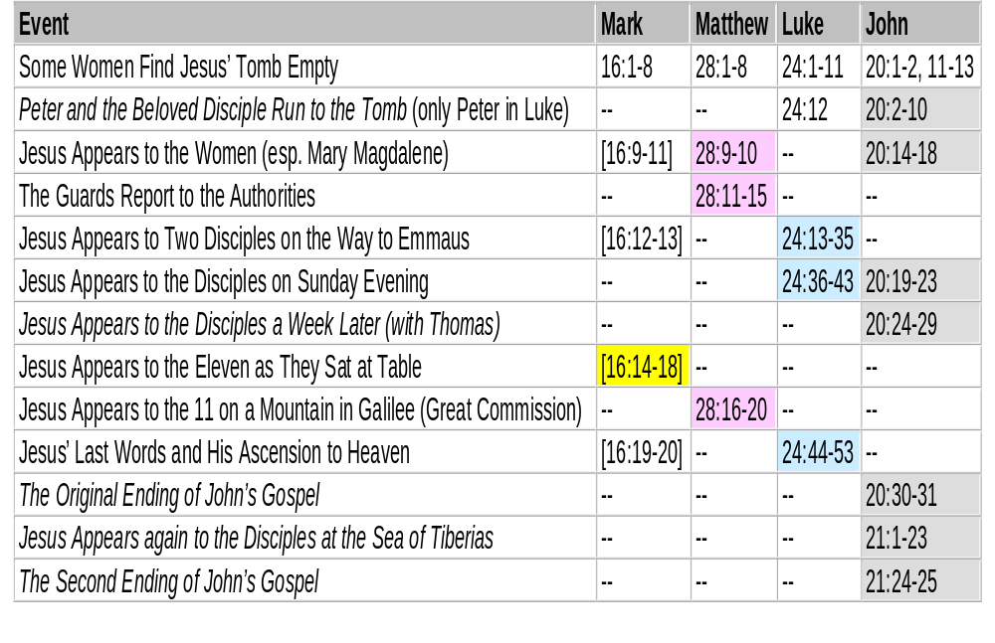
Appearances of the Risen Jesus

Slide 31
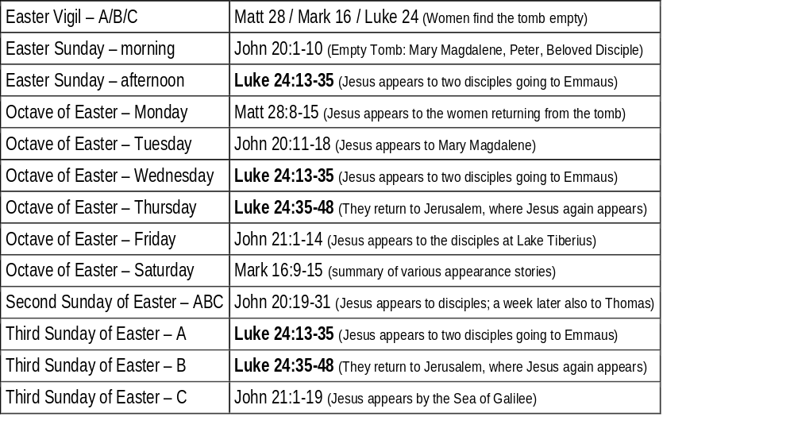
Appearance Stories in the Lectionary

Slide 32
John 20: Resurrection Appearances
Empty Tomb Narrative (vv. 1-10)
Risen Jesus Appears to Mary Magdalene on Sunday Morning (vv. 11-18)
Risen Jesus Appears to His Disciples that Sunday Evening (vv. 19-23)
Risen Jesus Appears to His Disciples again a Week Later (vv. 24-29)
Gospel's First Conclusion (vv. 30-31)

Slide 33
Epilogue (John 21:1-25)
Another Resurrection Appearance (21:1-14)
  Fishing Story, in Galilee (compare Luke 5?)
Jesus Asks Peter about his Love (21:15-19)
  Three sets: Question, Responses, Commission
  Two different verbs: Agapein vs. Philein?
Peter and the Beloved Disciple (21:20-23)
  He "remains"; You "follow me"; False Rumors?
Second Conclusion to the Gospel (21:24-25)
  Not enough books ! ? !

Slide 34
Easter Season Gospels: Overview
2nd Sun, ABC: John 20:19-31 (Thomas)
3rd Sun, AB: Luke 24; C: John 21
4th Sun: John 10 (Good Shepherd)
5th & 6th Suns: John 13, 14, 15 excerpts
  Esp. on Holy Spirit, Paraclete
Ascension: Matt 28 / Mark 16 / Luke 24
  [7th Sun: John 17 – Jesus’ Prayer]
Pentecost: Focus on Holy Spirit

Slide 35
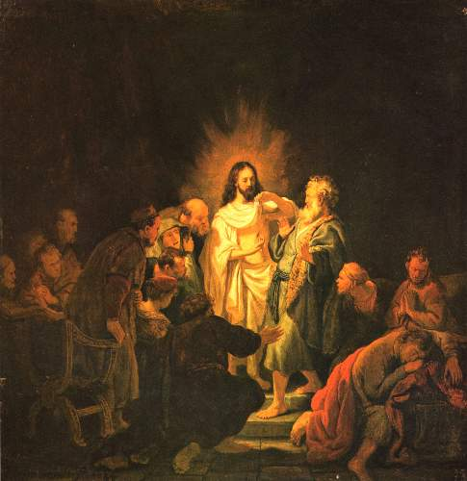

Slide 36
Easter 2ABC – John 20:19-31
On the evening of that first day of the week,
when the doors were locked, where the disciples were, for fear of the Jews,
Jesus came and stood in their midst and said to them, “Peace be with you.”
When he had said this, he showed them his hands and his side.
The disciples rejoiced when they saw the Lord.
Jesus said to them again, “Peace be with you.
As the Father has sent me, so I send you.”
And when he had said this, he breathed on them and said to them,
“Receive [the] Holy Spirit.
Whose sins you forgive are forgiven them, and whose [sins] you retain are retained.”
Thomas, called Didymus, one of the Twelve, was not with them when Jesus came.
So the other disciples said to him, “We have seen the Lord.”
But he said to them, “Unless I see the mark of the nails in his hands
and put my finger into the nailmarks
and put my hand into his side, I will not believe.”

Slide 37
Easter 2ABC – John 20:19-31 (cont.)
Now a week later his disciples were again inside and Thomas was with them.
Jesus came, although the doors were locked,
and stood in their midst and said, “Peace be with you.”
Then he said to Thomas, “Put your finger here and see my hands,
and bring your hand and put it into my side,
and do not be unbelieving, but believe.”
Thomas answered and said to him, “My Lord and my God!”
Jesus said to him, “Have you come to believe because you have seen me?
Blessed are those who have not seen and have believed.”
Now Jesus did many other signs in the presence of his disciples
that are not written in this book.
But these are written that you may [come to] believe
that Jesus is the Christ, the Son of God,
and that through this belief you may have life in his name.
[better: that by believing you may have life in his name.]

Slide 38
Relationship of Seeing & Believing
In John, “believe” is always a VERB (action/ doing)
never a noun (“faith” or “belief”).
“Unless I see… I will not believe” (Thomas)
“Blessed are those who have not seen and have believed” (Jesus)
Rather:
Unless we believe, we cannot see!

Slide 39
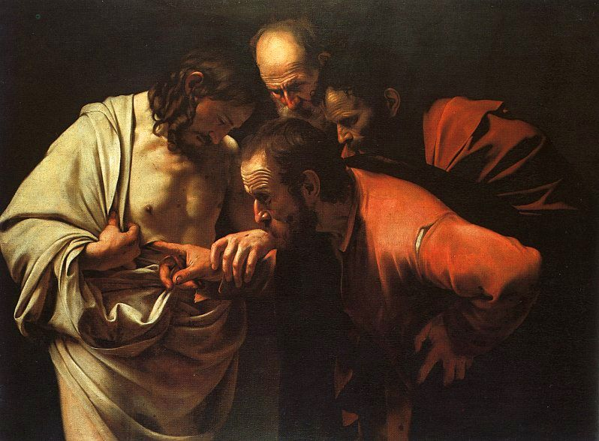

Slide 40
Easter 3A – Luke 24:13-35
That very day, the first day of the week, two of Jesus’ disciples were going
to a village seven miles from Jerusalem called Emmaus,
and they were conversing about all the things that had occurred.
And it happened that while they were conversing and debating,
Jesus himself drew near and walked with them, but their eyes were prevented from recognizing him.
He asked them, “What are you discussing as you walk along?”
They stopped, looking downcast. One of them, named Cleopas, said to him in reply,
“Are you the only visitor to Jerusalem who does not know of the things that have taken place there in these days?”
And he replied to them, “What sort of things?”
They said to him, “The things that happened to Jesus the Nazarene,
who was a prophet mighty in deed and word before God and all the people,
how our chief priests and rulers both handed him over to a sentence of death and crucified him.
But we were hoping that he would be the one to redeem Israel;
and besides all this, it is now the third day since this took place.
Some women from our group, however, have astounded us:
they were at the tomb early in the morning and did not find his body;
they came back and reported that they had indeed seen a vision of angels
who announced that he was alive. Then some of those with us went to the tomb
and found things just as the women had described, but him they did not see.”
And he said to them, “Oh, how foolish you are! How slow of heart to believe all that the prophets spoke!
Was it not necessary that the Christ should suffer these things and enter into his glory?”
Then beginning with Moses and all the prophets, he interpreted to them what referred to him in all the Scriptures.
As they approached the village to which they were going, he gave the impression that he was going on farther.
But they urged him, “Stay with us, for it is nearly evening and the day is almost over.”
So he went in to stay with them. And it happened that, while he was with them at table,
he took bread, said the blessing, broke it, and gave it to them.
With that their eyes were opened and they recognized him, but he vanished from their sight.
Then they said to each other, “Were not our hearts burning within us
while he spoke to us on the way and opened the Scriptures to us?”
So they set out at once and returned to Jerusalem where they found gathered together
the eleven and those with them who were saying,
“The Lord has truly been raised and has appeared to Simon!”
Then the two recounted what had taken place on the way and how he was made known to them in the breaking of bread.

Slide 41
Easter 3B – Luke 24:35-48
The two disciples recounted what had taken place on the way,
and how Jesus was made known to them in the breaking of bread.
While they were still speaking about this, he stood in their midst and said to them,
“Peace be with you.”
But they were startled and terrified and thought that they were seeing a ghost.
Then he said to them, “Why are you troubled? And why do questions arise in your hearts?
Look at my hands and my feet, that it is I myself.
Touch me and see, because a ghost does not have flesh and bones as you can see I have.”
And as he said this, he showed them his hands and his feet.
While they were still incredulous for joy and were amazed,
he asked them, “Have you anything here to eat?”
They gave him a piece of baked fish; he took it and ate it in front of them.
He said to them, “These are my words that I spoke to you while I was still with you,
that everything written about me in the law of Moses
and in the prophets and psalms must be fulfilled.”
Then he opened their minds to understand the Scriptures.
And he said to them, “Thus it is written that the Christ would suffer
and rise from the dead on the third day
and that repentance, for the forgiveness of sins, would be preached in his name
to all the nations, beginning from Jerusalem. You are witnesses of these things.”

Slide 42
Easter 3C – John 21:1-19 (or 1-14)
At that time, Jesus revealed himself again to his disciples at the Sea of Tiberias. He revealed himself in this way.
Together were Simon Peter, Thomas called Didymus, Nathanael from Cana in Galilee, Zebedee's sons, and two others of his disciples.
Simon Peter said to them, "I am going fishing." They said to him, "We also will come with you."
So they went out and got into the boat, but that night they caught nothing.
When it was already dawn, Jesus was standing on the shore; but the disciples did not realize that it was Jesus.
Jesus said to them, "Children, have you caught anything to eat?" They answered him, "No."
So he said to them, "Cast the net over the right side of the boat and you will find something."
So they cast it, and were not able to pull it in because of the number of fish.
So the disciple whom Jesus loved said to Peter, "It is the Lord."
When Simon Peter heard that it was the Lord, he tucked in his garment, for he was lightly clad, and jumped into the sea.
The other disciples came in the boat, for they were not far from shore, only about a hundred yards, dragging the net with the fish.
When they climbed out on shore, they saw a charcoal fire with fish on it and bread.
Jesus said to them, "Bring some of the fish you just caught."
So Simon Peter went over and dragged the net ashore full of one hundred fifty-three large fish.
Even though there were so many, the net was not torn. Jesus said to them, "Come, have breakfast."
And none of the disciples dared to ask him, "Who are you?“ because they realized it was the Lord.
Jesus came over and took the bread and gave it to them, and in like manner the fish.
This was now the third time Jesus was revealed to his disciples after being raised from the dead.
When they had finished breakfast, Jesus said to Simon Peter,
"Simon, son of John, do you love me more than these?"
Simon Peter answered him, "Yes, Lord, you know that I love you." Jesus said to him, "Feed my lambs."
He then said to Simon Peter a second time, "Simon, son of John, do you love me?"
Simon Peter answered him, "Yes, Lord, you know that I love you." Jesus said to him, "Tend my sheep."
Jesus said to him the third time, "Simon, son of John, do you love me?"
Peter was distressed that Jesus had said to him a third time, "Do you love me?" and he said to him,
"Lord, you know everything; you know that I love you." Jesus said to him, "Feed my sheep.
Amen, amen, I say to you, when you were younger, you used to dress yourself and go where you wanted;
but when you grow old, you will stretch out your hands, and someone else will dress you
and lead you where you do not want to go."
He said this signifying by what kind of death he would glorify God.
And when he had said this, he said to him, "Follow me."

Slide 43
Easter Gospels – Sundays & Weekdays
John 3 & 6 – weekdays only (wks 2 & 3)
John 10 – 4th Sunday
John 13-16 – 5th & 6th Sundays
[John 17 – 7th Sunday]
John 21
  21:1-19 (or 21:1-14) – Sunday 3C
  21:1-14 – Octave, Friday
  21:15-19 – 7th Week, Friday
  21:20-25 – 7th Week, Saturday

Slide 44

Questions & Break
Questions?
  Please “raise your hands” (electronically)
  Or open your mic
Break
  We will continue in 10 minutes.

Slide 45
Mount Saint Mary’s University “Ecclesia” Program Presents:
Living Word: Scriptures of the 2021 Liturgical Year
Lectionary Readings for the
Easter Season
Fr. Felix Just, S.J., Ph.D.
Living Word Catholic Biblical Ministries
http://catholic-resources.org

Slide 46
Outline of Today’s Webinar:
Easter Season: Overview & Structure
  Easter Triduum, Sunday, Octave, Season
  Initial Gospels: Empty Tomb & Resurrection Appearances
Easter Sundays & Weekdays (cont.)
  More Gospels: mostly JOHN
  First Readings: ACTS of the Apostles
3a) Second Readings on Sundays
  Year A: 1 Peter; Year C: Revelation
  Year B: 1 John
3b) Ascension & Pentecost
Ten-minute break between each part.
Optional extra Q&A after 12:30 ending.

Slide 47
Easter Gospels – Sundays & Weekdays
John 3 & 6 – weekdays only (weeks 2 & 3)
John 10 – 4th Sunday & weekdays
John 13-16 – 5th & 6th Sundays & weekdays
[John 17 – 7th Sunday & week 7]
John 21
  21:1-19 (or 21:1-14) – Sunday 3C
  21:1-14 – Octave, Friday
  21:15-19 – 7th Week, Friday
  21:20-25 – 7th Week, Saturday
See https://catholic-resources.org/John/Outlines.html

Slide 48
ACTS of the APOSTLES
See
https://catholic-resources.org/Bible/Acts.htm
and
https://catholic-resources.org/Lectionary/Overview-Acts.htm

Slide 49
Holy Spirit in ACTS
The Acts of the Apostles?
  Vol. 2, sequel to Luke’s Gospel (see Acts 1:1)
  Similar themes & emphases as Luke’s Gospel
  Prayer, Praise, Preaching, Poor, Healings, Meals…
The Acts of the Holy Spirit?
  As in Luke's Gospel, the Spirit of God inspires and guides most of the action in Acts.
  Disciples depicted just like Jesus, filled w/ God’s Spirit
  This book could be called "The Acts of the Holy Spirit"

Slide 50
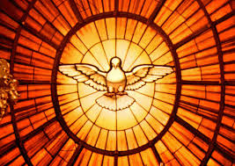
“Acts of the Holy Spirit”

Slide 51
Holy Spirit in ACTS (cont.)
Author (Luke) tells us that Jesus gave instructions to his chosen apostles "through the Holy Spirit " (Acts 1:2)
The disciples are "baptized with the Holy Spirit " on the day of Pentecost
  Event promised by Jesus in 1:5, 8
  Event narrated by the Evangelist in 2:1-4
  Event recalled by Peter in 11:15-16

Slide 52
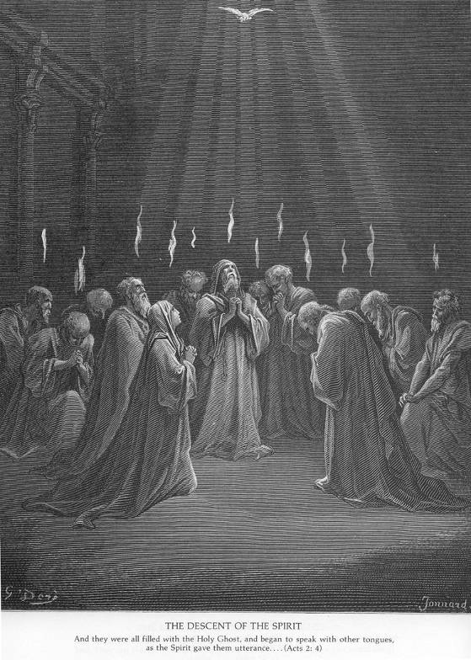
Pentecost
(Acts 2)
Gustave Doré

Slide 53
Pentecost Event in ACTS 2
When the day of Pentecost had come, they were all together in one place. ² And suddenly from heaven there came a sound like the rush of a violent wind, and it filled the entire house where they were sitting. ³ Divided tongues, as of fire, appeared among them, and a tongue rested on each of them. ⁴ All of them were filled with the Holy Spirit and began to speak in other languages, as the Spirit gave them ability.
⁵ Now there were devout Jews from every nation under heaven living in Jerusalem. ⁶ And at this sound the crowd gathered and was bewildered, because each one heard them speaking in the native language of each. ⁷ Amazed and astonished, they asked, "Are not all these who are speaking Galileans? ⁸ And how is it that we hear, each of us, in our own native language? ⁹ Parthians, Medes, Elamites, and residents of Mesopotamia, Judea and Cappadocia, Pontus and Asia, ¹⁰ Phrygia and Pamphylia, Egypt and the parts of Libya belonging to Cyrene, and visitors from Rome, both Jews and proselytes, ¹¹ Cretans and Arabs--in our own languages we hear them speaking about God's deeds of power."
¹² All were amazed and perplexed, saying to one another, "What does this mean?"
¹³ But others sneered and said, "They are filled with new wine."

Slide 54
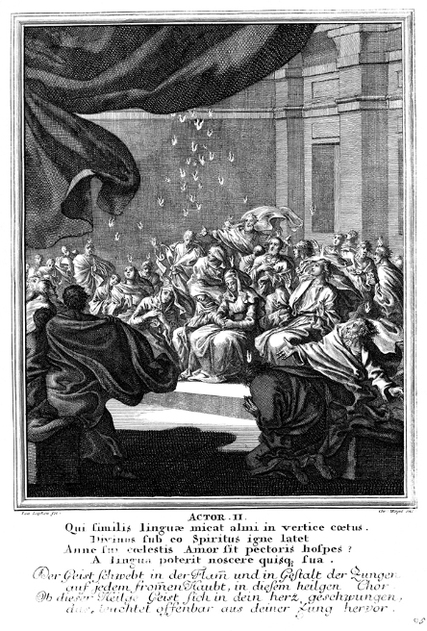
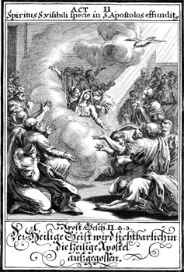
Pentecost: Spirit, Wind, Fire

Slide 55
Holy Spirit in ACTS (cont.)
The apostles are "full of" or "filled with" the Holy Spirit, esp. when they preach.
  (1:8; 2:4; 4:8, 31; 11:24; 13:9, 52)
The Spirit "speaks to" the apostles and prophets.
  (8:29; 10:19; 11:12; 13:1-4; 21:11)
Deacons/ministers must also be "full of the Spirit,"
esp. when they prophesy.
  (6:1-6, 10; 7:55-59; 11:28; 21:4)
Just as H.S. spoke through King David and the prophets in ancient Israel. (1:16; 4:25; 28:25)

Slide 56
Holy Spirit in ACTS (cont.)
God "will pour out" his Spirit on all people and all nations in the last days.
  (2:17-18, 33; 10:45)
Believers, including Gentiles, receive the Holy Spirit when they repent and are baptized.
  (2:38; 15:8; 19:5-6)
Sometimes the reception of the Holy Spirit even precedes baptism. (see 10:44-48)

Slide 57
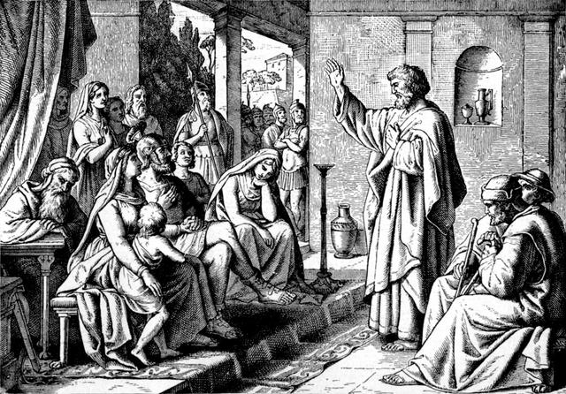
Peter & Cornelius (Acts 10)

Slide 58
Holy Spirit in ACTS 10
Peter in the Household of Cornelius (Roman Centurion)
⁴⁴ While Peter was still speaking, the Holy Spirit fell upon all who heard the word. ⁴⁵ The circumcised believers who had come with Peter were astounded that the gift of the Holy Spirit had been poured out even on the Gentiles,
⁴⁶ for they heard them speaking in tongues and extolling God. Then Peter said, ⁴⁷ "Can anyone withhold the water for baptizing these people who have received the Holy Spirit just as we have?" ⁴⁸ So he ordered them to be baptized in the name of Jesus Christ. Then they invited him to stay for several days.

Slide 59
Holy Spirit in ACTS (cont.)
Some people "test" or "lie to" or "oppose" the Holy Spirit, with dire consequences.
  (5:1-11; 7:51)
Spirit is conferred through the "laying on of hands."
  (8:17-19; 9:17; 19:6)
The Spirit leads and guides the decisions and actions of the Christian leaders.
  (15:28; 16:6-7; 19:21; 20:22-23)

Slide 60
Questions & Break
Questions?
  Please “raise your hands” (electronically)
  Or open your mic
Break
  We will continue in 10 minutes.

Slide 61
Mount Saint Mary’s University “Ecclesia” Program Presents:
Living Word: Scriptures of the 2021 Liturgical Year
Lectionary Readings for the
Easter Season
Fr. Felix Just, S.J., Ph.D.
Living Word Catholic Biblical Ministries
http://catholic-resources.org

Slide 62
Outline of Today’s Webinar:
Easter Season: Overview & Structure
  Easter Triduum, Sunday, Octave, Season
  Initial Gospels: Empty Tomb & Resurrection Appearances
Easter Sundays & Weekdays (cont.)
  More Gospels: mostly JOHN
  First Readings: ACTS of the Apostles
3a) Second Readings on Sundays
  Year A: 1 Peter; Year C: Revelation
  Year B: 1 John
3b) Ascension & Pentecost
Ten-minute break between each part.
Optional extra Q&A after 12:30 ending.

Slide 63
Lectionary for Mass, Intro –
The Sundays:
The Gospel readings…
The first reading…
For the reading from the Apostles (i.e., the “second reading”),
the First Letter of Peter is in Year A,
the First Letter of John in Year B,
the Book of Revelation in Year C.
These are the texts that seem to fit in especially well
with the spirit of joyous faith and sure hope proper to this season.
(Lectionary for Mass, "Introduction," chap. 5, par. 100. – bold emphases added)

Slide 64
Easter Sundays, Year A – 2nd Rdgs
2nd Sun: 1 Pet 1:3-9
3rd Sun: 1 Pet 1:17-21
4th Sun: 1 Pet 2:20b-25
5th Sun: 1 Pet 2:4-9
6th Sun: 1 Pet 3:15-18
7th Sun: 1 Pet 4:13-16
Suggestion: Read ALL of 1 Peter
See http://catholic-resources.org/Bible/Epistles-Peter.htm

Slide 65
Easter Sundays, Year C – 2nd Rdgs
2nd Sun: Rev 1:9-11a, 12-13, 17-19
3rd Sun: Rev 5:11-14
4th Sun: Rev 7:9, 14b-17
5th Sun: Rev 21:1-5a
6th Sun: Rev 21:10-14, 22-23
[7th Sun: Rev 22:12-14, 16-17, 20]
  Supplanted by Ascension?
Suggestion: Read ALL of REV, esp. ch. 21-22

Slide 66
Easter Sundays, Year B – 2nd Rdgs
2nd Sun: 1 John 5:1-6
  “Whoever is begotten by God conquers the world.”
3rd Sun: 1 John 2:1-5a
  “Jesus Christ is expiation not for our sins only but for those of the whole world.”
4th Sun: 1 John 3:1-2
  “We shall see God as he really is.”
5th Sun: 1 John 3:18-24
  “This is his commandment: that we may believe and love.”
6th Sun: 1 John 4:7-10
  “God is love.”
[7th Sun: 1 John 4:11-16 – Supplanted by Ascension?]
Suggestion: Read ALL of 1 John

Slide 67
Study Material on 1 John
See
https://catholic-resources.org/John/Epistles.html

Slide 68
Easter 2B – 1 John 5:1-6
Beloved:
Everyone who BELIEVES that Jesus is the Christ is begotten by God,
and everyone who LOVES the Father LOVES also the one begotten by him.
In this way we know that we LOVE the children of God
when we LOVE God and obey his commandments.
For the LOVE of God is this, that we keep his commandments.
And his commandments are not burdensome,
for whoever is begotten by God conquers the world.
And the victory that conquers the world is our FAITH.
Who indeed is the victor over the world
but the one who BELIEVES that Jesus is the Son of God?
This is the one who came through water and blood, Jesus Christ,
not by water alone, but by water and blood.
The Spirit is the one that testifies, and the Spirit is truth.

Slide 69
Easter 3B – 1 John 2:1-5a
My children, I am writing this to you
so that you may not commit sin.
But if anyone does sin, we have an Advocate with the Father,
Jesus Christ the righteous one.
He is expiation for our sins,
and not for our sins only but for those of the whole world.
The way we may be sure that we know him is to keep
his commandments.
Those who say, “I know him,” but do not keep his commandments
are liars, and the truth is not in them.
But whoever keeps his word,
the love of God is truly perfected in him.

Slide 70
Easter 4B – 1 John 3:1-2
Beloved:
See what love the Father has bestowed on us
that we may be called the children of God.
Yet so we are.
The reason the world does not know us
is that it did not know him.
Beloved, we are God’s children now;
what we shall be has not yet been revealed.
We do know that when it is revealed we shall be like him,
for we shall see him as he is.

Slide 71
Easter 5B – 1 John 3:18-24
Children, let us love not in word or speech but in deed and truth.
Now this is how we shall know that we belong to the truth
and reassure our hearts before him
in whatever our hearts condemn,
for God is greater than our hearts and knows everything.
Beloved, if our hearts do not condemn us,
we have confidence in God
and receive from him whatever we ask,
because we keep his commandments and do what pleases him.
And his commandment is this:
we should believe in the name of his Son, Jesus Christ,
and love one another just as he commanded us.
Those who keep his commandments remain in him, and he in them,
and the way we know that he remains in us
is from the Spirit he gave us.

Slide 72
Easter 6B – 1 John 4:7-10
Beloved, let us love one another,
because love is of God;
everyone who loves is begotten by God and knows God.
Whoever is without love does not know God, for God is love.
In this way the love of God was revealed to us:
God sent his only Son into the world
so that we might have life through him.
In this is love:
not that we have loved God, but that he loved us
and sent his Son as expiation for our sins.

Slide 73
Easter 7B – 1 John 4:11-16
Beloved, if God so loved us,
we also must love one another.
No one has ever seen God.
Yet, if we love one another, God remains in us,
and his love is brought to perfection in us.
This is how we know that we remain in him and he in us,
that he has given us of his Spirit.
Moreover, we have seen and testify
that the Father sent his Son as savior of the world.
Whoever acknowledges that Jesus is the Son of God,
God remains in him and he in God.
We have come to know and to believe in the love God has for us.
God is love, and whoever remains in love
remains in God and God in him.

Slide 74
Lectionary for Mass, Intro –
The Solemnities of the Ascension and of Pentecost:
For the first reading the Solemnity of the Ascension retains the account of the Ascension according to the Acts of the Apostles. This text is complemented by the second reading from the Apostle on Christ in exaltation at the right hand of the Father. For the Gospel reading, each of the three Years has its own text in accord with the differences in the Synoptic Gospels.
In the evening Mass celebrated on the Vigil of Pentecost four Old Testament texts are provided; any one of them may be used, in order to bring out the many aspects of Pentecost. The reading from the Apostles shows the actual working of the Holy Spirit in the Church. The Gospel reading recalls the promise of the Spirit made by Christ before his own glorification.
For the Mass on Pentecost day itself, in accord with received usage, the account in the Acts of the Apostles of the great occurrence on Pentecost day is taken as the first reading. The texts from the Apostle Paul bring out the effect of the action of the Spirit in the life of the Church. The Gospel reading is a remembrance of Jesus bestowing his Spirit on the disciples on the evening of Easter day; other optional texts describe the action of the Spirit on the disciples and on the Church.
(Lectionary for Mass, "Introduction," chap. 5, par. 102. – emphasis added)

Slide 75
Ascension: Thursday or Sunday?
Thursday:
  Ecclesiastical provinces of Boston, Hartford, New York, Newark, Omaha, and Philadelphia
  I.e. North-East & Nebraska
Sunday:
  Rest of USA
  Advantage: more people celebrate Ascension
  Disadvantage: drops 7th Easter Sun. readings
    Esp. John 17, Great Prayer of Jesus (Tues.-Thurs.)

Slide 76
Ascension, Years ABC
1st Reading (ABC): ACTS 1:1-11
  “As the Apostles were looking on, Jesus was lifted up.”
Responsorial (ABC): Psalm 47:2-3, 6-7, 8-9
  “God mounts his throne to shouts of joy: a blare of trumpets for the Lord.”
2nd Readings:
  A: Eph 1:17-23 – “God seated Jesus at his right hand in the heavens.”
  B (opt.): Eph 4:1-13 – “To the extent of the full stature of Christ.”
  C (opt.): Heb 9:24-28; 10:19-23 – “Christ has entered into heaven itself.”

Slide 77
Ascension, Years ABC – Gospels
Gospel Acclamation: Mt 28:19a, 20b
  “Go and teach all nations, says the Lord;
  I am with you always, until the end of the world.”
Gospels:
  Year A: Matt 28:16-20
    “All power in heaven and on earth has been given to me.”
  Year B: Mark 16:15-20
    “The Lord Jesus was taken up into heaven
    and took his seat at the right hand of God.”
  Year C: Luke 24:46-53
    “As he blessed them, he was taken up to heaven.”

Slide 78
Ascension (ABC) – Acts 1:1-11
In the first book, Theophilus,
I dealt with all that Jesus did and taught
until the day he was taken up,
after giving instructions through the Holy Spirit
to the apostles whom he had chosen.
He presented himself alive to them
by many proofs after he had suffered,
appearing to them during forty days
and speaking about the kingdom of God.
While meeting with them,
he enjoined them not to depart from Jerusalem,
but to wait for “the promise of the Father
about which you have heard me speak;
for John baptized with water,
but in a few days you will be baptized with the Holy Spirit.”

Slide 79
Ascension (ABC) – Acts 1:1-11, cont.
When they had gathered together they asked him,
“Lord, are you at this time going to restore the kingdom to Israel?”
He answered them, “It is not for you to know the times or seasons
that the Father has established by his own authority.
But you will receive power when the Holy Spirit comes upon you,
and you will be my witnesses in Jerusalem,
throughout Judea and Samaria, and to the ends of the earth.”
When he had said this, as they were looking on,
he was lifted up, and a cloud took him from their sight.
While they were looking intently at the sky as he was going,
suddenly two men dressed in white garments stood beside them.
They said, “Men of Galilee, why are you standing there looking at the sky?
This Jesus who has been taken up from you into heaven
will return in the same way as you have seen him going into heaven.”

Slide 80
Ascension (ABC) – Psalm 47
Ref. (6) – God mounts his throne to shouts of joy:
a blare of trumpets for the Lord. or: Alleluia.
All you peoples, clap your hands,
shout to God with cries of gladness,
For the LORD, the Most High, the awesome,
is the great king over all the earth. Ref.
God mounts his throne amid shouts of joy;
the LORD, amid trumpet blasts.
Sing praise to God, sing praise;
sing praise to our king, sing praise. Ref.
For king of all the earth is God;
sing hymns of praise.
God reigns over the nations,
God sits upon his holy throne. Ref.

Slide 81
Ascension, A – Eph 1:17-23
Brothers and sisters:
May the God of our Lord Jesus Christ, the Father of glory,
give you a Spirit of wisdom and revelation resulting in knowledge of him.
May the eyes of your hearts be enlightened,
that you may know what is the hope that belongs to his call,
what are the riches of glory in his inheritance among the holy ones,
and what is the surpassing greatness of his power for us who believe,
in accord with the exercise of his great might, which he worked in Christ,
raising him from the dead and seating him at his right hand
in the heavens, far above every principality, authority, power, and dominion,
and every name that is named not only in this age but also in the one to come.
And he put all things beneath his feet
and gave him as head over all things to the church, which is his body,
the fullness of the one who fills all things in every way.

Slide 82
Ascension, B – Eph 4:1-13
Brothers and sisters, I, a prisoner for the Lord,
urge you to live in a manner worthy of the call you have received,
with all humility and gentleness, with patience, bearing with one another through love,
striving to preserve the unity of the spirit through the bond of peace:
one body and one Spirit, as you were also called to the one hope of your call;
one Lord, one faith, one baptism;
one God and Father of all, who is over all and through all and in all.
But grace was given to each of us according to the measure of Christ’s gift.
Therefore, it says:
He ascended on high and took prisoners captive; he gave gifts to men.
What does “he ascended” mean except that he also descended into the lower regions of the earth?
The one who descended is also the one who ascended far above all the heavens,
that he might fill all things.
And he gave some as apostles, others as prophets,
others as evangelists, others as pastors and teachers,
to equip the holy ones for the work of ministry, for building up the body of Christ,
until we all attain to the unity of faith and knowledge of the Son of God, to mature to manhood,
to the extent of the full stature of Christ.

Slide 83
Ascension, C – Heb 9:24-28; 10:19-23
Christ did not enter into a sanctuary made by hands, a copy of the true one, but heaven itself,
that he might now appear before God on our behalf. Not that he might offer himself repeatedly,
as the high priest enters each year into the sanctuary with blood that is not his own;
if that were so, he would have had to suffer repeatedly from the foundation of the world.
But now once for all he has appeared at the end of the ages to take away sin by his sacrifice.
Just as it is appointed that men and women die once, and after this the judgment, so also Christ,
offered once to take away the sins of many, will appear a second time, not to take away sin
but to bring salvation to those who eagerly await him.
Therefore, brothers and sisters, since through the blood of Jesus
we have confidence of entrance into the sanctuary
by the new and living way he opened for us through the veil, that is, his flesh,
and since we have a great priest over the house of God,
let us approach with a sincere heart and in absolute trust,
with our hearts sprinkled clean from an evil conscience
and our bodies washed in pure water.
Let us hold unwaveringly to our confession that gives us hope,
for he who made the promise is trustworthy.

Slide 84
Ascension, A – Matt 28:16-20
The eleven disciples went to Galilee,
to the mountain to which Jesus had ordered them.
When they saw him, they worshiped, but they doubted.
Then Jesus approached and said to them,
“All power in heaven and on earth has been given to me.
Go, therefore, and make disciples of all nations,
baptizing them in the name of the Father,
and of the Son, and of the Holy Spirit,
teaching them to observe all that I have commanded you.
And behold, I am with you always, until the end of the age.”

Slide 85
Ascension, A – Matt 28:16-20
“All power in heaven and on earth has been given to me.
Evangelize: Go, therefore, and make disciples of all nations,
Sacramentalize: baptizing them in the name of the Father,
and of the Son, and of the Holy Spirit,
Catechize: teaching them to observe all that I have commanded you.
And behold, I am with you always, until the end of the age.”

Slide 86
Ascension, B – Mark 16:15-20
He said to them, “Go into the whole world and proclaim the gospel to every creature. ¹⁶ Whoever believes and is baptized will be saved; whoever does not believe will be condemned. ¹⁷ These signs will accompany those who believe: in my name they will drive out demons, they will speak new languages. ¹⁸ They will pick up serpents with their hands, and if they drink any deadly thing, it will not harm them. They will lay hands on the sick, and they will recover.”
¹⁹ So then the Lord Jesus, after he spoke to them, was taken up into heaven and took his seat at the right hand of God. ²⁰ But they went forth and preached everywhere, while the Lord worked with them and confirmed the word through accompanying signs.

Slide 87
Ascension, C – Luke 24:46-53
And he said to them, “Thus it is written that the Messiah would suffer and rise from the dead on the third day ⁴⁷ and that repentance, for the forgiveness of sins, would be preached in his name to all the nations, beginning from Jerusalem. ⁴⁸ You are witnesses of these things. ⁴⁹ And behold I am sending the promise of my Father upon you; but stay in the city until you are clothed with power from on high.”
⁵⁰ Then he led them out as far as Bethany, raised his hands, and blessed them. ⁵¹ As he blessed them he parted from them and was taken up to heaven. ⁵² They did him homage and then returned to Jerusalem with great joy, ⁵³ and they were continually in the temple praising God.

Slide 88
Is Jesus Still With Us?
Typical Catholic Answer: Yes!
  Really? Where? How? Just like we are?
BOTH/AND Approach:
  Theology: Always BOTH sides of a coin!
  http://catholic-resources.org/Both-And.htm
Is Jesus present with us? Yes and No!
  Matthew 28: Jesus’ PRESENCE
  Luke 24: Jesus’ ABSENCE

Slide 89
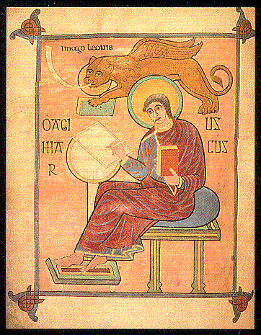
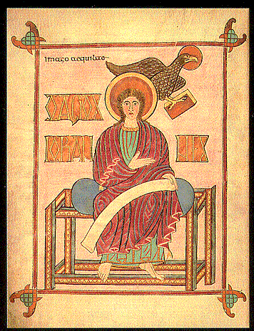
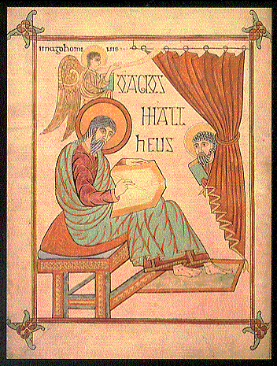
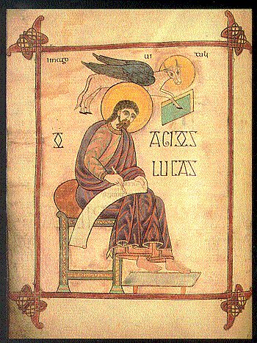

Slide 90
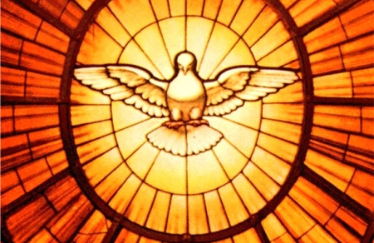
PENTECOST

Slide 91
Lectionary for Mass, Intro –
The Solemnities of the Ascension and of Pentecost:
For the first reading the Solemnity of the Ascension retains the account of the Ascension according to the Acts of the Apostles.
This text is complemented by the second reading from the Apostle on Christ in exaltation at the right hand of the Father.
For the Gospel reading, each of the three Years has its own text in accord with the differences in the Synoptic Gospels.
In the evening Mass celebrated on the Vigil of Pentecost four Old Testament texts are provided; any one of them may be used, in order to bring out the many aspects of Pentecost. The reading from the Apostles shows the actual working of the Holy Spirit in the Church. The Gospel reading recalls the promise of the Spirit made by Christ before his own glorification.
For the Mass on Pentecost day itself, in accord with received usage, the account in the Acts of the Apostles of the great occurrence on Pentecost day is taken as the first reading. The texts from the Apostle Paul bring out the effect of the action of the Spirit in the life of the Church. The Gospel reading is a remembrance of Jesus bestowing his Spirit on the disciples on the evening of Easter day; other optional texts describe the action of the Spirit on the disciples and on the Church.
(Lectionary for Mass, "Introduction," chap. 5, par. 102. – emphasis added)

Slide 92
Vigil of Pentecost (ABC)
First Reading (four choices):
  Gen 11:1-9 – Tower of Babel (languages)
  Exod 19:3-8a, 16-20b – Israelites at Mount Sinai (smoke & fire)
  Ezek 37:1-14 – Valley of Dry Bones (God’s spirit enlivens)
  Joel 3:1-5 – “I will pour out my spirit upon the servants and handmaids.”
Responsorial: Psalm 104:1-2, 24+35, 27-28, 29b-30
  “Lord, send out your Spirit, and renew the face of the earth.”
2nd Reading: Rom 8:22-27
  “The Spirit intercedes with inexpressible groanings.”
Gospel Acclamation:
  “Come, Holy Spirit, fill the hearts of the faithful and kindle in them the fire of your love.”
Gospel: John 7:37-39
  “Rivers of living water will flow.”

Slide 93
Pentecost Sunday (ABC)
First Reading (ABC): Acts 2:1-11
  “They were all filled with the Holy Spirit, and began to speak.”
Responsorial (ABC): Psalm 104:1ab+24ac, 29b-30, 31+34
  “Lord, send out your Spirit, and renew the face of the earth.”
Second Reading:
  A) 1 Cor 12:3b-7, 12-13 – “In one Spirit we were all baptized into one body.”
  B) Gal 5:16-25 (opt.) – “The fruit of the Spirit.”
  C) Rom 8:8-17 (opt.) – “Those who are led by the Spirit of God are children of God.”
Sequence…
Gospel Acclamation:
  “Come, Holy Spirit, fill the hearts of your faithful and kindle in them the fire of your love.”
Gospel:
  A) John 20:19-23 – “As the Father sent me, so I send you; Receive the Holy Spirit.”
  B) John 15:26-27; 16:12-15 (opt.) – “The Spirit of truth will guide you to all the truth.”
  C) John 14:14-16, 23b-26 (opt.) – “As the Father sent me, so I send you. Receive the Holy Spirit.”

Slide 94
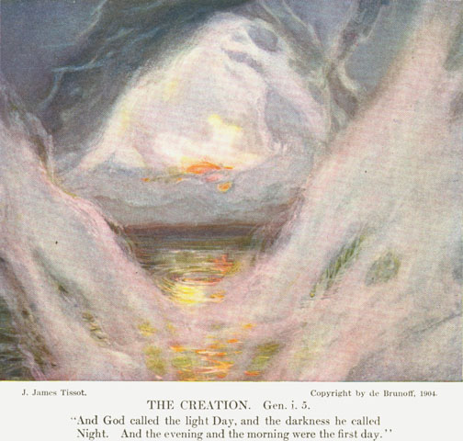
Jacques Tissot - Creation

Slide 95
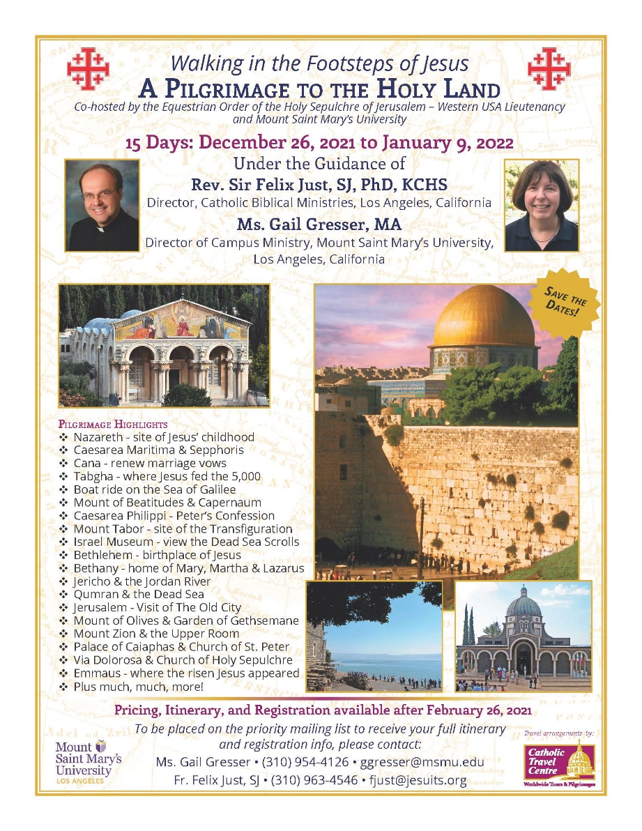
Upcoming Pilgrimages
In the Footsteps of Jesus:
Pilgrimage to the Holy Land
  Dec. 26, 2021 to Jan. 9, 2022
Oberammergau Passion Play:
Pilgrimage to Austria and Germany
  May 14-22, 2022
May 2023
  In the Footsteps of St. Paul:
  Pilgrimage to Turkey
May 2024
  In the Footsteps of Jesus:
  Pilgrimage to the Holy Land
May 2025
  In the Footsteps of St. Paul:
  Pilgrimage to Greece

Slide 96
DONATIONS
Please support MSMU’s Ecclesia program and Living Word Catholic Biblical Ministries. Make a tax-deductible donation, so we can offer more webinars and other programs to anyone, regardless of their financial circumstances.
Online donations can be made through VenMo: @Jesuits-LMU
  and soon hope to accept donations through PayPal also.
Or, make your check payable to "LMU Jesuit Community."
  Please write "Ecclesia Webinars" or "Living Word Series" in the memo field.
Then mail your check to:
  Fr. Felix Just, SJ
  LMU Jesuit Community
  PO Box 45041
  Los Angeles, CA 90045
THANKS!

Slide 97
“Living Word” Webinar Series
Zoom Webinars on the Catholic Lectionary for Mass
  Saturdays, 9:00 a.m. – 12:30 p.m. (Pacific Time)
  Open to the Public (feel free to invite others)
  FREE (but donations appreciated)
Monthly, from Nov. 2020 to April 2021
  Nov. 21, 2020 – Readings of Advent
  Dec. 19, 2020 – Readings of the Christmas Season
  Jan. 9, 2021 – Gospel of Mark (Liturgical Year B)
  Feb. 13, 2021 – Readings of Lent
  March 27, 2021 – Readings of Holy Week & Easter Triduum
  April 17, 2021 – Readings of the Easter Season
Recordings available at https://catholic-resources.org

Slide 98
Closing Prayer: Pentecost Sequence
Veni, Sancte Spiritus
Come, Holy Spirit, come!
And from your celestial home
Shed a ray of light divine!
Come, Father of the poor!
Come, source of all our store!
Come, within our bosoms shine.
You, of comforters the best;
You, the soul's most welcome guest;
Sweet refreshment here below;
In our labor, rest most sweet;
Grateful coolness in the heat;
Solace in the midst of woe.
O most blessed Light divine,
Shine within these hearts of yours,
And our inmost being fill!
Where you are not, we have naught,
Nothing good in deed or thought,
Nothing free from taint of ill.
Heal our wounds, our strength renew;
On our dryness pour your dew;
Wash the stains of guilt away:
Bend the stubborn heart and will;
Melt the frozen, warm the chill;
Guide the steps that go astray.
On the faithful, who adore
And confess you, evermore
In your sevenfold gift descend;
Give them virtue's sure reward;
Give them your salvation, Lord;
Give them joys that never end.
Amen. Alleluia.

Slide 99

HAPPY EASTER!
BLESSED PENTECOST!
Thanks for participating today!
  More Questions or Comments? – Feel Free to Stay Online

